Slide 1
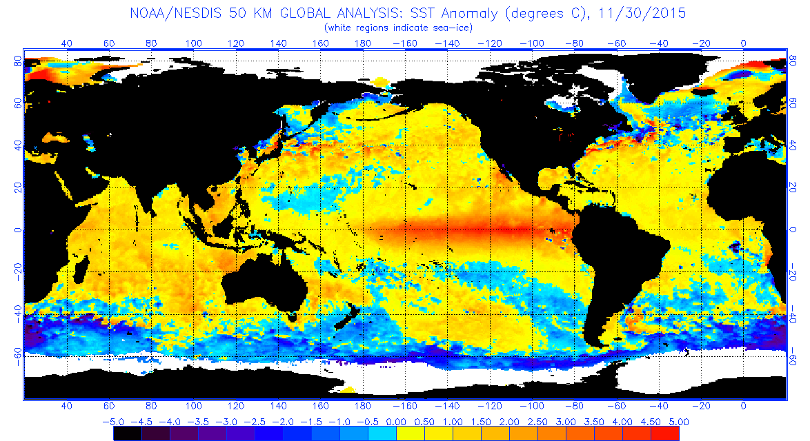
Our weather patterns – what’s normal & what’s next?
Phillip Island - Rhyll
28th February 2020
Graeme Anderson Climate Specialist - Agriculture Victoria
@climatedogs

Slide 2
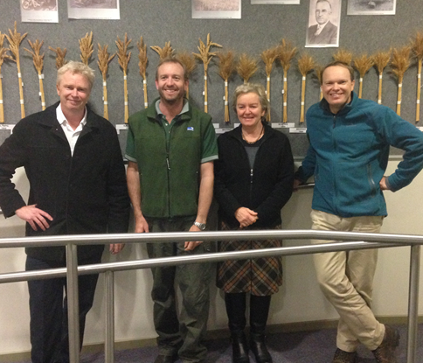
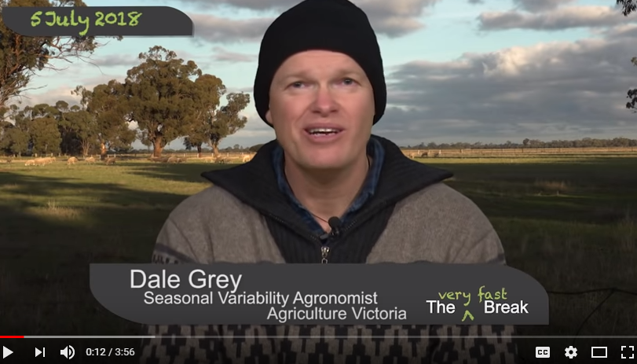
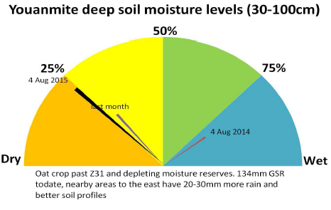
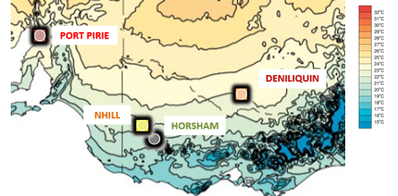
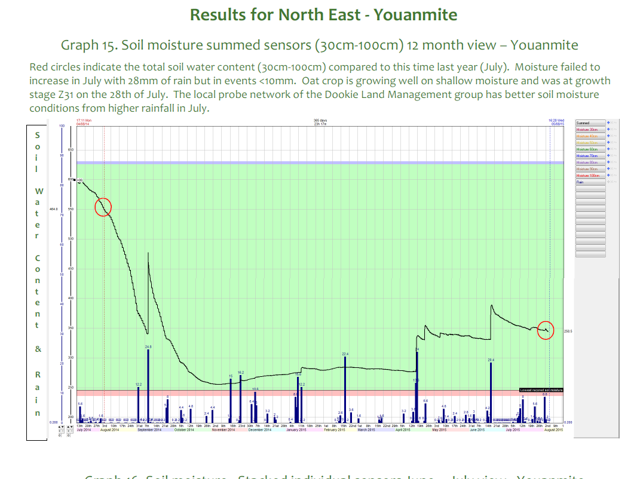
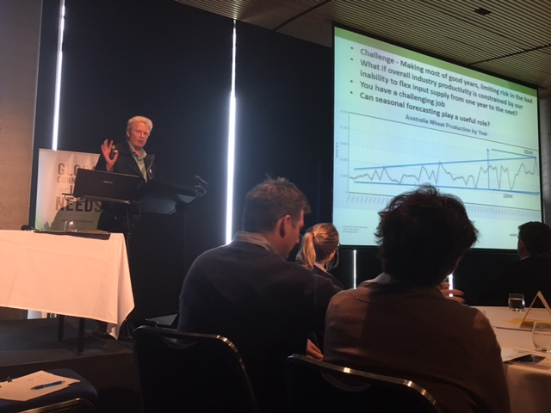
www.agriculture.vic.gov.au/climaterisk
Agriculture Victoria
Seasonal Risk & Climate Team
Climate literacy, seasonal variability & change, extension products for Victoria
Monthly “commentary” The Break
4000 subscribe to e-newsletters Fast Break & Soil Moisture Monitor
Global forecast comparisons for Vic
Deep soil moisture probe data & tech
140 forums/year – upscaling climate drivers & variability via request
Climate Webinar Series
ClimateDogs animations, analogues
New GRDC South ‘Using Seasonal Forecasts’ project across Vic, SA & Tas
Dairy Team’s Milking the Weather…

Slide 3
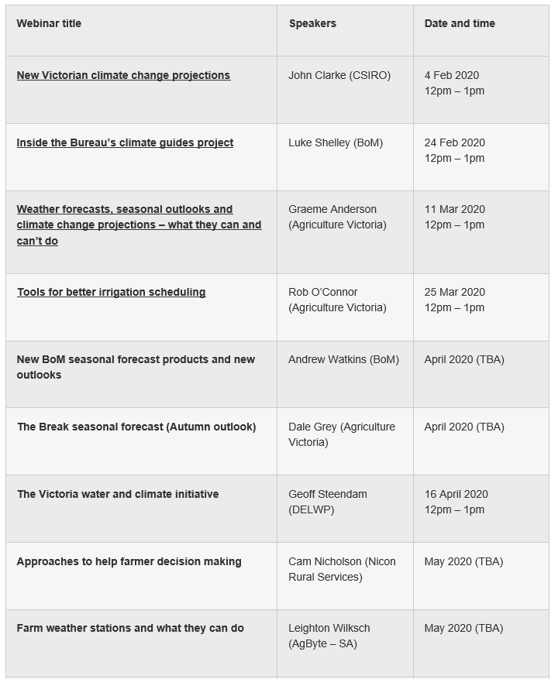
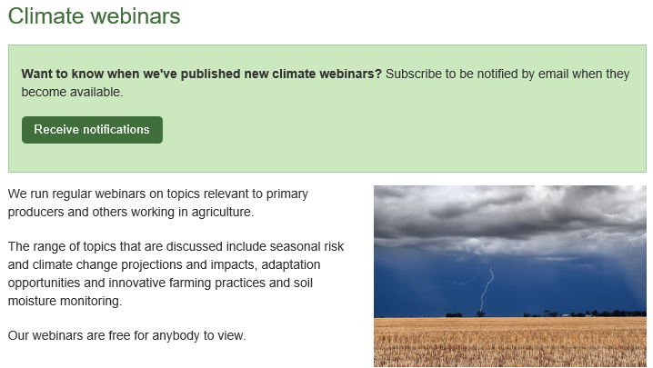
Climate Webinar Series 2020
Lunchtime – join via internet – ask questions
Leading speakers
Recordings to watch when suits
Free – subscribe to be emailed updates……..
www.agriculture.vic.gov.au/climaterisk

Slide 4
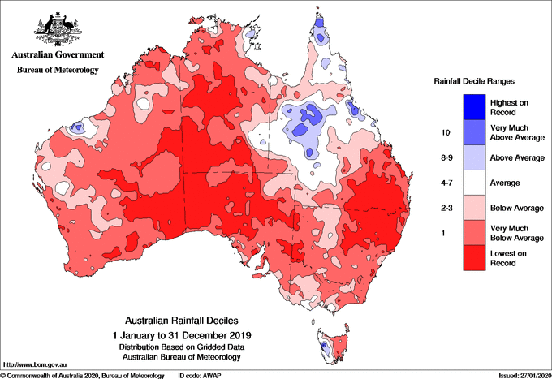
Rainfall Deciles 2019
Note: BoM-CSIRO NRM brochures www.bom.gov.au/climate/climate-guides
soon…… (Luke Shelley)

Slide 5
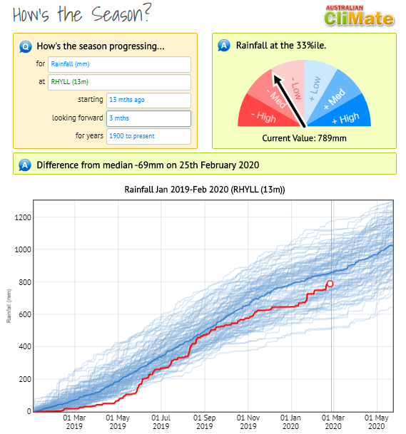
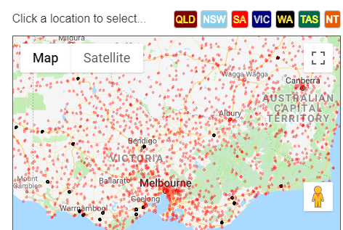
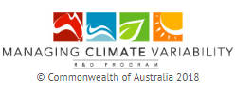
climateapp.net.au
Great Tool!
Thanks to Managing Climate Variability collaboration
(GRDC, MLA etc)
Since Jan…..
Notes:
First up, here’s a plug for the terrific CliMate tool for Australia.
You can pop it on your phone or computer, download your local rainfall records and do things like check your progress.
I’ve just done this for Harden and since January I can see things been pretty dry up your way.

Slide 6
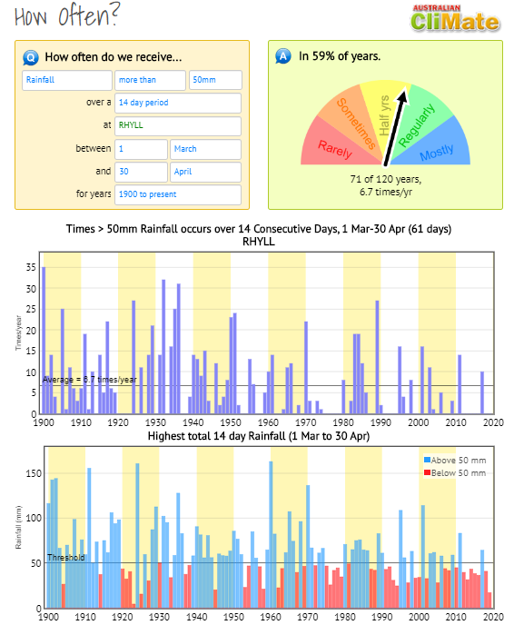
climateapp.net.au
Great Tool!
Thanks to Managing Climate Variability collaboration
(GRDC, MLA etc)
Since Jan…..
Notes:
First up, here’s a plug for the terrific CliMate tool for Australia.
You can pop it on your phone or computer, download your local rainfall records and do things like check your progress.
I’ve just done this for Harden and since January I can see things been pretty dry up your way.

Slide 7
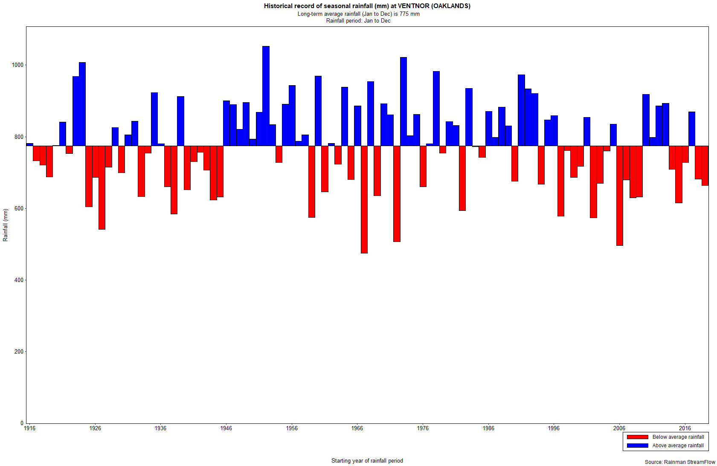
Annual
Ventnor (Oaklands)
Annual Rainfall Anomaly 1916-2019
Long Term Average 775mm
(last 20 years = 13 drier, 7 wetter)

Slide 8
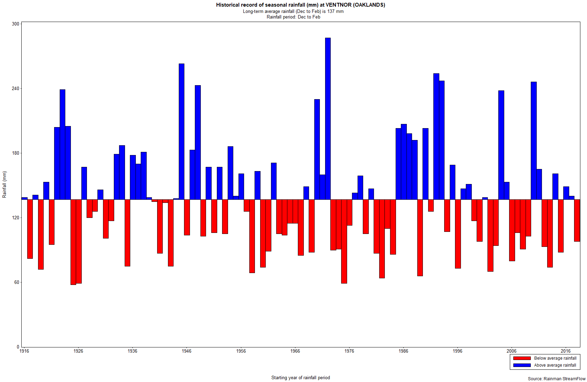
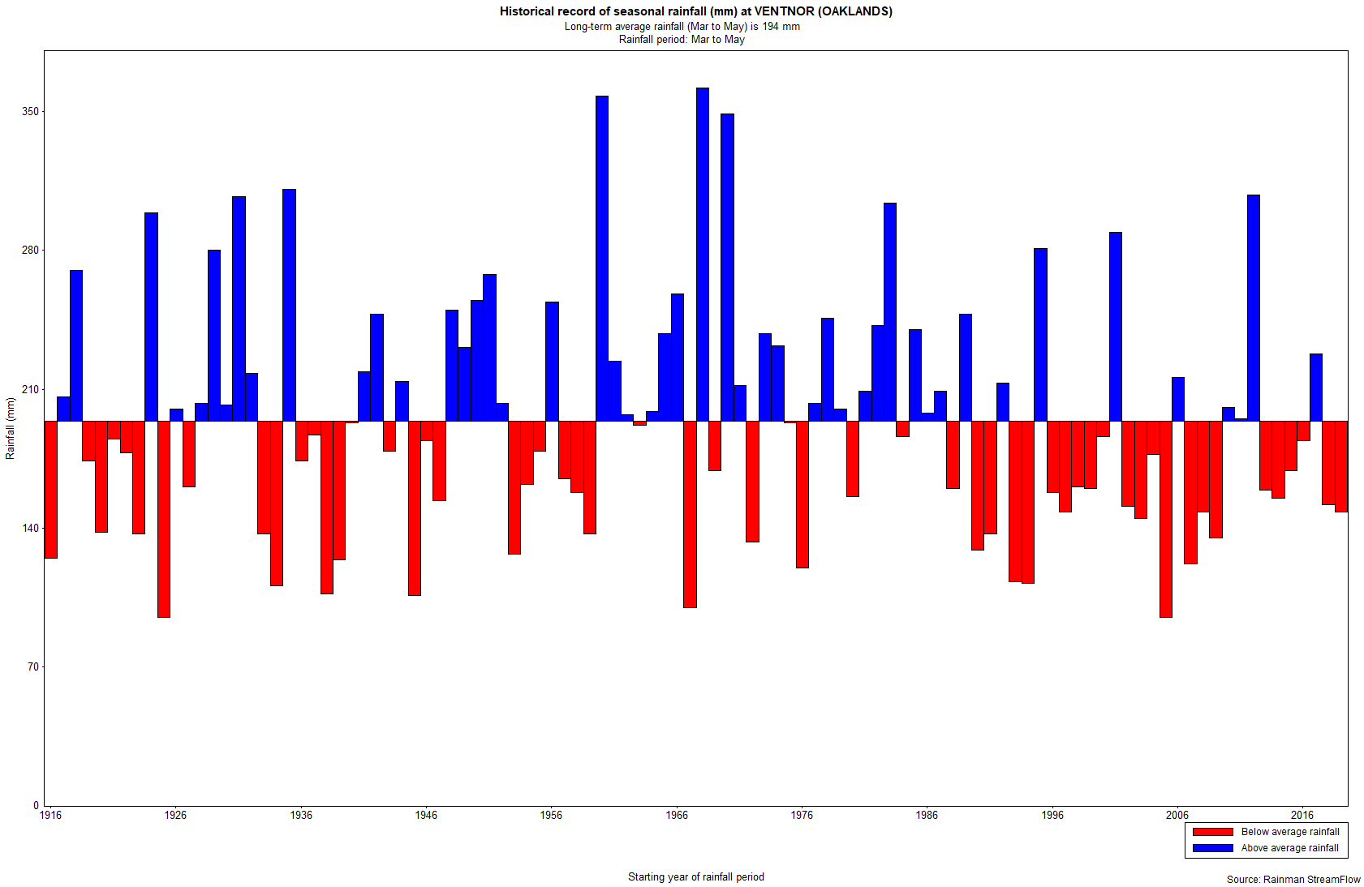
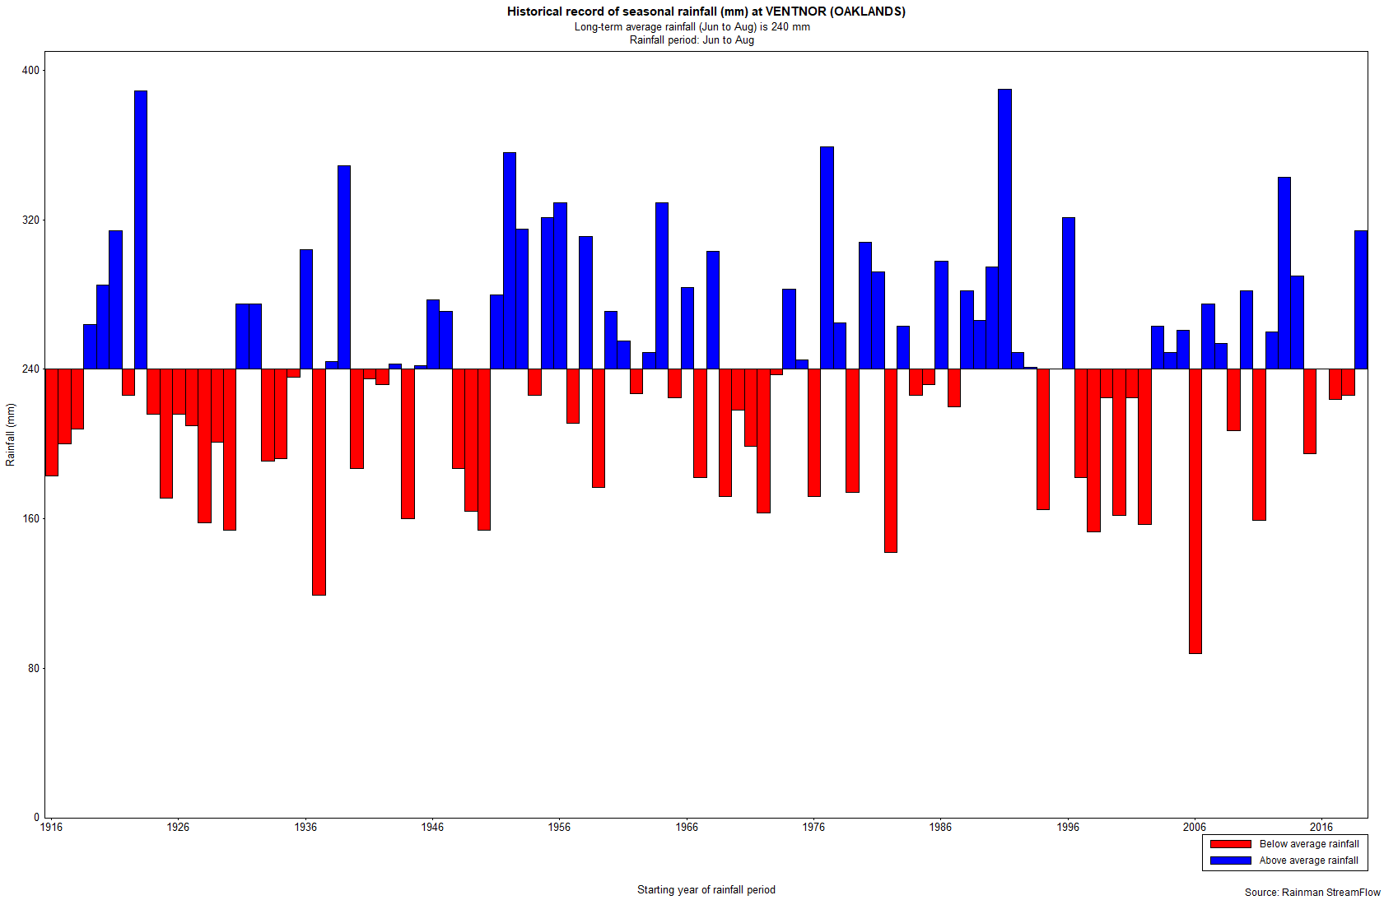
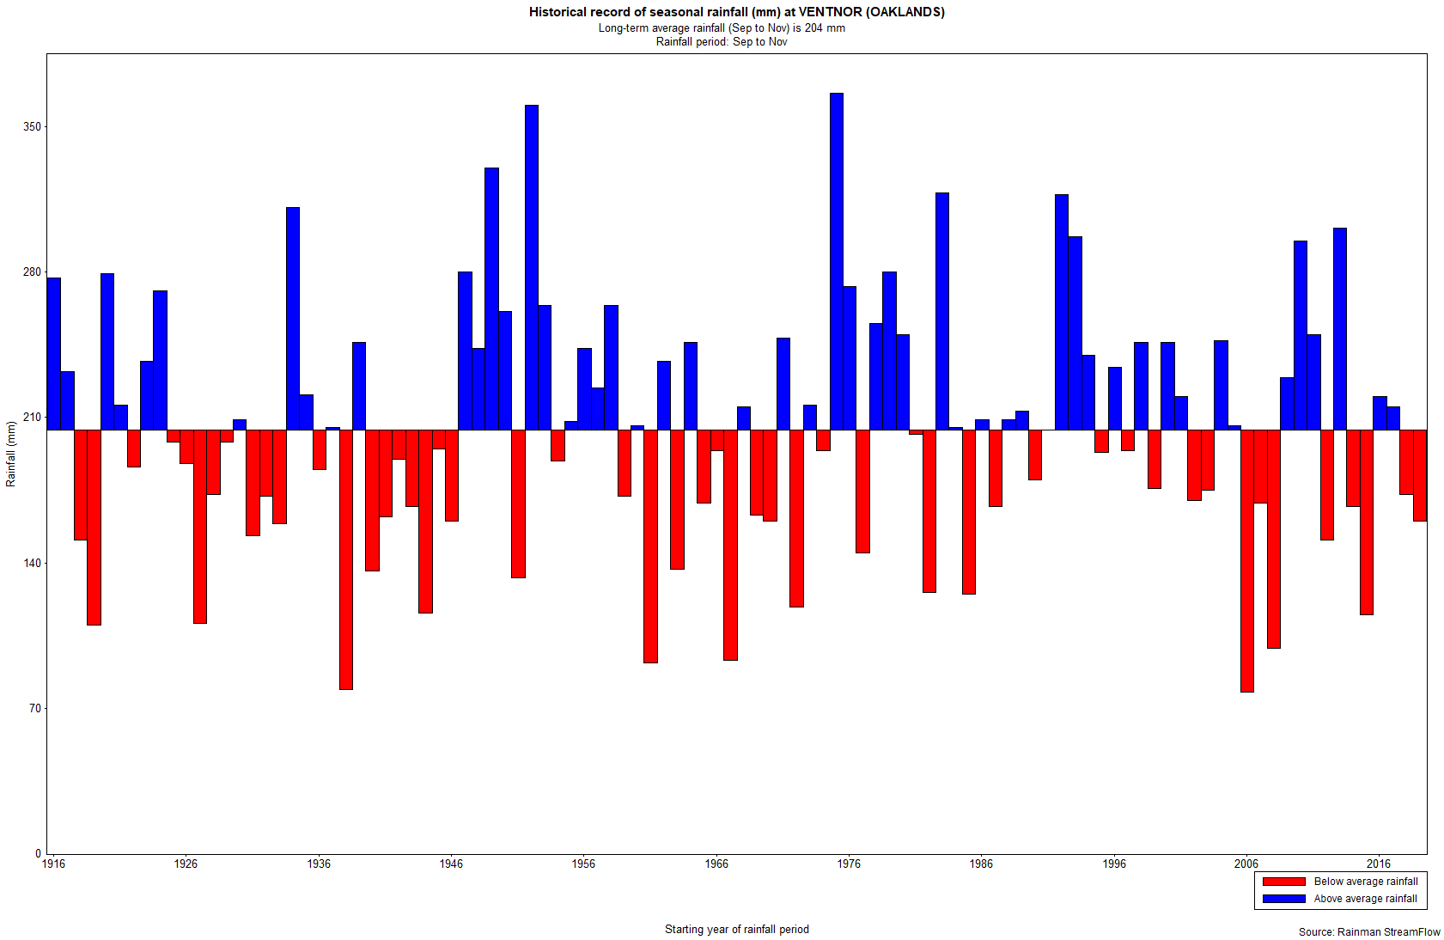
Summer 137mm
Autumn 194mm
Winter 240mm
Spring 204mm

Slide 9
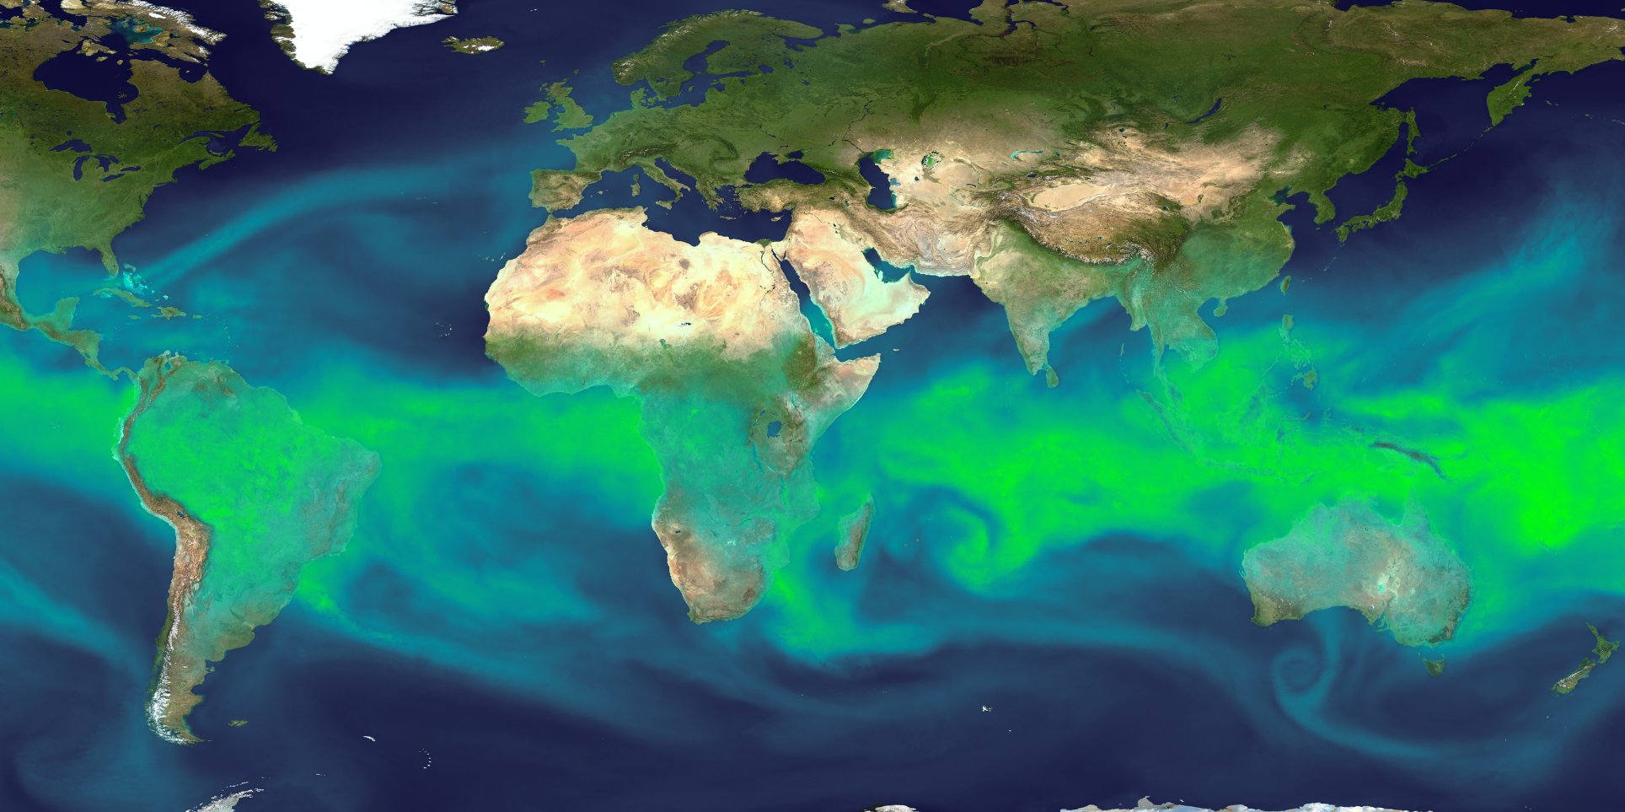
Total Precipitable Water
A key ingredient for rainfall
Why seasonal forecasters watch the equator……
https://eldoradoweather.com/climate/world-maps/world-precipitable-water.html

Slide 10
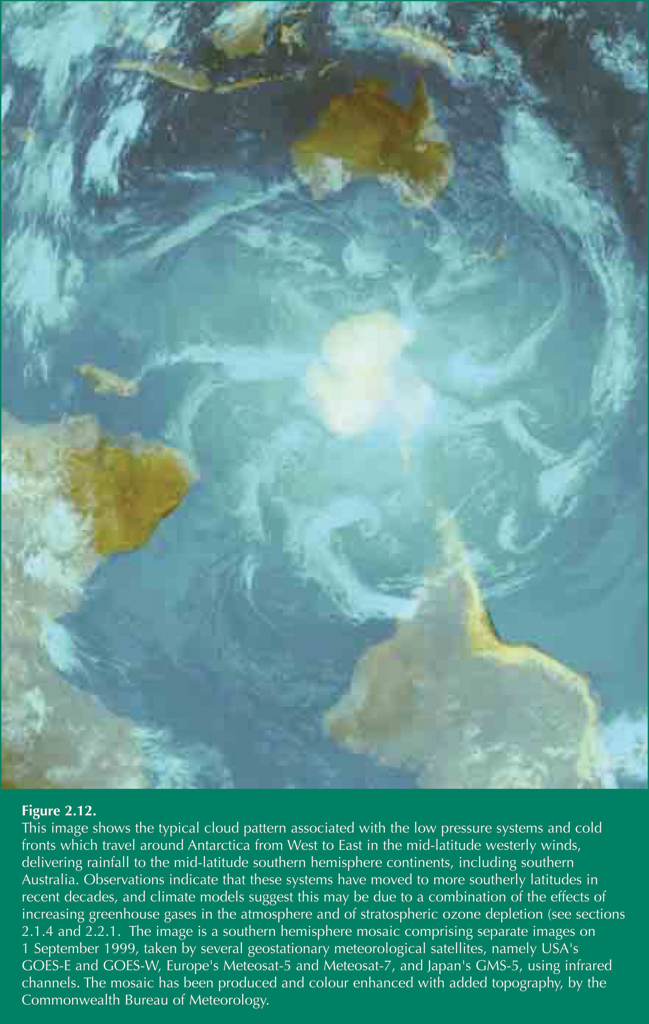
Key climate influencers southeast Aust rainfall:
ENSO – Pacific Ocean moisture source
IOD – Indian Ocean moisture source
SAM – the fronts….
STR – the highs…..
Key drivers of our seasonal variability – always have been and always will be! (BOM, CSIRO etc)
ENSO
IOD
STR
SAM
Notes:
BoM & CSIRO science has come a long way, and we now know the key drivers of Victoria’s wetter or drier seasons better than ever.
Victoria lives at the crossroads of 4 key large scale climate drivers. It’s complicated, but it’s the combinations of how these 4 climate drivers interact that explain our wet seasons and our big droughts.
Better understanding the key ocean and atmospheric drivers that create the rainfall that falls on Victoria’s catchments and farms has been a key component of DEPI-Farm Services seasonal risk communication activities.
The key ingredients for making Victoria’s rainfall include:
The ENSO (El Nino & Southern Oscillation) and IOD (Indian Ocean Dipole) cycles are key drivers of moisture circulation
The SAM (Southern Annular Mode) and STR (Sub-tropical Ridge) are significant triggers which influence rainfall events in Victoria
I like to think of them as the 4 sheep dogs that round up Victoria’s rainfall. Just like sheepdogs, when they behave all goes well, however if some one or two of them start playing up then it makes the job of farming harder!
Big drought of 2006 was when both ENSO & IOD were both at dry end of their cycles.
Big wet of spring 2010 was when ENSO & IOD were both at wet end of their cycles.
IOD at drier end of cycle in springs of 2011 & 2012, and was in slightly wetter phase for winter/spring of 2013. In 2014 IOD was good for winter but the spring was drier due to near ElNino conditions and higher pressure pattern.
These slides provide a basic overview of how these systems affect our rainfall, and seasonal variability.
The image shows the circulation of southern ocean driven climate systems – and the regular cold fronts that radiate around the Antarcrtic vortex.
Victorian farmers have watched since 1997 the fronts appearing near Perth (that previously delivered rain in Vic 3 days later) slowly slip southwards. CSIRO & BoM have observed changes and can tell us why this has been happening.

Slide 11
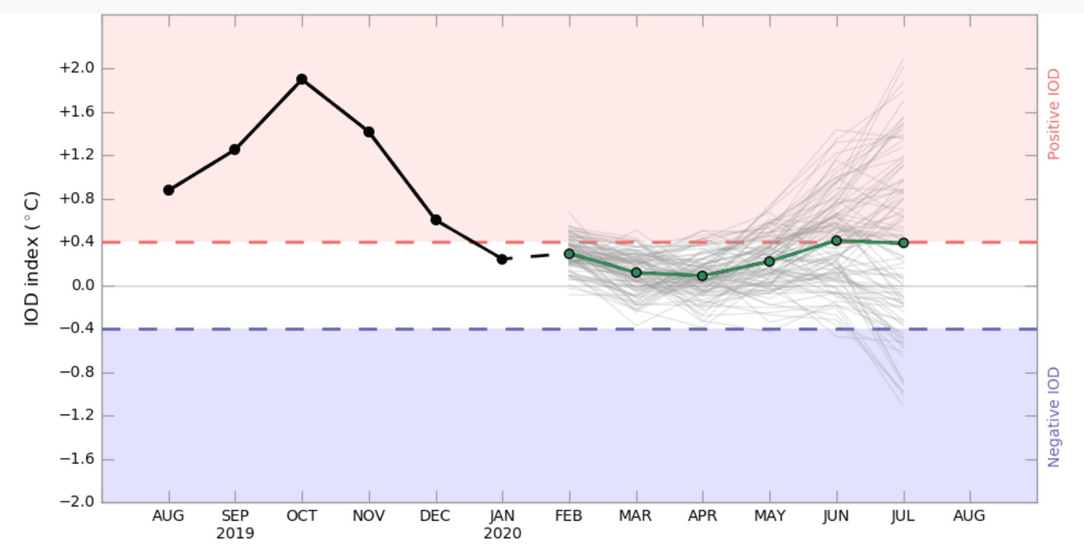
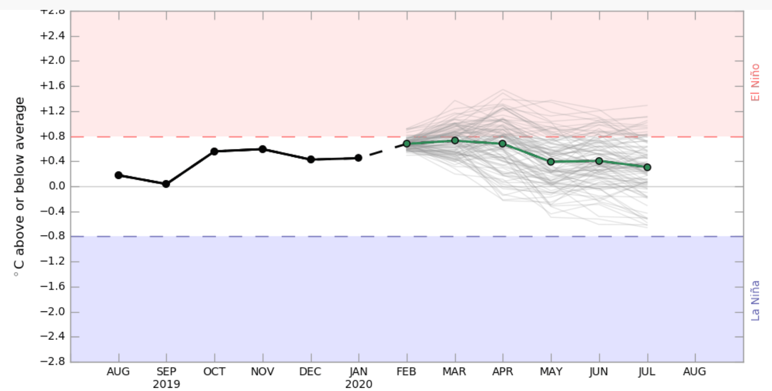
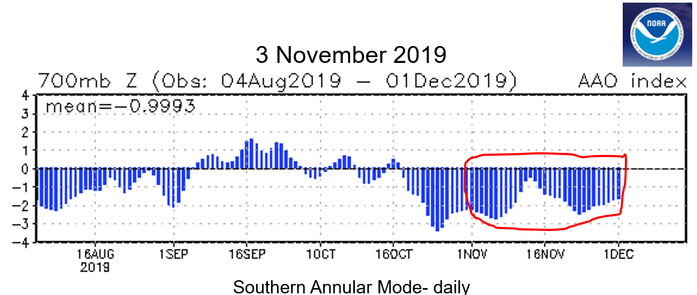
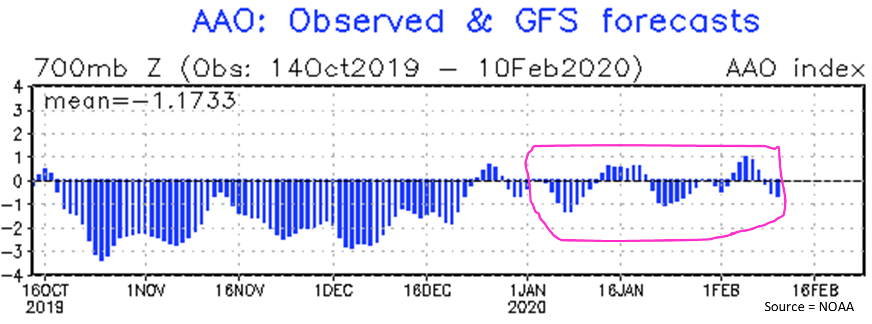
2019 season :
ENSO – neutral
IOD – strong drier Indian Ocean +ve
SAM – regular southwest fronts that helped parts of Victoria
ENSO
IOD
STR
SAM
Notes:
BoM & CSIRO science has come a long way, and we now know the key drivers of Victoria’s wetter or drier seasons better than ever.
Victoria lives at the crossroads of 4 key large scale climate drivers. It’s complicated, but it’s the combinations of how these 4 climate drivers interact that explain our wet seasons and our big droughts.
Better understanding the key ocean and atmospheric drivers that create the rainfall that falls on Victoria’s catchments and farms has been a key component of DEPI-Farm Services seasonal risk communication activities.
The key ingredients for making Victoria’s rainfall include:
The ENSO (El Nino & Southern Oscillation) and IOD (Indian Ocean Dipole) cycles are key drivers of moisture circulation
The SAM (Southern Annular Mode) and STR (Sub-tropical Ridge) are significant triggers which influence rainfall events in Victoria
I like to think of them as the 4 sheep dogs that round up Victoria’s rainfall. Just like sheepdogs, when they behave all goes well, however if some one or two of them start playing up then it makes the job of farming harder!
Big drought of 2006 was when both ENSO & IOD were both at dry end of their cycles.
Big wet of spring 2010 was when ENSO & IOD were both at wet end of their cycles.
IOD at drier end of cycle in springs of 2011 & 2012, and was in slightly wetter phase for winter/spring of 2013. In 2014 IOD was good for winter but the spring was drier due to near ElNino conditions and higher pressure pattern.
These slides provide a basic overview of how these systems affect our rainfall, and seasonal variability.
The image shows the circulation of southern ocean driven climate systems – and the regular cold fronts that radiate around the Antarcrtic vortex.
Victorian farmers have watched since 1997 the fronts appearing near Perth (that previously delivered rain in Vic 3 days later) slowly slip southwards. CSIRO & BoM have observed changes and can tell us why this has been happening.

Slide 12
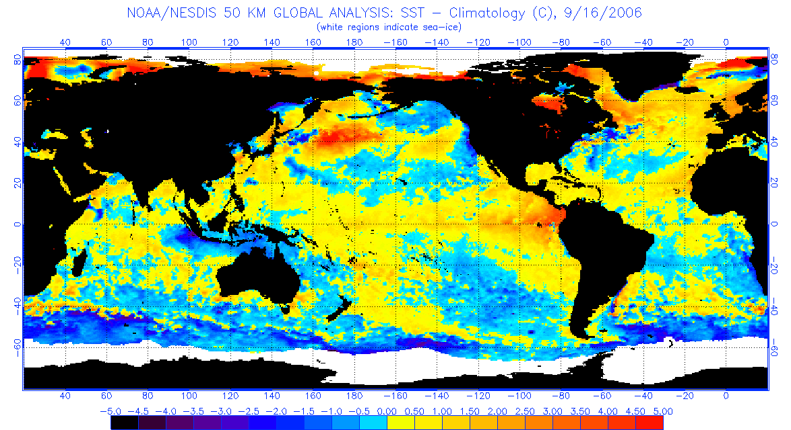
Sea Surface Temp Anomaly - Sept 2006 (dry pattern)
www.ospo.noaa.gov/Products/ocean/sst/anomaly
Notes:
SST anomaly – Sea Surface Temperature Anomaly Map (ie difference in temp compared to normal)
A key issue is how warm (compared to average) the moisture bearing waters are to Australia’s north, northeast (ENSO) and northwest (IOD).
Shows the 2006 drought in spring.
Classic El Nino pattern, with warm water on equator at sth America, and cooler than average water near Australia.
Indian Ocean, cooler water near Aust, warmer near Africa.
Basically, when we have cooler than average water near us, they generate less moisture in our part of the world. Thus less moisture to make rainfall.

Slide 13
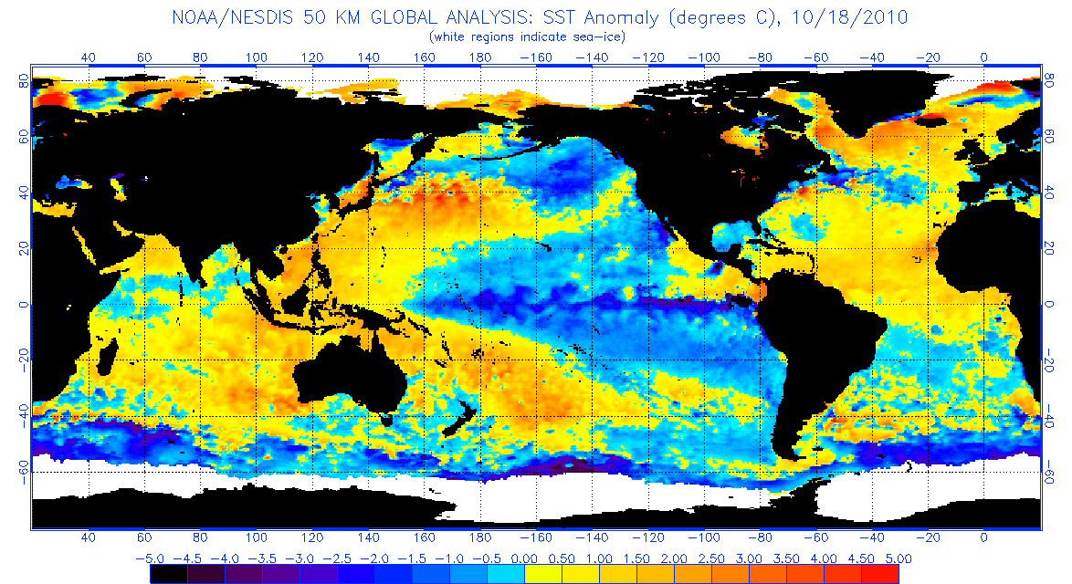
Sea Surface Temp Anomaly - Oct 2010 (wetter pattern)
www.ospo.noaa.gov/Products/ocean/sst/anomaly
Notes:
SST anomaly – Sea Surface Temperature Anomaly Map (ie difference in temp compared to normal)
A key issue is how warm (compared to average) the moisture bearing waters are to Australia’s north, northeast (ENSO) and northwest (IOD).
Shows the 20010 very wet spring.
Classic La Nina pattern, with cool water on equator at sth America, and warmer than average water near Australia.
Indian Ocean, warmer water near Aust, cooler near Africa.
Basically, when we have warmer than average water near us, they generate more moisture in our part of the world. Thus more moisture to make rainfall…..it’s just a matter then of the weather that converts it (and who it falls on!)

Slide 14
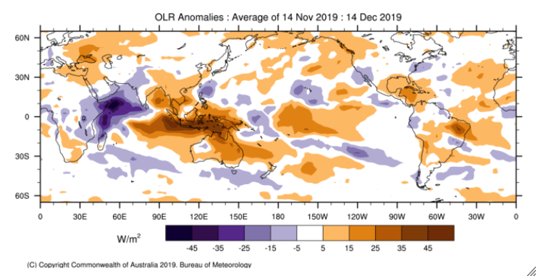
2019 Less cloud & moisture (IOD+ve)….
But southerly fronts helped parts of Vic

Slide 15
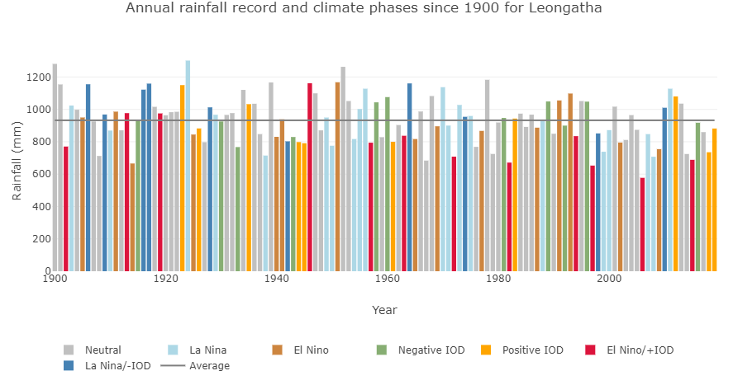
www.forecasts4profit.com.au/Local-Climate-Tool

Slide 16
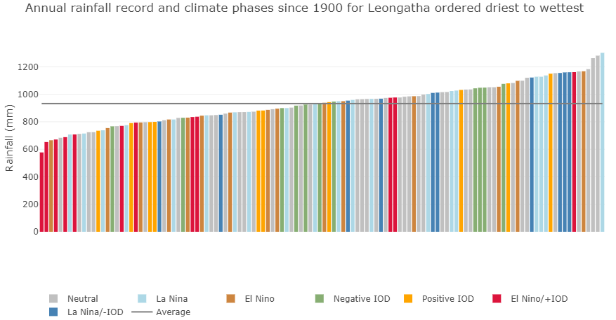
www.forecasts4profit.com.au/Local-Climate-Tool

Slide 17
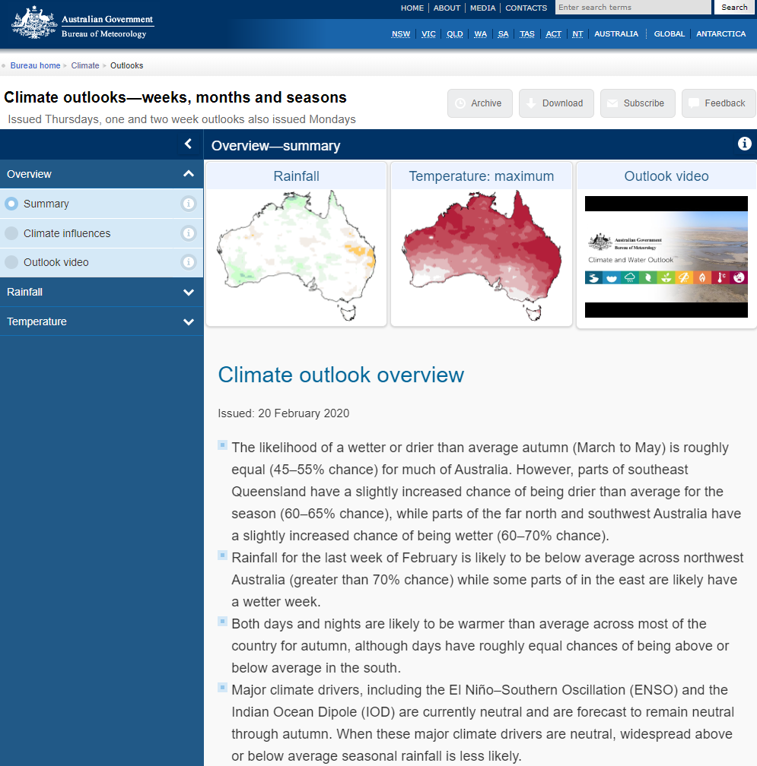
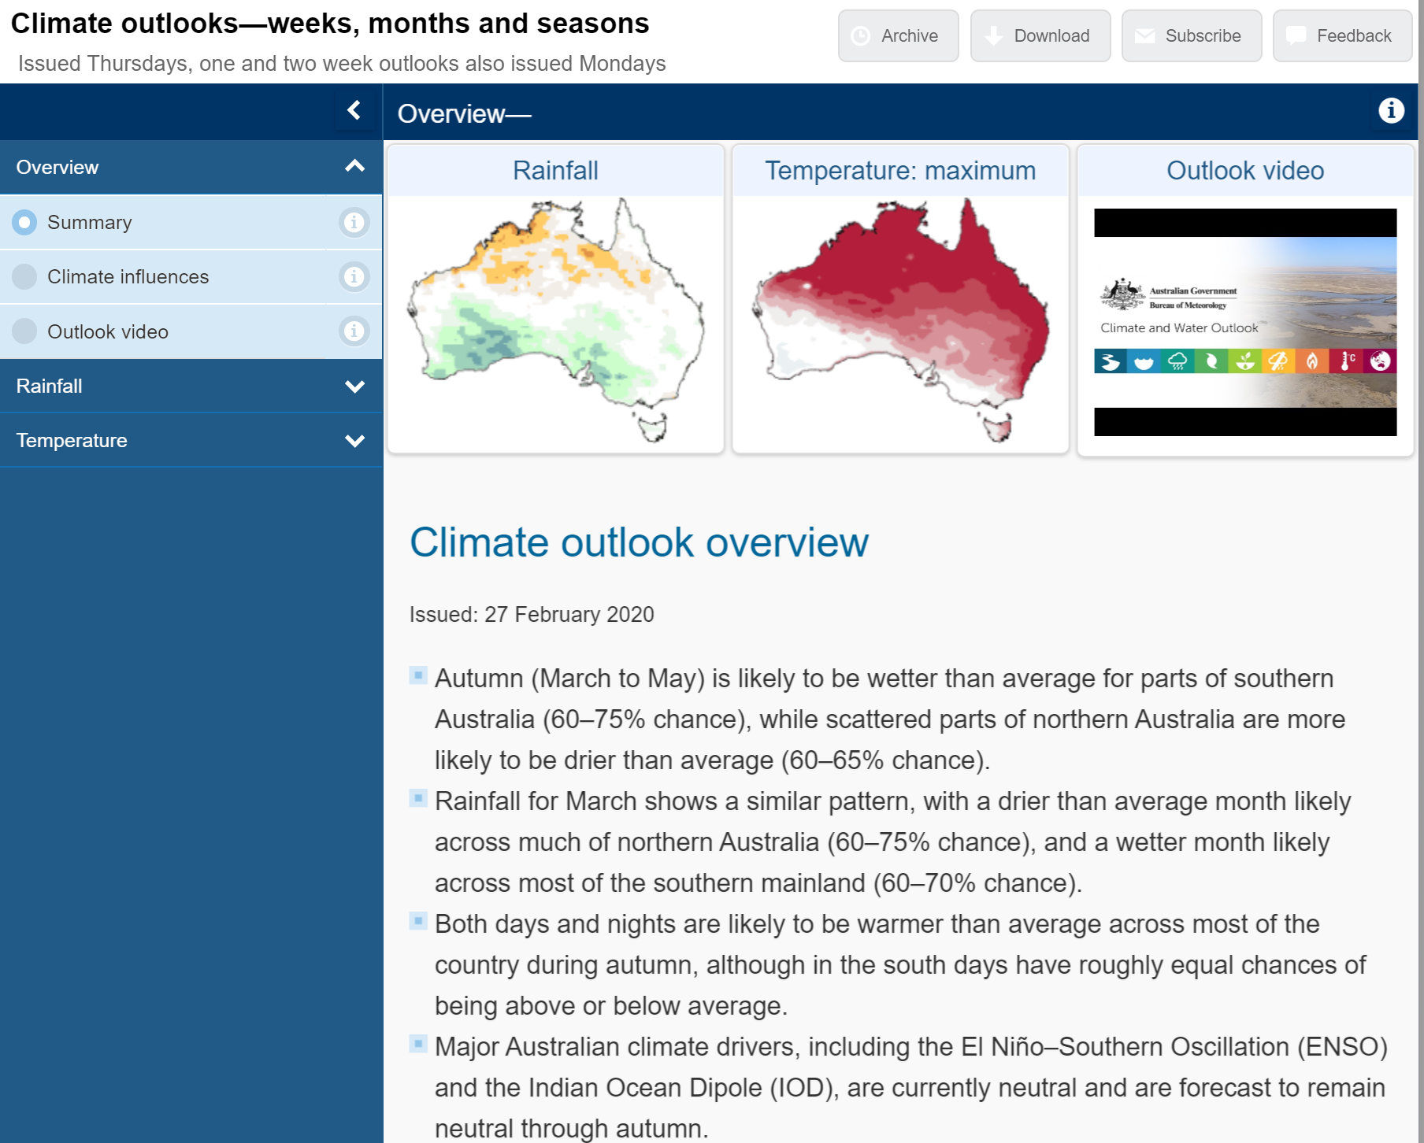
www.bom.gov.au/climate/outlooks

Slide 18
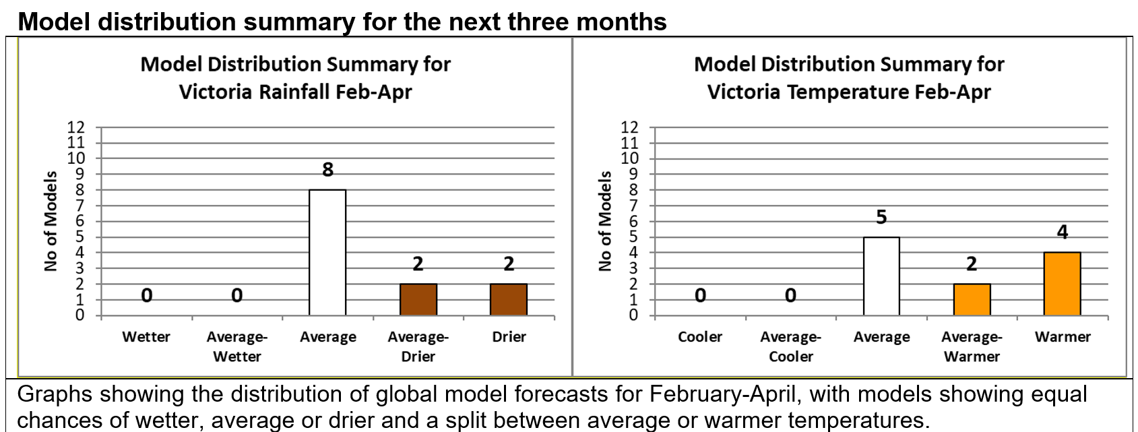
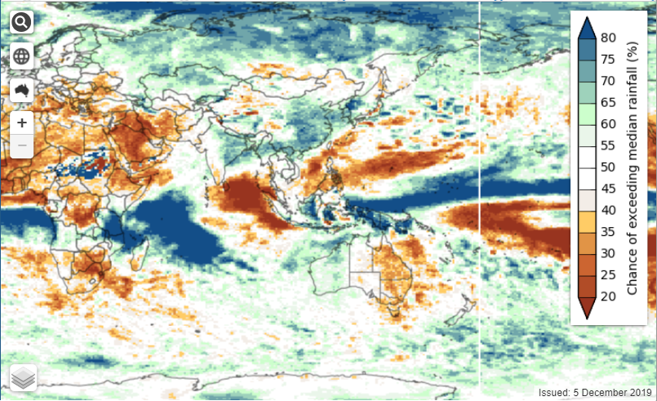
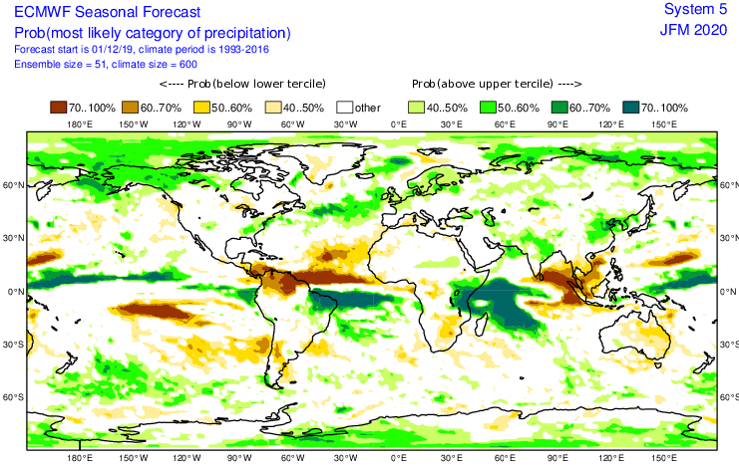
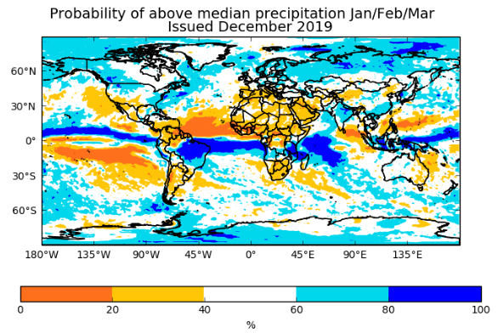
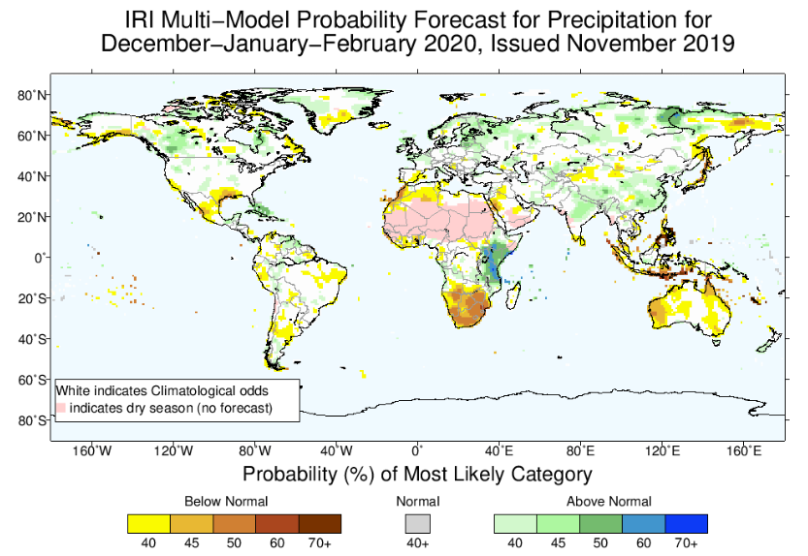
Editor-Dale Grey (scans 12 models)
Subscribe to: The.break@agriculture.vic.gov.au

Slide 19
Any Curve Balls?

Slide 21
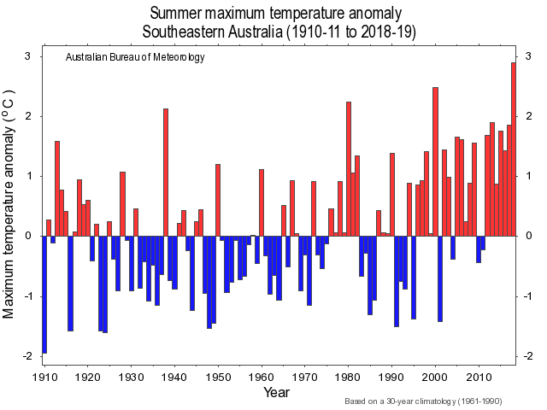
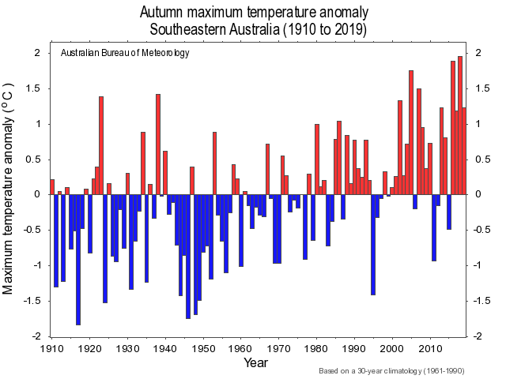
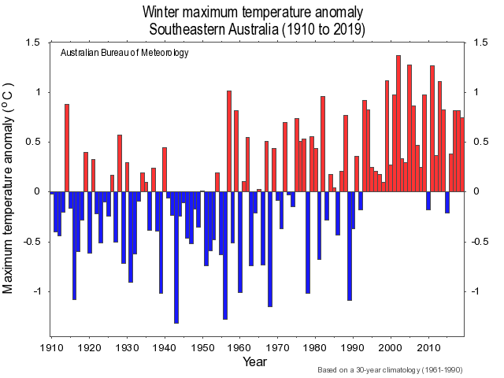
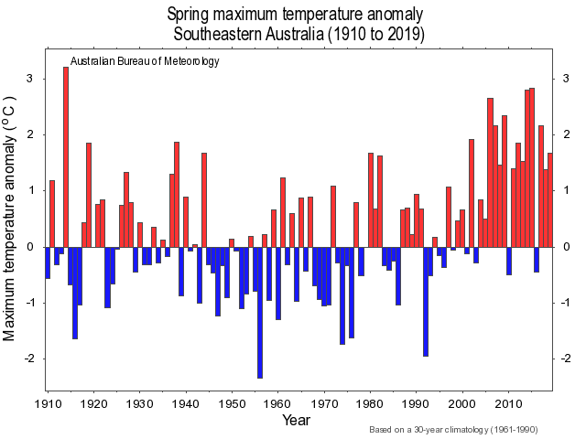
Summer Max Temp
Autumn Max Temp
Winter Max Temp
Spring Max Temp
Notes:
BoM data for Southeast Aust Max Temperature Anomaly graphs.
Variable from month to month and year to year, but with warmer anomalies common in recent record.
Note Spring, where 7 of last 10 springs have been 1-2 degrees warmer than long term average. If we have good soil moisture, warmer springs means more growth. If we have drier soils, warmer springs means the season can cut out quicker. The combination can provide what farmers call “bumpy springs”.

Slide 22
The important changes include:
▶ a southerly shift in the ‘storm track’, the band where weather systems tend to travel in the southern hemisphere, to the south of Australia. This shift can reduce the influence of the synoptic-scale weather systems that bring rain to Victoria.
▶ an intensification of the subtropical ridge, the high pressure belt that generally sits on or to the north of Victoria and is a result of the number and intensity of high-pressure systems that occur (highs are generally linked to drier conditions) (see Grose et al. 2015c).
▶ an expansion of the Hadley Circulation, the major north–south circulation of the atmosphere over the hemispheres, that determines the edge of the tropics, resulting in a southward extension of the tropics, particularly in summer.
▶ a weakening of the subtropical jet stream in winter over the Australian region. This is the westerly middle to upper troposphere air current that flows over southern Australia that sits at about 25–30°S in winter (Grose et al. 2017a).
www.climatechange.vic.gov.au/adapting-to-climate-change-impacts/victorian-climate-projections-2019
Notes:
Farming – multitude of practices that can reduce emissions, prevent carbon losses and add to carbon sequestration. There are no silver bullets, but lots of silver buckshot!

Slide 23
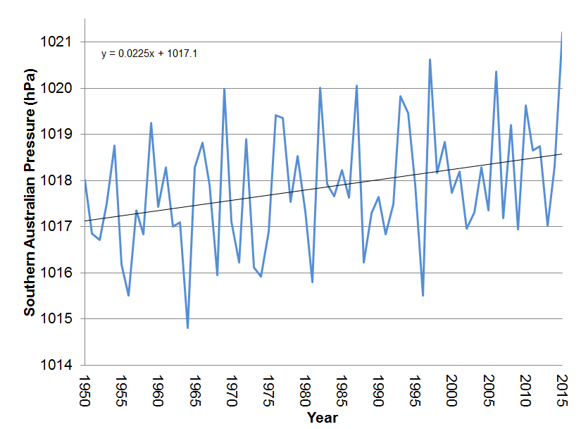
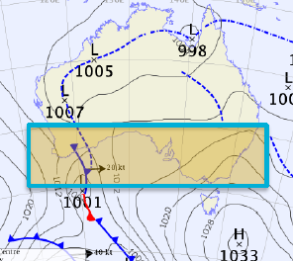
Rising pressure pattern over southern Australia
April-Oct Pressure – Southern Australia 1950-2015
Region (100-155E_40-30N) Source: BoM David Jones
Notes:
Shows recent trends since 1950 of increasing high pressures over southeast Australia…………….
As the global temperatures increase this trend of increasing STR intensity could continue.
This will cause our climate to behave differently than it has historically.
So, while we have had big wet and dry phases in the past, the changing nature of the subtropical ridge and implications for strength of high pressures in a warmer world could take us into new territory. This affects Victoria’s autumn and winter rainfall.

Slide 24
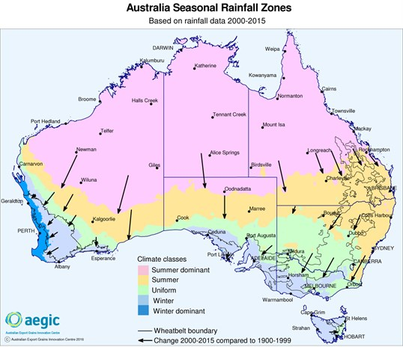
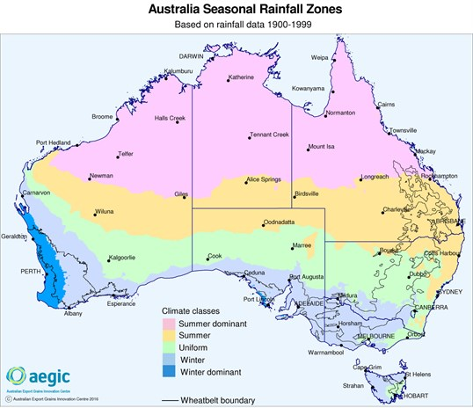
AEGIC - Seasonal
rainfall zones shift
south across Australia
since 2000
(Rainfall Seasonality)
www.aegic.org.au/media/news/2016/02/new-australian-climate-developing.aspx

Slide 25
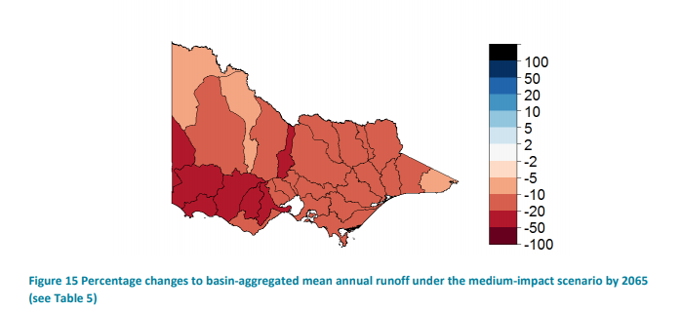
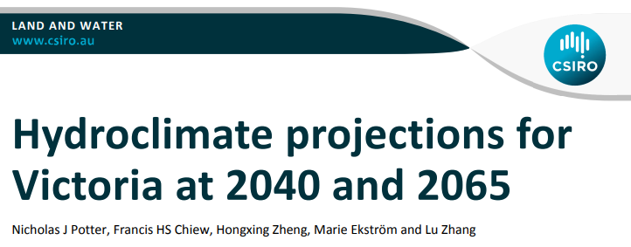
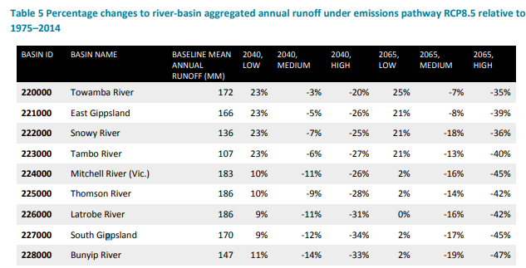
www.water.vic.gov.au/climate-change/climate-and-water-resources-research/victorian-climate-initiative
Future runoff?
A range of scenarios
Higher emissions leads to greater impacts
Drying trend likely but occasionally very wet – ie plan for variability
https://publications.csiro.au/rpr/download?pid=csiro:EP161427&dsid=DS2
Notes:
Shows recent trends since 1950 of increasing high pressures over southeast Australia…………….
As the global temperatures increase this trend of increasing STR intensity could continue.
This will cause our climate to behave differently than it has historically.
So, while we have had big wet and dry phases in the past, the changing nature of the subtropical ridge and implications for strength of high pressures in a warmer world could take us into new territory. This affects Victoria’s autumn and winter rainfall.

Slide 26
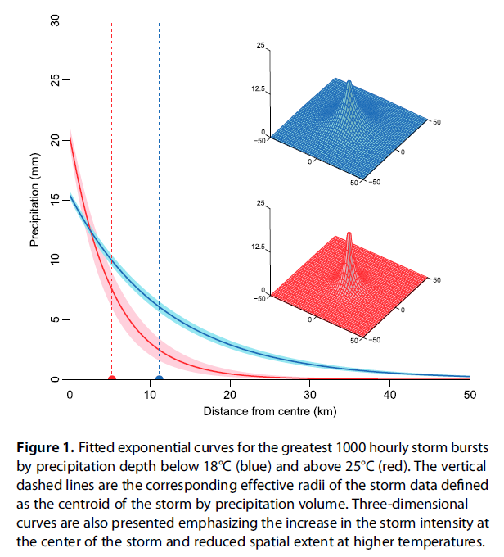
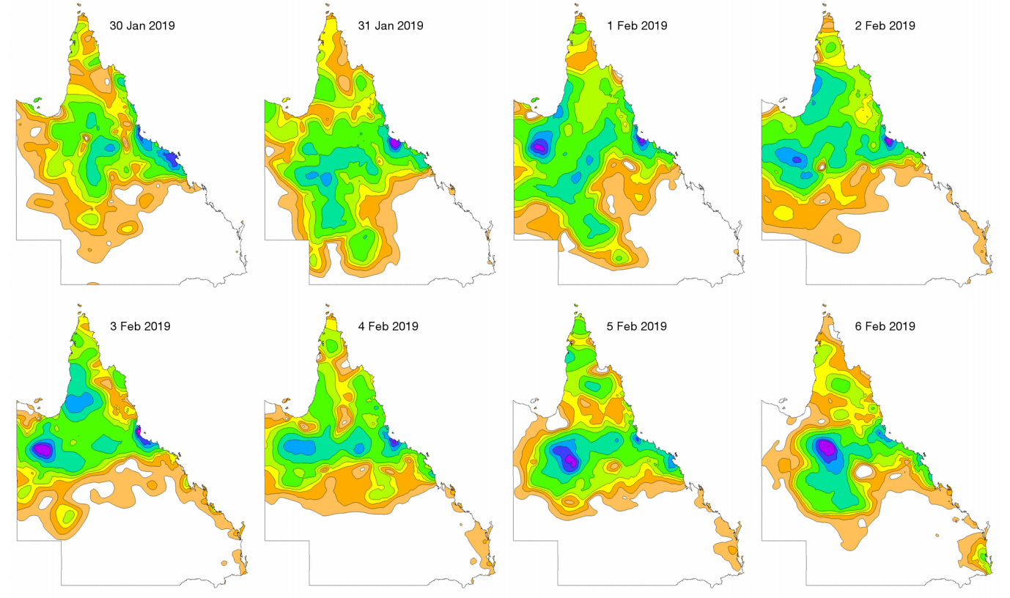
Rainfall Intensity Increases
Westra etal
Drier pattern overall,
but increases in
rainfall intensity……
Slow moving/stationary weather events?
www.bom.gov.au/climate/current/statements/scs69.pdf

Slide 27
https://water.vic.gov.au/__data/assets/pdf_file/0014/52331/Guidelines-for-Assessing-the-Impact-of-Climate-Change-on-Water-Availability-in-Victoria.pdf

Slide 28
www.climatechange.vic.gov.au/adapting-to-climate-change-impacts/victorian-climate-projections-2019
Notes:
Farming – multitude of practices that can reduce emissions, prevent carbon losses and add to carbon sequestration. There are no silver bullets, but lots of silver buckshot!

Slide 29
Note: BoM-CSIRO NRM brochures www.bom.gov.au/climate/climate-guides
soon…… (Luke Shelley)

Slide 30
Circles of concern, influence,
and control.
Steps to taking your own actions….
What’s under your control?

Slide 31
Farmers & Agriculture ingredients for success:
Modern technologies, R&D, genetics, innovations etc
Improved farm & regional infrastructure (eg storage, water, fodder, communications, transport, social etc)
Growth in local & export markets (and biosecurity)
Business management for variable years & income
Farm plans, min-tillage, soils, pasture cover, NRM skills
Networks, knowledge channels, confidence to grow
www.agriculture.vic.gov.au/agriculture/food-and-fibre-exports
Notes:
In terms of tackling climate variability & change, here’s some of the ingredients for successful agriculture.
We’ll need a constant flow of new technologies and R&D, genetics and innovations to get better at what we do,
And improved infrastructure both on farms and regionally (on things like water and fodder storage, communications, logistics and transport and social infrastructure) so we’ve got what we need to be well set up for the future
Growth in markets is a good thing, and critical to maintain our competitiveness but as an exporting nation making sure our biosecurity is top notch to keep markets open to us (be wary of taking shortcuts when times are tough)
Farms managing variability well do a great job on their business management, making wise decisions in the good years that sets them up for when the tougher ones do arrive. With both market & climate volatility this becomes more important than ever.
These days farmers and landcare are doing a better job protecting their soils and land assets to ensure good pasture cover, using stock mgmt. and containment ensuring no damage and paddocks ready to go when it does rain again.
And importantly its about people! Surround yourself with good people & networks, stay connected, have good knowledge channels and advice that will provide you with support and coaching to get to where you want to!
And while agriculture has a bright future, that doesn’t always mean a bright future is guaranteed for everyone involved in farming today – so it’s important that you surround yourself with good people and networks and make the decisions that are right for your situation – (and think about big 5 questions – are you enjoying what your doing, is your family supportive, are you living the lifestyle you want to, will you have enough to retire on and can you sustain the effort). It’s important to look after yourself and make sure you take hold of the steering wheel………so you’re working towards a better future no matter what you’re doing.
What modern farmers do to manage variability today is amazing!
18 years with only 3 above average rainfall, plus warmer too.
Modern technologies, skills, genetics, systems, business, markets etc

Slide 32
Thank You
Subscribe to ‘The Break’, Webinars etc
www.agriculture.vic.gov.au/climaterisk
www.climatekelpie.com.au
graeme.anderson@agriculture.vic.gov.au
Tweets @climatedogs

Slide 33
Weather watching….
BoM Chartviewer - Next 7 days
http://www.bom.gov.au/australia/charts/viewer/index.shtml
BoM Water & Land - 4 & 8 day rainfall outlook
http://www.bom.gov.au/jsp/watl/rainfall/pme.jsp
BoM Met Eye rain,wind, temp forecasts
http://www.bom.gov.au/australia/meteye/

Slide 34
Runoff……….
http://www.bom.gov.au/water/hrs

Slide 35
Any Curve Balls?
www.climatekelpie.com.au/index.php/climatedogs/

