Slide 1
Climate Change in Victoria Past, Present and Future
Climate Science and Communications
Climate Change Division
climate.science@delwp.vic.gov.au
Notes:
Good afternoon everyone, thanks for attending todays webinar on Climate Change in Victoria – past present and future.
"I would like to begin by acknowledging the traditional owners of the country on which we meet, wherever that may be, and pay my respects to their Elders, both past and present."
The main purpose of these introductory webinars part of a longer-term plan by our Climate Science Communications team within DELWP to provide capacity building and training resources and opportunities to Victorian government and stakeholders.
Following up on the positive response we had to the CSIRO-run training last year on the Victorian Climate Projections 2019 and the release Victoria’s Climate Science Report - we hope to provide you with some information and resources but also to start to build a relationship with you so that we can provide you with more tailored information, workshops and training to help to understand the potential risks of climate change and integrate the best available science in your work.

Slide 2
Some things to note before we start:
We are recording
Please use the Q&A function to ask questions
This webinar will be followed up by another webinar next week
Slides are available
Notes:
We are using the Teams Live public function and it is being recorded.
Please use the Q& A function - we will pause in the middle of the presentation and also have allowed plenty of time at the end – you will need to use the Q&A function to type the questions in and you can use the thumbs up to vote for a question.
This webinar is being followed up by another webinar focusing on the Victorian Climate Projections 2019 providing a more detailed look at the projections and tips for interpreting and applying the data.
These slides are available for you to use.

Slide 3
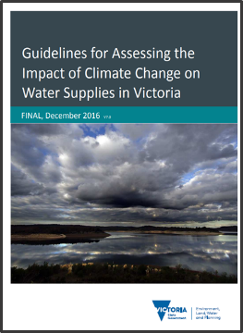
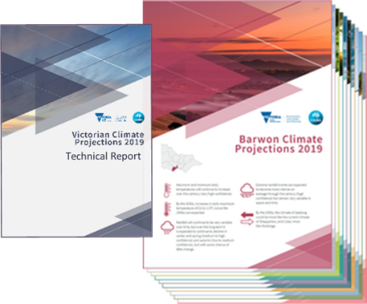
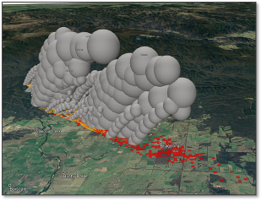
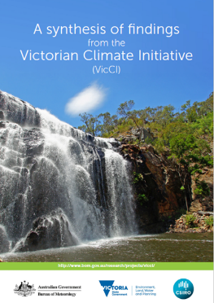
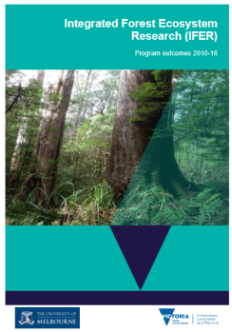

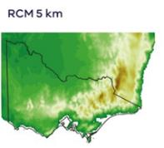

Victorian Government climate science research
The Victorian Government is providing climate research and future projections to help understand our climate risk and inform decisions that support a resilient future for Victoria.
Bushfire risk
Notes:
Our team is working with other parts of DELWP and Victorian Govt, specifically the water and fire sectors, to understand how to provide a collaborative and comparable approach to how the Vic Govt approaches climate research and future projections to help understand our climate risk and inform decisions that support a resilient future for Victoria

Slide 4

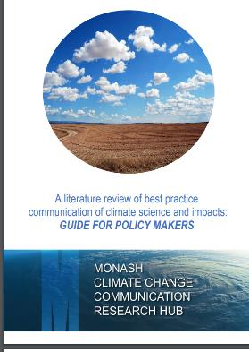
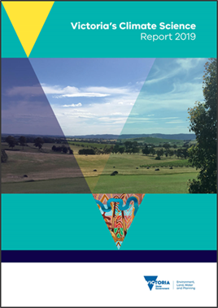
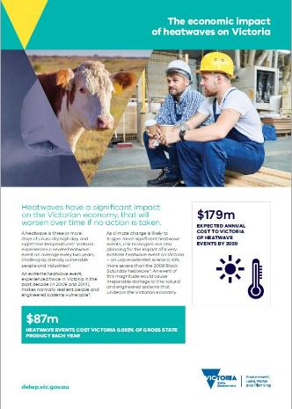
Victoria’s Climate Science Resources
Victorian Climate Projections 2019
Best Practice Communication for policy makers
Victoria's Climate Science 2019
Economic Impact of Heatwave
Notes:
Here are some reports and factsheets currently available that our team has produced to help present the information for Victoria. These reports are the source of most of the information in this presentation and available online for you to use.
https://www.climatechange.vic.gov.au/climate-science-report-2019
https://www.climatechange.vic.gov.au/__data/assets/pdf_file/0027/419148/CCC-Lit-Review-Guide-for-Policymakers.pdf
https://www.climatechange.vic.gov.au/adapting-to-climate-change-impacts/victorian-climate-projections-2019

Slide 5



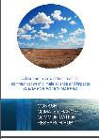



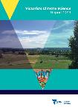
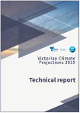
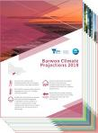


How to decide which information to use?
First ask how will the information be used?
Communication
Climate Science Communication Guide
More information or data required?
VCP19 technical report
And
VCP19 regional reports
Change factor data sets
Statewide information
Climate Science Report
Detailed study
Data for incorporating into existing models
Application ready data sets
Identify climate change impacts
VCP19 technical report summary information
Regional or sector specific planning:
Narrative scenarios
Risk / vulnerability assessments
Pathways Planning
Regional of sector specific modeling
Are there sector specific guidelines or products available
Consider all available data.
For example: The Water sector has: Guidelines for Assessing the Impact of Climate Change on Water Supplies in Victoria, Victorian Water and Climate Initiative products and ARR
Summary information from the VCP19 regional reports
Simple
Complex
Notes:
Our own experience and stakeholder feedback tells us that it can be very difficult to even know where to start. This decision tree asks some simple questions to help you narrow down the first place to look for help depending on what you want the information for. If you are looking for more information on the data and modelling please see the follow-up webinar focusing on the Victorian Climate Projections 2019.

Slide 6
Content of today’s webinar
What can we really say about climate change in Victoria?
How has Victoria’s climate already changed?
How is it likely to change into the future?
Q&A
What Regional Information is available?
What about uncertainty?
Q&A
Notes:
Not just about sharing the science – many of you will be familiar with the science in terms of the climate trends. These slides are also a reminder of what resources we have available to share, if you are thinking about communicating climate change to your stakeholders and the ways in which we can support you to build confidence in talking about climate change and in applying the climate science.

Slide 7
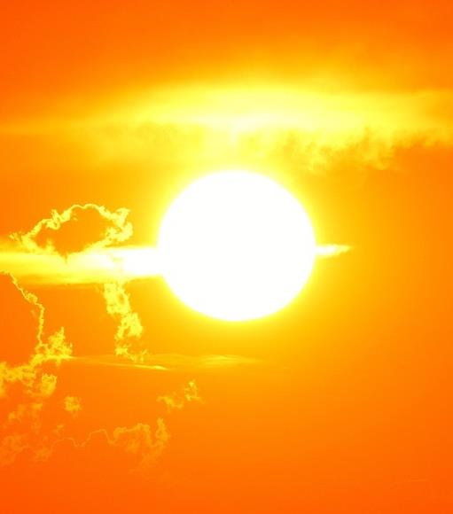
How has Victoria’s Climate Changed?

Slide 8
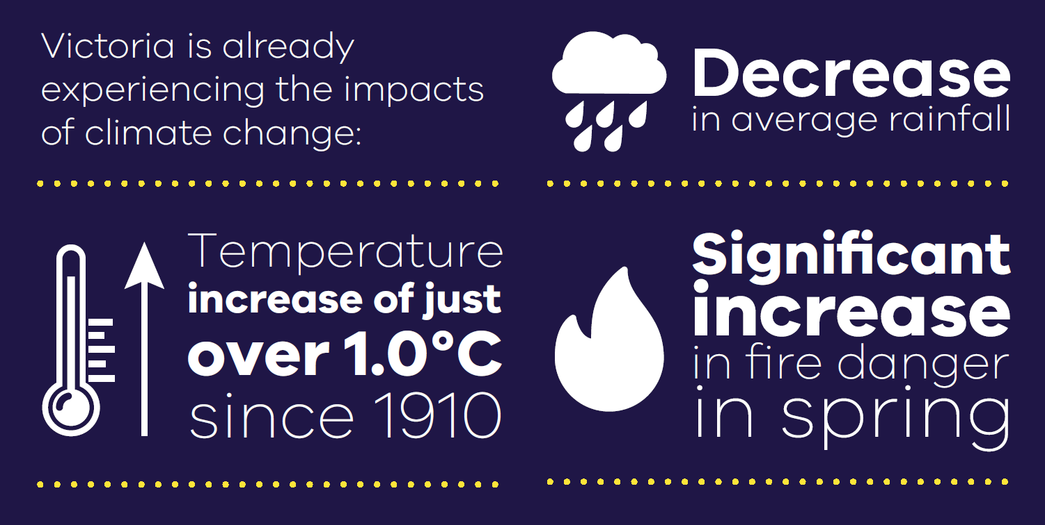
Current Climate
Notes:
Observed Changes in Victoria’s weather.
Source: Victorian Climate Science Report 2019.
So what do we know about how these change have already influenced Victoria’s climate and weather?
There is no doubt that Victoria’s weather has been getting hotter and drier and as a result fire danger is increasing.

Slide 9
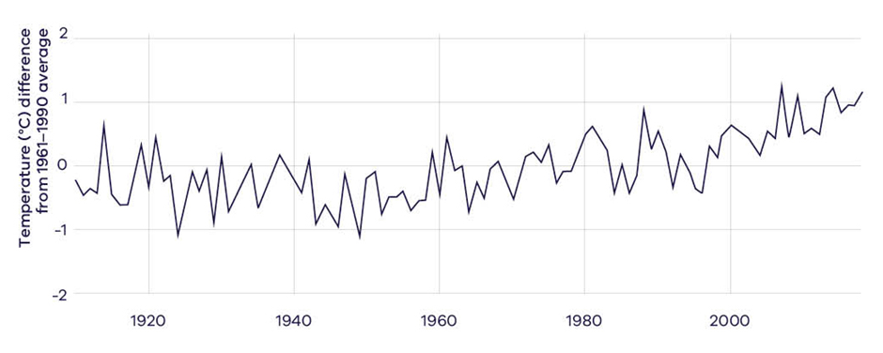

Climate change – the future will not be like the past
Observed average annual temperature in Victoria (BoM, 2019, CSIRO, 2019).
Anyone under the age of 24
who has always lived in Victoria
has never experienced a year of below-average temperature.
Notes:
This is an example of how you can help people to seek meaning from data. This graph shows that Victoria’s youth have a very different experience of average climate to that of Victoria’s average decision maker (the 45-70yr olds)
How much hotter?
Anyone under the age of 24 who has always lived in Victoria
has never experienced a year of below-average temperature.

Slide 10
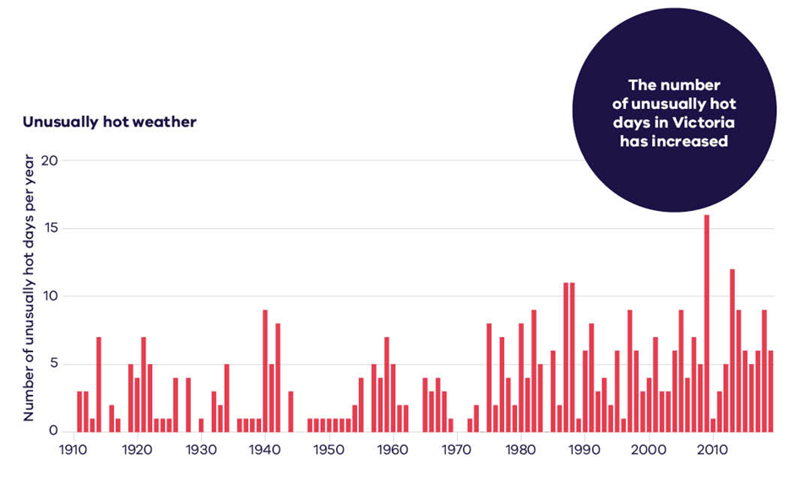
Victoria has had more very hot days
Notes:
These are OBSERVATIONS, not projections. Again, providing evidence of the impacts of climate change.
Source: BoM 2019
It’s not just that annual average temperatures have increased by 1 degree since 1910, but the number of unusually hot days has also increased.
"Unusually hot days are those above the 99th percentile of each month from the years 1910 to April 2019"

Slide 11
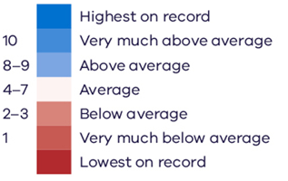
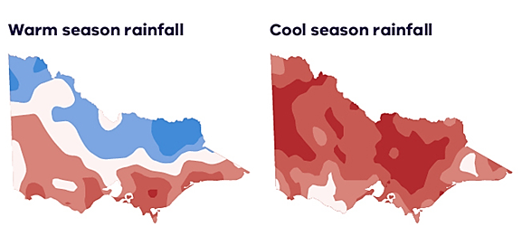
Observed Rainfall change in Victoria for the last 30 years
Notes:
These are OBSERVATIONS, not projections. Again, providing evidence of the impacts of climate change.
Source: Bureau of Meteorology, 2019
Rainfall has decreased, particularly in the cool season when we rely on it for replenishment of water supplies.

Slide 12
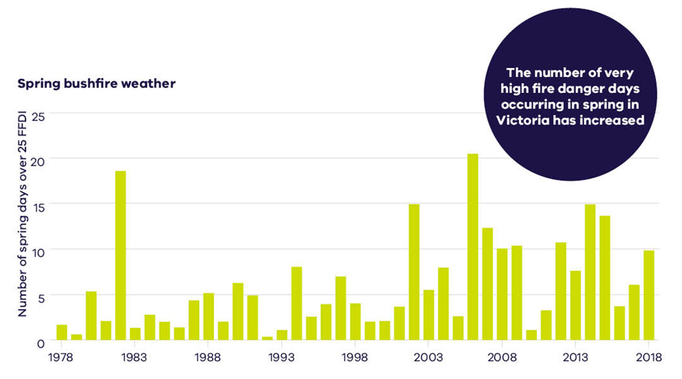
Fire danger in Spring is increasing for Victoria
Notes:
Source: Victoria’s Climate Science Report 2019
The Forest Fire Danger Index (FFDI) estimates the fire danger on a given day based on temperature, humidity and wind speed.
These factors contribute to the observed increase in spring fire weather.

Slide 13
What about the future?
Notes:
So what have the VCP19 projections told us?

Slide 14
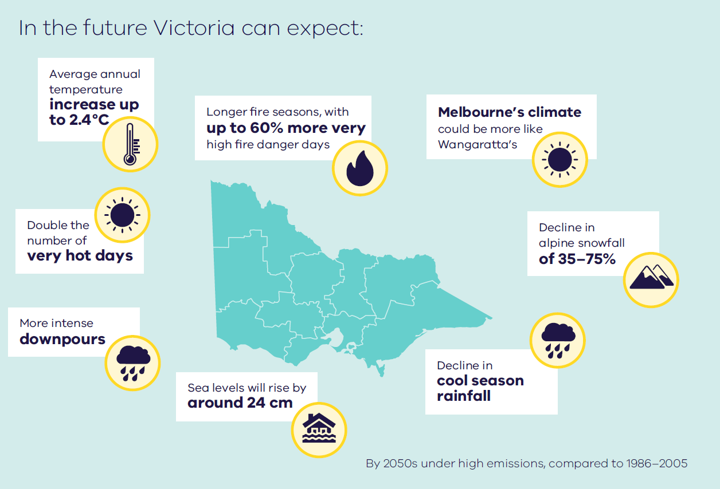
What about the future?
Notes:
This is an example of the kind of information the Victorian Climate Projections 2019 provides through its 10 regional reports, to promote the resources for decision-makers. These are available online at www.climatechange.vic.gov.au/vcp19, along with a technical report that discusses all of the projections for Victoria. Datasets are available on the CSIRO/Bureau of Meteorology climate change website www.climatechangeinaustralia.gov.au/vcp19.
These figures show average figures for the state under high emissions by the 2050’s. But, what about further into the future and under other emissions scenarios?

Slide 15
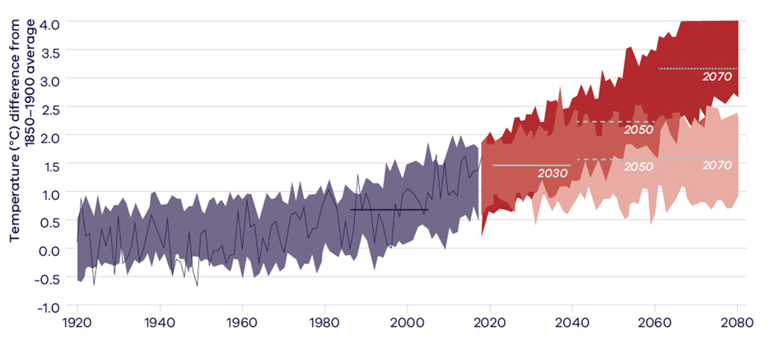
Victoria's Projected Temperature Pathways
Historical models
Observed
Baseline
High emission scenario
Overlap between high and low
Low emission scenario
Notes:
This graph shows how emissions pathways will have a big impact on Victoria’s future. The red represents a pathway with no climate policy; current commitments by governments are lower than this, but far short of achieving the salmon coloured pathway (see the UNEP Gap Report https://www.unenvironment.org/resources/emissions-gap-report-2019).
Average annual temperature of Victoria in observations and models, showing the highest emissions pathway from the IPCC Fifth Assessment Report (RCP 8.5) and the lowest (RCP 2.6). The lines show the 20-year average temperature for each time period (CSIRO, 2019).
This image shows Historical information as well as future projections based on High and Low emission scenarios. A couple of things to note:
1 The range of uncertainty – the range large because Victoria’s climate is highly variable
2 Up until the 2040s there is very little difference. We are locked into some change and adaptation is essential.
3 If we continue on the high emissions scenario – things get a lot worse.

Slide 16
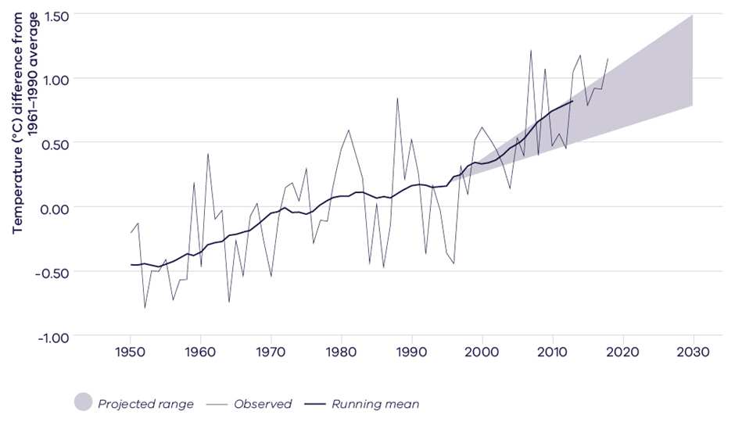
How are we Tracking – Temperature?
Observed temperature is tracking towards the warmer end of projections
Notes:
This graph compares the observed average annual temperatures for Victoria with the projected range of climate change from earlier projections.

Slide 17
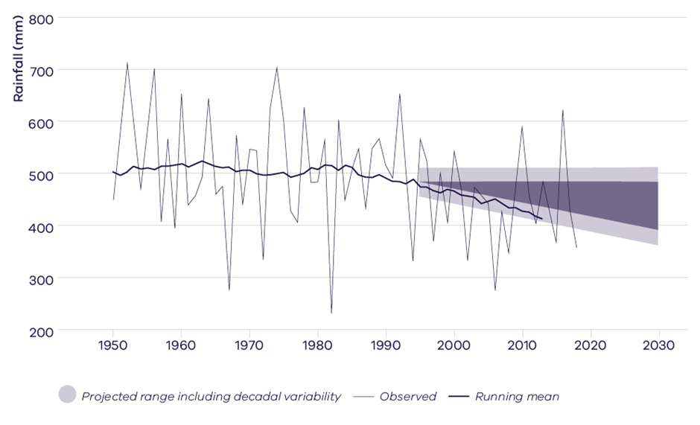
How are we Tracking - Cool Season Rainfall?
Observed cool season rainfall is tracking towards the drier end of projections
Notes:
Cool season rainfall. Observed rainfall averaged over Victoria (the thin black line) plus the 20-year running mean (thicker line). Projected rainfall change to 2030 (relative to 1986–2005) is in dark grey shading; an indication of decadal variability is in light grey shading. Source: Victoria’s Climate Science Report 2019
Rainfall is harder to reliably project than temperature, because rainfall varies more in time and space AND depends on more processes that are challenging to simulate (such as weather systems).
Observed cool season rainfall declines are tracking at or below the dry end of projections. Despite this overall reduction in rainfall, Victoria will still experience some very wet years due to natural variability.

Slide 18
What Regional Information is available?
Notes:
So what have the VCP19 projections told us?

Slide 19

Future Climate – Victorian Climate Projections 2019
Working with CSIRO’s Climate Science Centre​
​
5 km high-resolution climate modelling
Data analysis and comparison​
Technical report ​
10 Regional reports​
Guidance package
Visualisation tool (under development)
Notes:
The following information was modelled by CSIRO as part of VCP19, and presented in a set of regional reports available at www.climatechange.vic.gov.au/vcp19 – along with key information on fire risk, rainfall, snowfall and other climate information for the 2030s and 2050s.

Slide 20
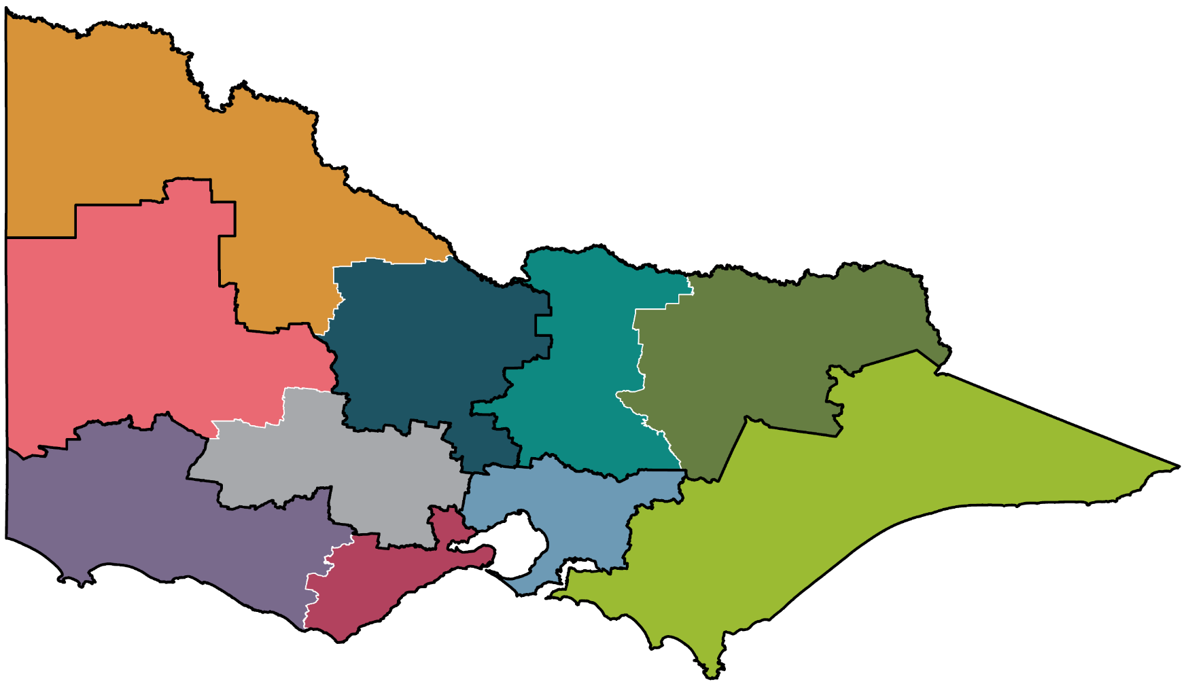
Future Climate – Regional Partnership Regions
Mallee
Wimmera Southern Mallee
Loddon Campaspe
Ovens Murray
Goulburn
Central Highlands
Great South Coast
Greater Melbourne
Gippsland
Barwon

Slide 21
Barwon:
By the 2050s Barwon can expect:
Average maximum temperatures increase by up to 2.6ºC
Annual rainfall to decrease by as much as 20mm
Spring rainfall to decrease by as much as 26mm
Longer fire seasons
Up to 49% more very high fire danger days
Twice as many days over 35ºC
Geelong's climate could be more like Shepparton
Colac's climate could be more like Wodonga
Notes:
Under a high emissions scenario.

Slide 22
Gippsland:
By the 2050s Gippsland can expect:
Average maximum temperatures Increase by up to 2.9ºC
Annual rainfall to decrease by as much as 16mm
Spring rainfall to decrease by as much as 26mm
Longer fire seasons
Up to 32% more very high fire danger days
Almost twice as many days over 35ºC
Traralgon’s climate could be more like Bairnsdale
Bairnsdale 's climate could be more like Cowra, NSW
Notes:
Under a high emissions scenario.

Slide 23
Great South Coast:
By the 2050s Great South Coast can expect:
Average maximum temperatures Increase by up to 2.6°C
Annual rainfall to decrease by as much as 20mm
Spring rainfall to decrease by as much as 23mm
Longer fire seasons
Up to 56% more very high fire danger days
Twice as many days over 35°C
Warrnambool's climate could be more like Benalla
Notes:
Under a high emissions scenario.

Slide 24
Loddon Campaspe:
By the 2050s Loddon Campaspe can expect:
Average maximum temperatures Increase by up to 3ºC
Annual rainfall to decrease by as much as 20mm
Spring rainfall to decrease by as much as 27mm
Longer fire seasons
Up to 62% more very high fire danger days
More than twice as many days over 38ºC
Bendigo’s climate could be more like Shepparton
Notes:
Under a high emissions scenario.

Slide 25
Ovens Murray:
By the 2050s Ovens Murray can expect:
Average maximum temperatures Increase by up to 3.1ºC
Annual rainfall to decrease by as much as 21mm
Spring rainfall to decrease by as much as 28mm
Longer fire seasons
Up to 44% more very high fire danger days
Twice as many days over 35ºC
Wodonga’s climate could be more like Forbes, NSW
Notes:
Under a high emissions scenario.

Slide 26
Central Highlands:
By the 2050s Central Highlands can expect:
Average maximum temperatures Increase by up to 2.9ºC
Annual rainfall to decrease by as much as 20mm
Spring rainfall to decrease by as much as 31mm
Longer fire seasons
Up to 68% more very high fire danger days
Twice as many days over 35ºC
Ballarat's climate could be more like Hamilton
Notes:
Under a high emissions scenario.

Slide 27
Goulburn:
By the 2050s Goulburn can expect:
Average maximum temperatures Increase by up to 3.1ºC
Annual rainfall to decrease by as much as 21mm
Spring rainfall to decrease by as much as 28mm
Longer fire seasons
Up to 60% more very high fire danger days
Twice as many days over 35ºC
Shepparton's climate could be more like Griffith, NSW.
Notes:
Under a high emissions scenario.

Slide 28
Greater Melbourne:
By the 2050s Greater Melbourne can expect:
Average maximum temperatures Increase by up to 2.7ºC
Annual rainfall to decrease by as much as 19mm
Spring rainfall to decrease by as much as 29mm
Longer fire seasons
Up to 42% more very high fire danger days
Twice as many days over 35ºC
Melbourne's climate could be more like Wangaratta..
Notes:
Under a high emissions scenario.

Slide 29
Mallee:
By the 2050s Mallee can expect:
Average maximum temperatures Increase by up to 2.8ºC
Annual rainfall to decrease by as much as 19mm
Spring rainfall to decrease by as much as 24mm
Longer fire seasons
Up to 50% more very high fire danger days
Twice as many days over 40ºC
Mildura’s climate could be more like Menindee, NSW
Swan Hill's climate could be more like Balranald, NSW
Notes:
Under a high emissions scenario.

Slide 30
Wimmera Southern Mallee:
By the 2050s Wimmera Southern Mallee can expect:
Average maximum temperatures Increase by up to 2.9ºC
Annual rainfall to decrease by as much as 22mm
Spring rainfall to decrease by as much as 28mm
Longer fire seasons
Up to 48% more very high fire danger days
Twice as many days over 38ºC
Horsham’s climate could be more like Deniliquin.
Notes:
Under a high emissions scenario.

Slide 31
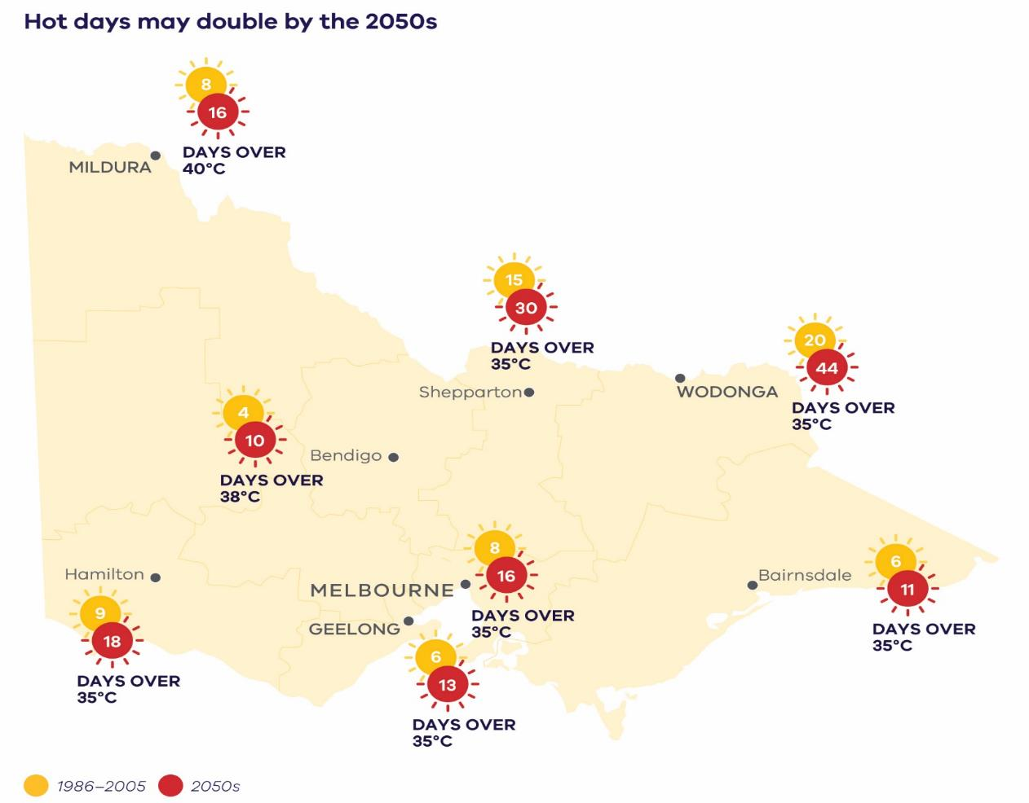
Increased risk of hot days...
Notes:
The projections show that hot days (days over 35 or 40 degrees) may double by the 2050s.
Very hot days can impact human health, damage infrastructure and test the resilience of health and emergency services and the provision of utilities
Source: Victoria’s Climate Science Report 2019

Slide 32
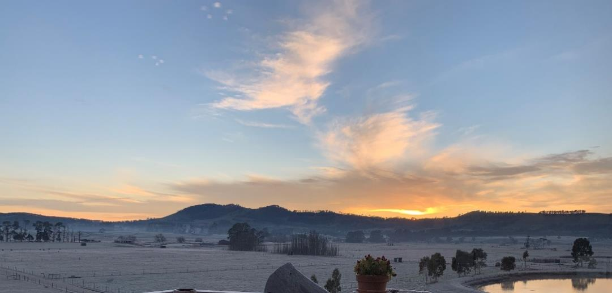
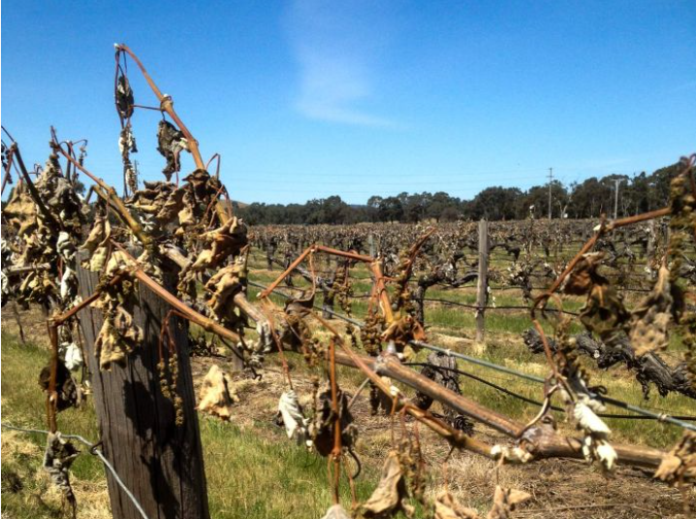
……and cold extremes
More cold clear nights increases risk of frost in the short- to medium term
Notes:
The projections also show an increased risk of frost in the near future, due to an increase in cold clear nights, which can also impact fruit crops, particularly grapes and cherries.

Slide 33
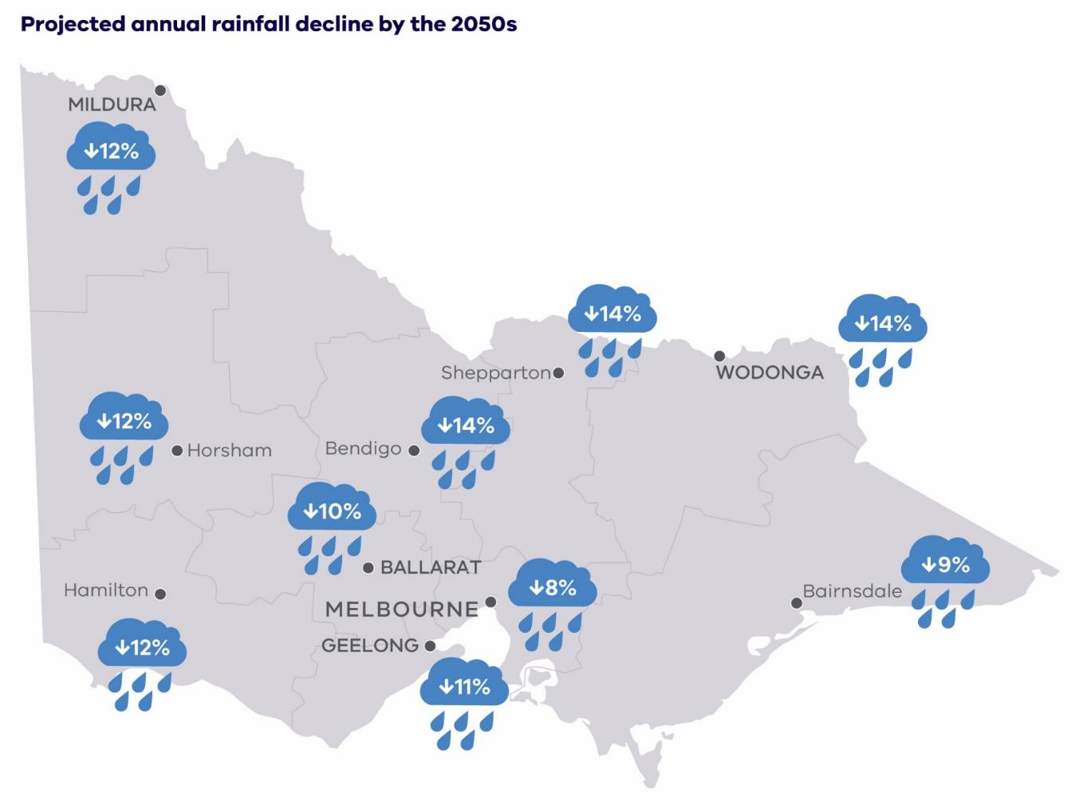
Drier overall…
Notes:
Victoria is likely to continue to get drier in the long term in all seasons except summer
Average annual rainfall decline, projected for the 2050s under a high emissions scenario.
Source: Victoria’s Climate Science Report 2019

Slide 34
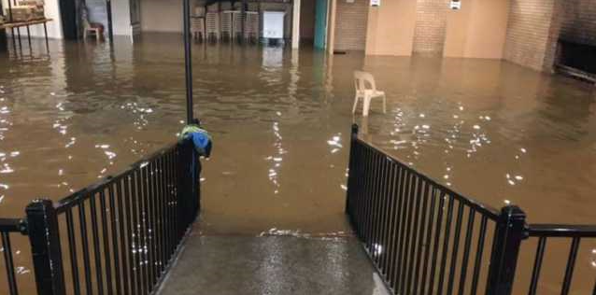
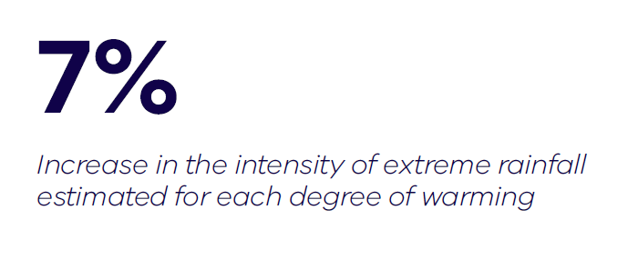
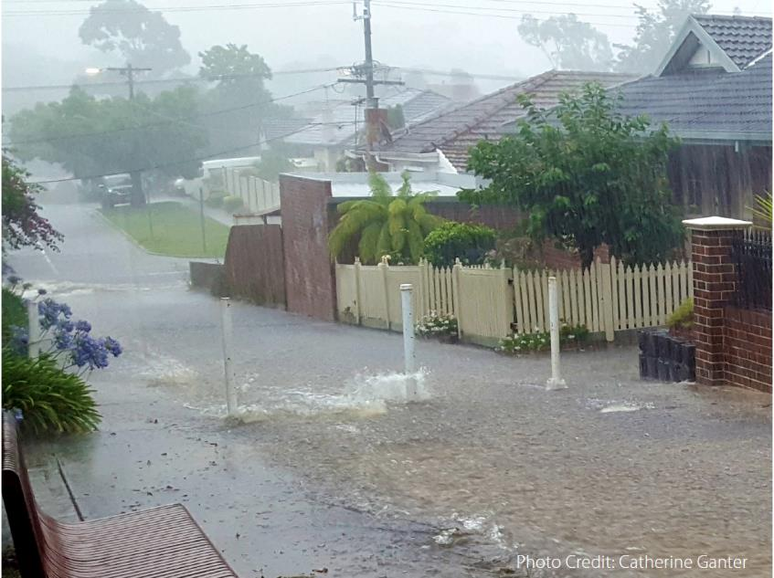
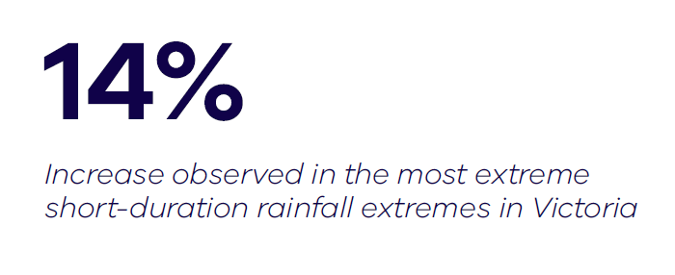
…but increased risk of intense rainfall events
Notes:
However extreme rainfall events, such as the flash floods north of Wangaratta in December 2018, are likely to get more extreme.
A warmer atmosphere can hold more water and scientists estimate that the intensity of extreme rainfall may increase by about 7% for each degree of warming.
However, they have already observed a 14% increase in rainfall intensity in the most extreme rainfall extremes in Victoria. There is ongoing research in this area being undertaken by BOM through the Victorian Water and Climate Initiative run through the Water and Catchments group of DELWP.

Slide 35
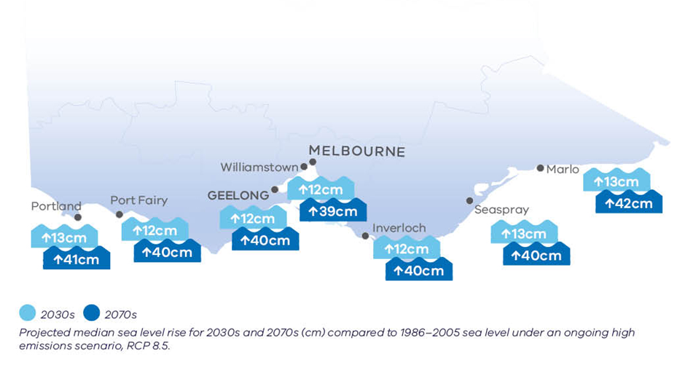
Rising sea level increases the risk of coastal erosion and inundation
Notes:
Sea levels are projected to continue to rise and the most recent IPCC report, suggests sea level rises greater than were previously predicted increasing the risk of damage to roads and buildings.
A US National Oceanic and Atmospheric Administration (NOAA) report in 2017 on global and regional sea-level rise scenarios stated that ‘projections and results presented in several peer-reviewed publication provide evidence to support a physically plausible global mean sea-level rise in the range of 2.0 to 2.7 metres, and recent results regarding Antarctic ice-sheet instability indicate that such outcomes may be more likely than previously thought.’ The NOAA report recommends a revised ‘extreme’ upper-bound scenario for global mean sea-level rise of 2.5 metres by the year 2100.
The report notes that while this is unlikely (0.1% under RCP 8.5) there are known and possible pathways for this outcome. In addition to the changes listed in the infographic per se, there is potential for the confluence of compounded events (for example, rainfall, river flooding, and storm surge) to have even greater impact under climate change.
Furthermore, there may be more severe changes at the boundaries of changing atmospheric circulation patterns, Victoria’s coast and marine environments under projected climate change: impacts, research gaps and priorities leading to shifts in erosion and accretion patterns, rotation of beaches and a less stable coastline. For example, a belt of high pressure systems called the subtropical ridge greatly influences Australia’s climate and is moving southwards due to climate change. This could lead to a change in the wind regime along the southeast coast of Victoria – this region is dominated by westerly winds, but with the movement of the subtropical ridge there could be an increase in easterlies, leading to westward transport of sediment and potential changes in beach alignment.
https://www.marineandcoastalcouncil.vic.gov.au/__data/assets/pdf_file/0022/411718/VCC_Science_Panel_Report_2018_Full_32pp_WEB.pdf

Slide 36
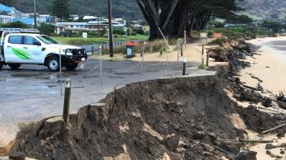
Long-term sea level rise
At 1.1 metre sea level rise:
3500 kilometres of Victoria’s roads
125 kilometres of railway
2000 commercial buildings at risk of inundation.
Notes:
To provide the potential risk of infrastructure, these have been taken from a first pass (high-level) risk assessment done by the Commonwealth Govt in 2011: https://www.environment.gov.au/climate-change/adaptation/publications/climate-change-risks-coastal-buildings .This is based this assessment on a 1.1 m figure which was the high-end sea-level rise estimates out to the end of the century 2100 (at the time of the assessment prior to 2011).
DELWP is currently working on the Port Phillip Bay Coastal Hazard Assessment which may provide updated estimates and they are using a range of sea-level rise estimates up to 1.4 m.

Slide 37
What about Uncertainty?
Notes:
You can’t have a conversation about climate change without also having a conversation about uncertainty. So where does all this uncertainty come from?
(see also webinar 2 for a more in depth discussion of the sources of uncertainty)

Slide 38
Uncertainty
Historical models
Observed
Baseline
High emission scenario
Overlap between high and low
Low emission scenario
Notes:
You can’t have a conversation about climate change without also having a conversation about uncertainty;
So where does all this uncertainty come from?

Slide 39
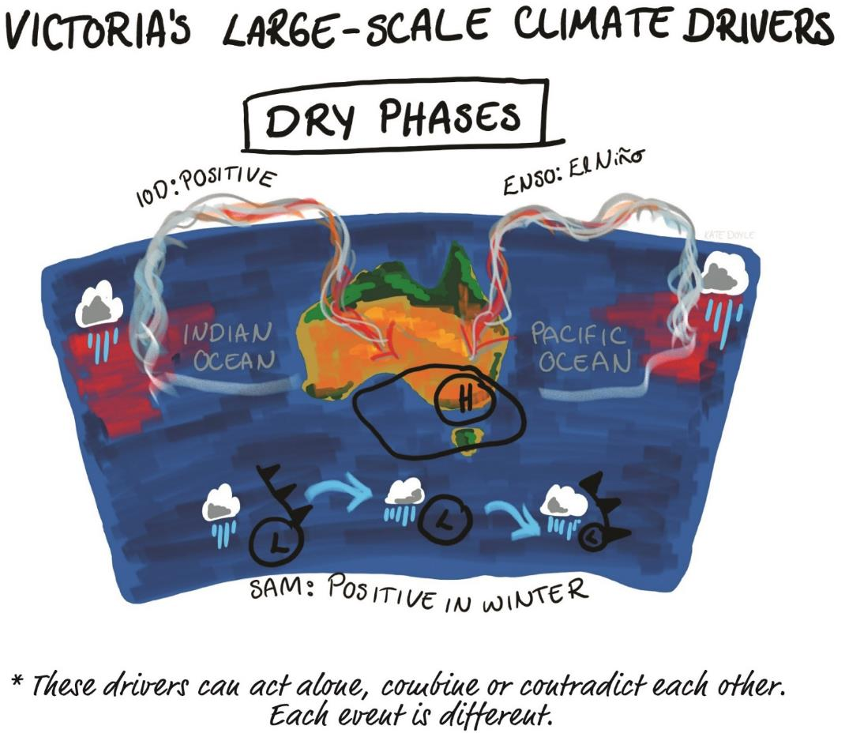
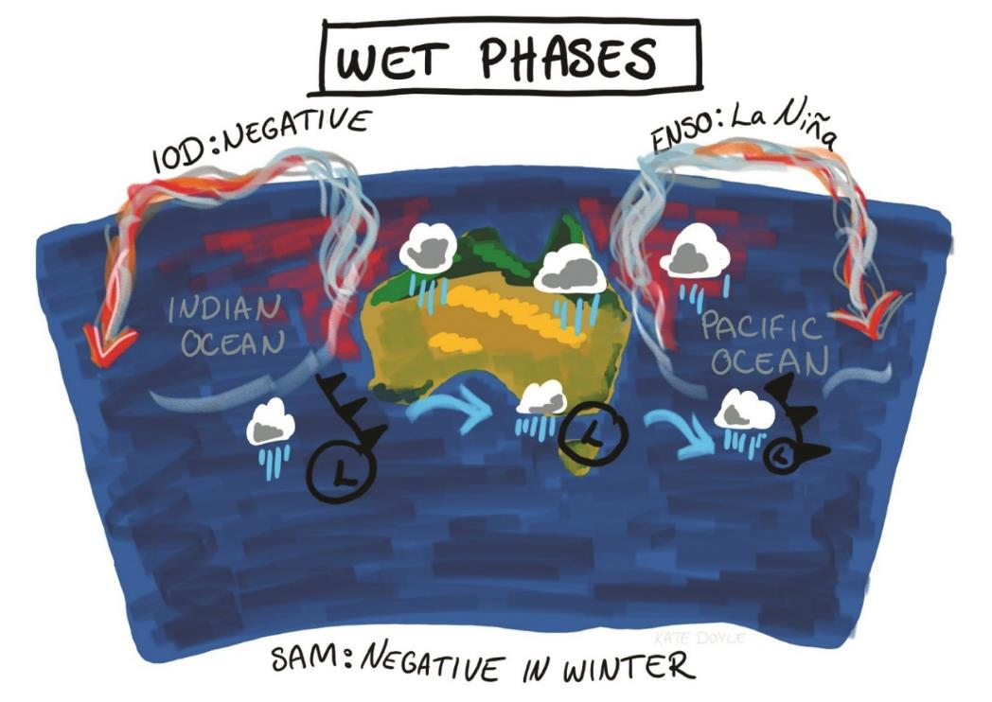
Why is there so much uncertainty?
http://agriculture.vic.gov.au/agriculture/weather-and-climate/understanding-weather-and-climate/climatedogs
Notes:
I’m sure that you’ve all heard someone say that Victoria’s climate is highly variable. When we start talking about climate change and in Victoria we are already starting with a higher level of uncertainty than some other regions.
Victoria’s climate varies from year to year and decade to decade due to the influence of large-scale climate drivers such as the El Niño Southern Oscillation.
Victoria’s climate is shaped by weather systems, seasonal influences and large-scale climate drivers. So, it’s really complicated.
If you want to learn more about this and see a brilliant example of communications, I highly recommend that you check out AgVic’s Climate Dogs videos. There is a link at the bottom of this slide.

Slide 40
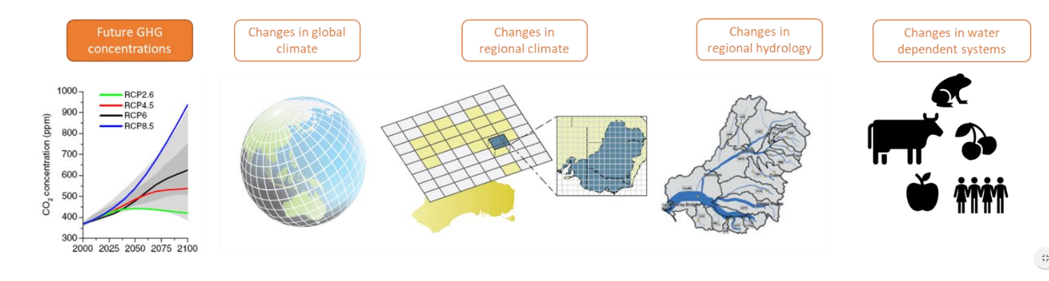
Why is there so much uncertainty?
global climate model
hydrological model
ecology, technology, economy, society
downscaling
increasing relevance
increasing uncertainty
Notes:
Example adapted from South Eastern Australian Climate Initiative
Within the models themselves there are also sources of uncertainty. If we start with the global climate models, we can be really confident in what they tell us and although the uncertainty increases, we are still very confident in the long-term trends, particularly for temperature.
This particular example comes from the Water sector and shows that the increase of uncertainty that goes along with the increase in relevance to finer planning scales.
Uncertainty increases so does the number of plausible possible futures

Slide 41
Plan for multiple possible futures
Uncertainty is unavoidable, and there are planning and decision-making approaches that accommodate it.
Climate projections provide a solid evidence base to assess plausible ranges of future change
Honestly assess the range of possibilities
Recognise ‘unknown unknowns’
Make decisions that are robust across the range of plausible futures
Do not lock in one path of action
Notes:
Uncertainty should not stand in the way of action. You may know the range of possibilities but you’re not sure exactly what will eventuate (the ‘known unknowns’), or you may not even be sure of what is possible (the ‘unknown unknowns’). These factors must be honestly assessed to make decisions under uncertain future conditions. This means factoring some uncertainty in to decision making. Climate projections provide a solid evidence base to assess plausible ranges of future change, but given the deep uncertainty about the far future, you should make decisions that are robust across the range of plausible futures, and do not lock in one path of action.
Tools and approaches such as scenario planning, pathways planning and vulnerability and risk assessments provide ways of doing this and we are working across the department and across government to help provide advice and support in this area.

Slide 42
Current projects and Case Studies
Scenario planning in the water sector
Applying climate science to risk
Specialist training and support for Sector Adaptation Action Plan development
Visualisation project
Hazard mapping
Specialist advice

Slide 43
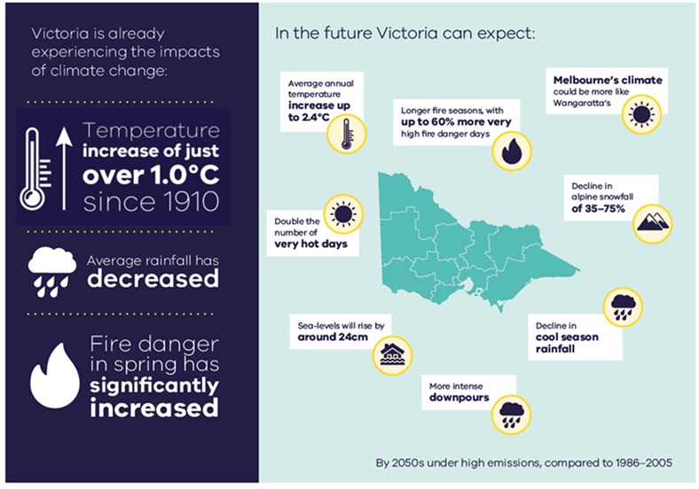
Recap – Victoria’s Climate
Notes:
Victoria is already experiencing the impacts of climate change. It’s getting hotter and drier and fire danger is increasing
We expect this to continue into the future as will sea-level rise and a decline in snowfall.

Slide 44
Recap - What’s available?
Climate projections provide a solid evidence base for planning and policy
There are a range of resources available
This includes regional information
There is uncertainty, but we can deal with it!
We are here to help
Get in touch! climate.science@delwp.vic.gov.au

Slide 45
Recap - What’s available?
Communication
Climate Science Communication Guide
More information or data required?
VCP19 technical report
And
VCP19 regional reports
Change factor data sets
Statewide information
Climate Science Report
Detailed study
Data for incorporating into existing models
Application ready data sets
Identify climate change impacts
VCP19 technical report summary information
Regional or sector specific planning:
Narrative scenarios
Risk / vulnerability assessments
Pathways Planning
Regional of sector specific modeling
Are there sector specific guidelines or products available
Consider all available data.
For example: The Water sector has: Guidelines for Assessing the Impact of Climate Change on Water Supplies in Victoria, Victorian Water and Climate Initiative products and ARR
Summary information from the VCP19 regional reports
climate.science@delwp.vic.gov.au
Notes:
You can get more detail on the Vic Climate Projections in a follow up webinar on Friday the 26th.

Slide 46
www.climatechange.vic.gov.au
climate.science@delwp.vic.gov.au

