Slide 1
Water planning and budgeting
Benita Kelsall
Dairy Extension Officer
Notes:
A hobby farm by definition is a - small farm operated primarily for pleasure rather than profit.
Because of this, there may be a different focus or emphasis on the values for that property;
Water supply in the context of:
Lifestyle – being away from farm too;
Aesthetics – beauty ;
Farming / self sufficiency;
Conservation and/or biodiversity;
Reliance on off farm income or semi-retirement;
Water supply for pets, rather than commercial animals.
Hobby farms also sit within the landscape in the divide between ‘real farms’ and ‘urban areas’. As hobby farmers we may have expectations of our rural and urban neighbours, in much the same way they have expectations of us.

Slide 2
Notes:
Acknowledgement
I will be here later today, if you need to follow up with me.

Slide 3
Water reliability and change
Buying a new property
Changing stock type or numbers
Notes:
When might it be useful?

Slide 4
Water reliability and change
Drought, climate or emergency planning
Existing supplies fail
Notes:
Warmer temperatures
Increases in evaporation
Plants and animal water needs may increase
Bushfire risk
Increased frequency of high intensity rainfall
Potentially less rainfall in spring/winter

Slide 5
Past
Present
Farm Water Audit (a snapshot of now)
Future
Notes:
Past
Present
Future

Slide 6
Farming System
The home property runs
320 breeding ewes with lambing starting 1st June
Half sold before end Dec
Other half sold March-April
97 one year old heifers and 20 two year old steers/heifers and 3 bulls.
Neighbouring leased properties run
80 breeding cows and Dargo stock
Cattle are autumn calving (Feb)
With milder winters autumn calving is working well

Slide 7
The water supply - past
Stock directly accessed dams in paddocks, relying on catchment runoff to fill them.
Town water was used as the primary supply of water during dry periods.

Slide 8
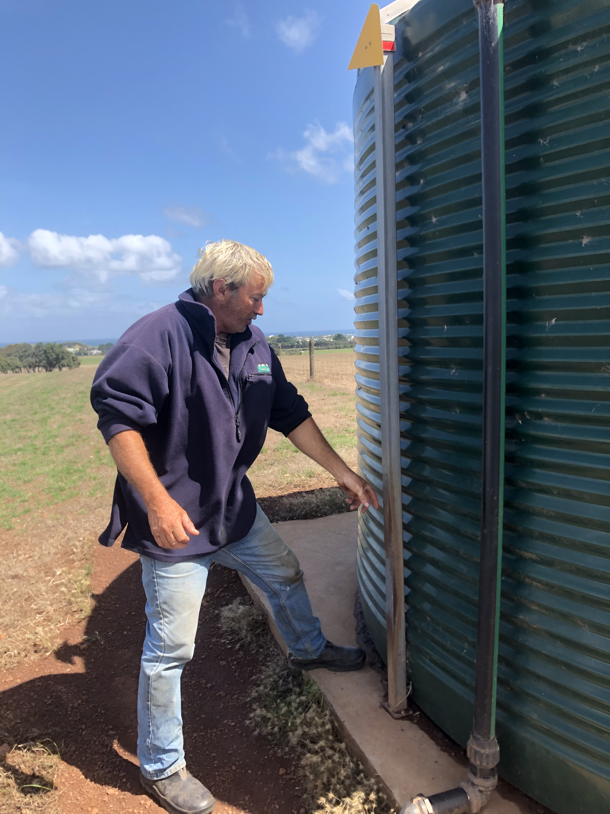
The water supply - present
Upgraded the water supply system with support through various grants;
Constructed a new 4.8 megalitre dam that collects road runoff
Placed troughs in each paddock
Installed a 31,700 L header tank and solar pump
New system paid for itself in 6 years compared to price of mains water
Notes:
Upgraded the water supply system with support through various grants involved;
Placing troughs in each paddock
Collecting road runoff
Construction of a new dam
Header tank and solar pump
New system paid for itself in 6 years compared to price of mains water.

Slide 9
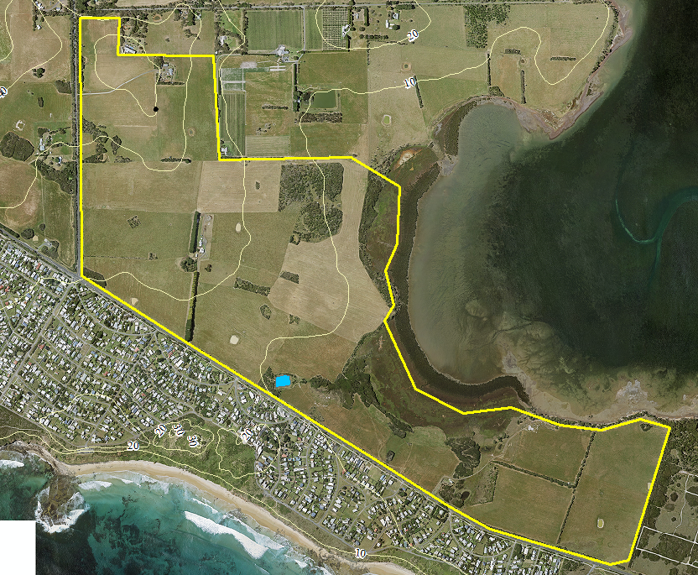
Header tank 31,700L
Road runoff
Main dam

Slide 10
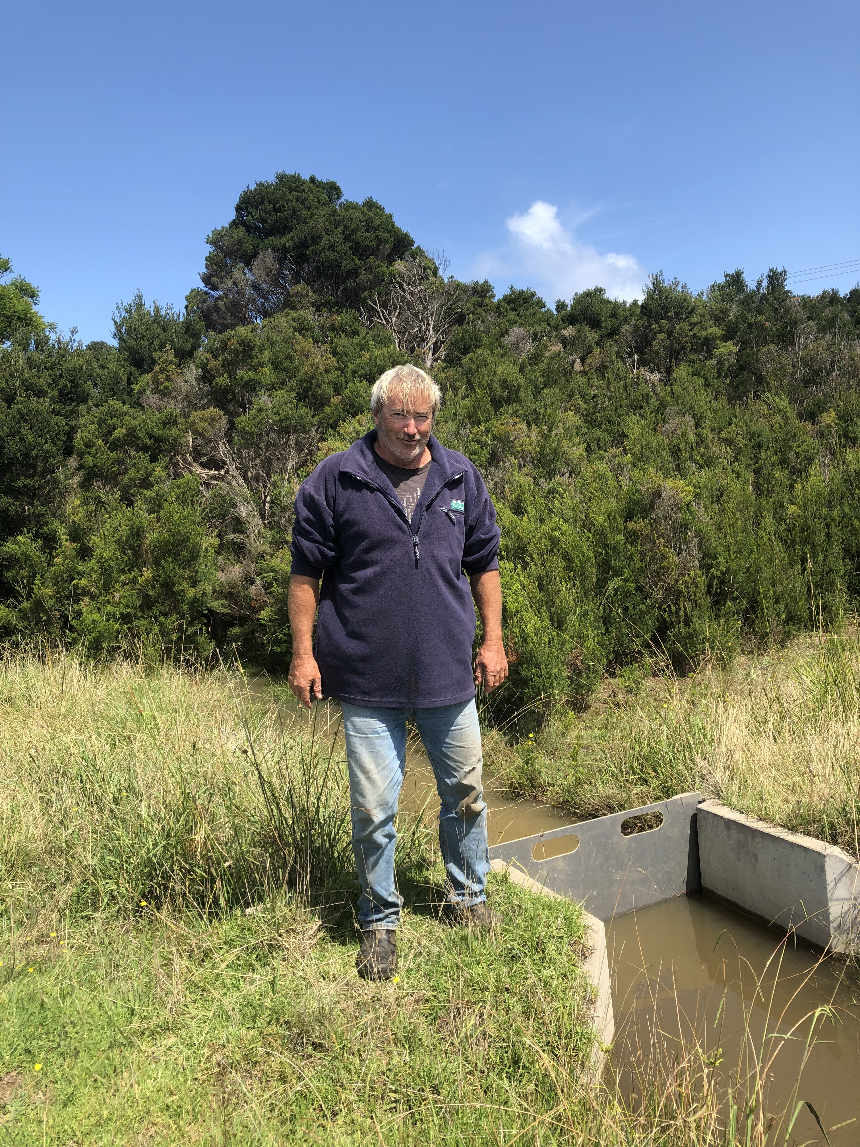
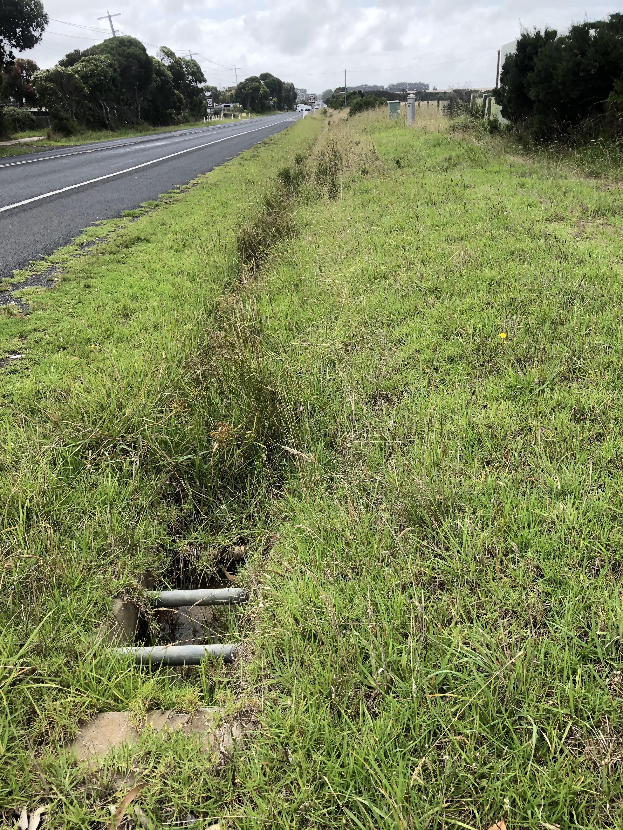
Challenges and opportunities facing water supply
Water quality
Dam is supplied with storm water
Which has the potential to carry sewage overflow.
Development
A wider road is proposed in the future
Notes:
There is a big irrigation gate valve gillatine so it can shut off the water in a second.
A smaller farm may mean ….
Challenges associated with hobby farms and water supplies;
Water sources may be limited – smaller/no catchments,
Water storages may be limited
May be away from the farm for periods of time – holidays/ comuting for work etc.
Opportunity;
- New way to develop/ set up to suit your situation

Slide 11
Farm Water Requirements
Notes:
Way to think about water – how much do you need, and when you need it – covered by the on-farm storage. Water supply – water quality considerations come into this.

Slide 12
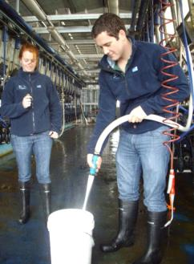
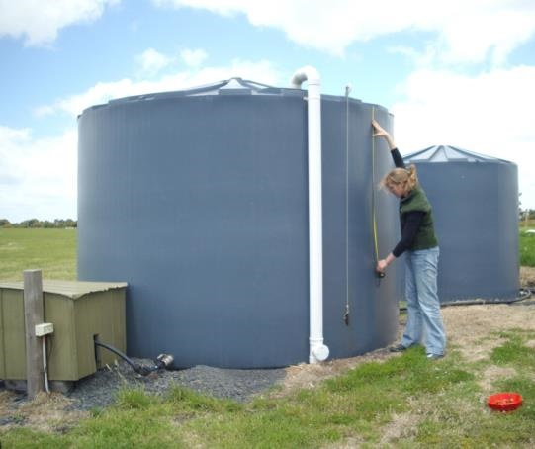
Determine how much water you will need
π r² x height
Measure water use or use an ‘average’ as a starting point with online tools or booklets
What might you need water for on a farm?
Notes:
DEMONSTRATE – with cards…
Measure it yourself or get a meter.
DEMONSTRATION – bring in different size hoses… with flow rate marked on them…
Explain first, then demonstrate.
Flow Rate Exercise
Demonstration… or use a bottle of water and mini bucket … with some volunteers.
Flow Rate method:
Requires a watch to count the seconds
A large container of known volume
Knowledge of how long the water is used for in that process _IMPORTANT TO TIME THIS (often under estimated)!
Calculating the volume of a tank – can provide an overall summary of water use (depending on what the tank supplies water for).
Need to:
Measure the volume
Proportion of tank used per milking or for which process.
Can turn off the replenishment valve to calculate the proportion.
Gallons to litres
1 Australian Gallon = 4.5 litres
5,000 gallons = 22,500 litres
10,000 gallons = 45,000 litres
!

Slide 13
Stock water requirements
Factors that influence animals water intake include:
Type of animal- size, condition or physiological state of animal
Diet
Level of activity
Quality of water on offer
Environmental conditions – shade.
Notes:
- If time permits – water intake and shade relationship – anecdotal evidence?

Slide 14
How much water does a steer need per day in summer?
Notes:
Draw picture here
Relevance of annual water requirements – useful to know yearly water requirement to compare with supplies.
A 50m x 20m x 1m deep Olympic sized swimming pool is 1ML

Slide 15
Table of stock water requirements
Livestock | Daily Average (L/day) | Summer Average (L/day) | Yearly average (L/head/year)
Beef cattle | 80 | 98 | 22,500
Beef cattle (weaners) | 50 | 70 | 18,250
Prime lamb on pasture | 4 | 5.6 | 1,460
Nursing Ewe on dry feed | 10 | 14 | 3,650
Laying hen | 0.33 | 0.46 | 120
Goat (milking) | 6 | 8.4 | 2,190
Working horse | 55 | 77 | 20,075
Dairy cow (milking) | 150 | 210 | 54,750
Notes:
Many factors that contribute to how much an animal will drink – lactating or not, size, walking distance, feed intake (dry/wet) etc.
Testing stock drinking water

Slide 16
Water needs for the property
Water use | Daily total required (Average) | Summer daily (Peak demand) | Yearly volume required
327 ewes | 3,270 L/day | 4,578 L/day | 1,193,550 L/year
50 lambs for 6 months of the year | 200 L/day | 280 L/day | 36,000 L/year
97 heifers (12 months) | 4,850 L/day | 6,790 L/day | 1,770,250 L/year
20 head cattle ( 2 year old) | 1,600 L/day | 1,960 L/day | 584,000 L/year
3 bulls | 240 L/day | 294 L/day | 87,600 L/year
 |  | 13,902 L/day | 3,671,400 L/year
Notes:
ADD DATA HERE

Slide 17
Summer peak daily water requirement
To size pipes for a gravity fed water supply system it’s important to know the flow rate required at the trough. This is based on;
Summer peak flow rate is the summer daily requirement consumed within a 4 hour period.
For this example the summer daily water requirement is 13,902L/day (within a four hour period). A peak flow rate of 58 litres/minute.

Slide 18
Other uses of water
Dairy shed
Evaporation
Seepage
Losses from leaky troughs and pipes
Household
An allowance for 155 litres/person/day
Fire fighting
Will depend on fire-plan. CFA recommends minimum 10,000 L available for household fires.

Slide 19
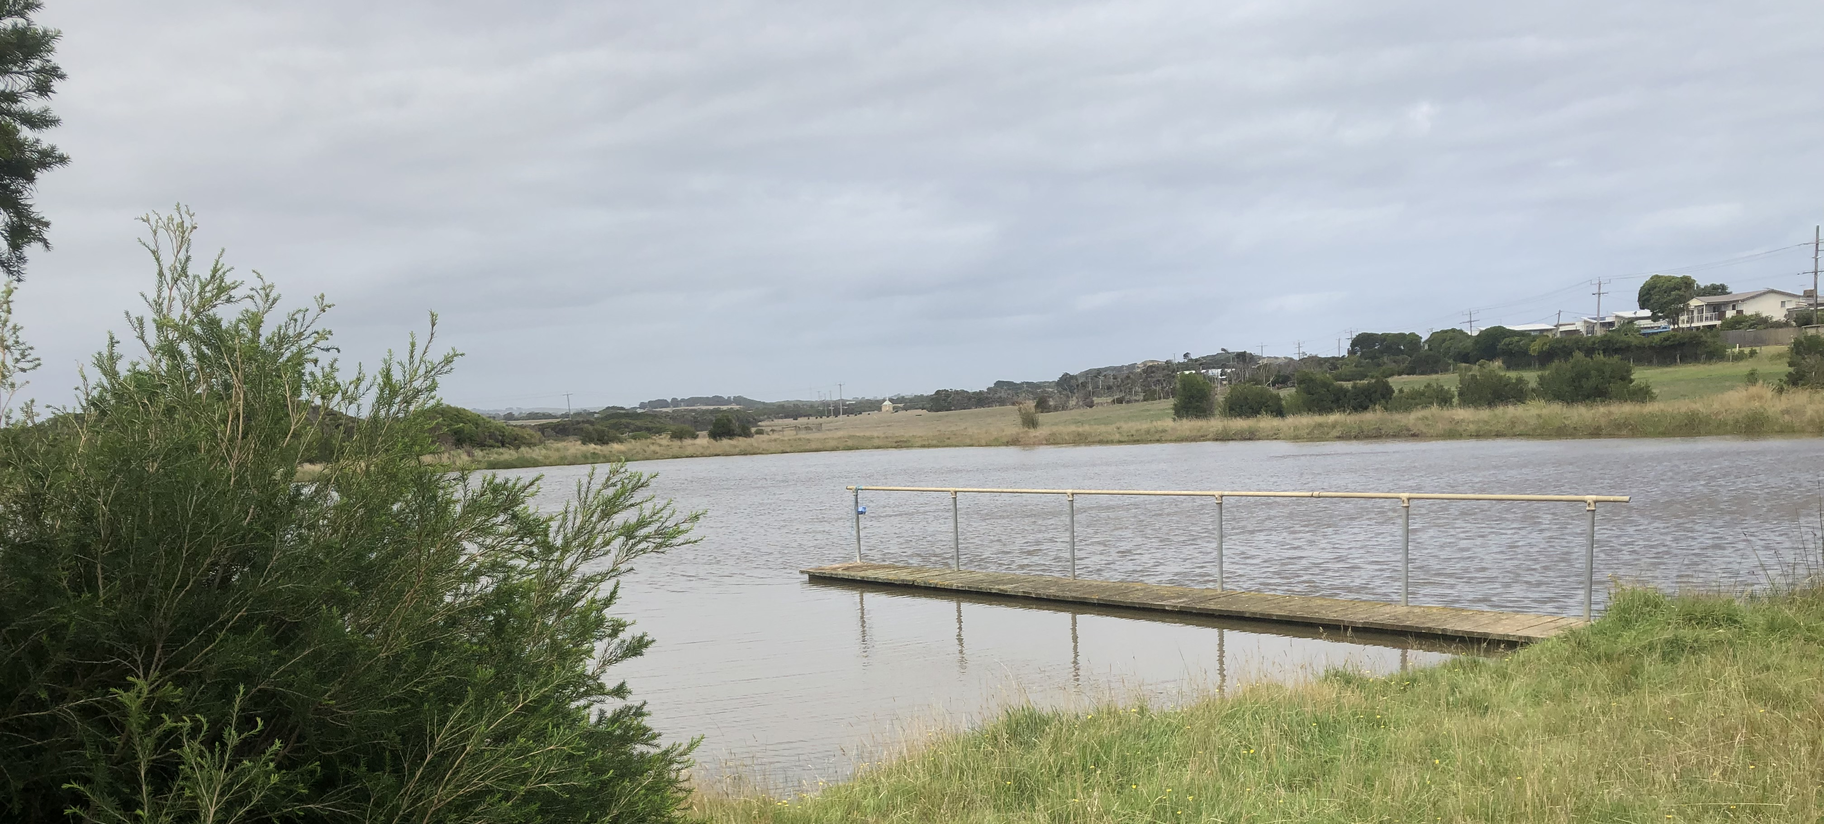
How much water can you lose to evaporation?
Phillip Island has an evaporation of ~ 1200mm annually.
The 40m x 60m x 3m deep dam (4.8ML) could lose around half (2.4ML) of its total volume to evaporation each year in summer when it’s needed most.
Notes:
A similar amount of rainfall will fall onto the dam surface – usually in winter and overflows….
Refer to notes if want to calcula
Shallow dams with large surface areas suffer from high evaporative loss
Two dam of the same volume in South Gippsland
A 4m deep will lose 40% of volume in evaporation over a year
A 1m deep will lose 90% of volume in evaporation over a year
te the actual figures for evaporation.

Slide 20
Water Supply
Groundwater or Springs
Creeks and Rivers
Rainfall from catchment runoff into dam
It may be necessary to consider the range of water supplies available, their quality, cost and reliability
Notes:
Can water supply needs be met with rainfall alone?
Town water is missing.

Slide 21
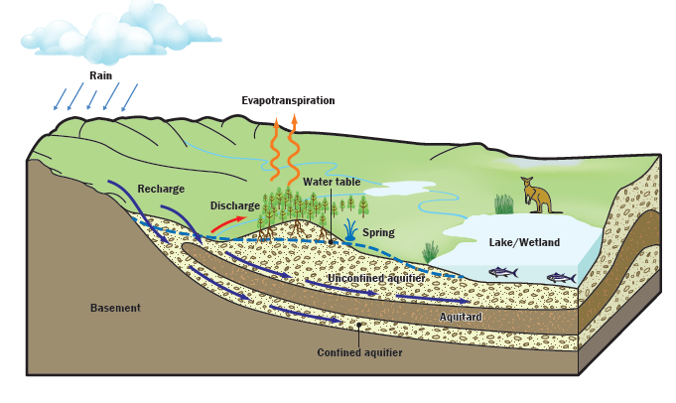
Groundwater
Source: Southern Rural Water, Phort Phillip GW Atlas, 2010
http://www.srw.com.au/wp-content/uploads/2016/03/Port-Phillip-GW-Atlas-Complete-Web.pdf

Slide 22
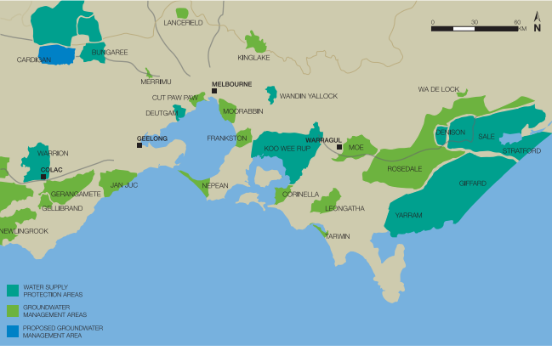
Groundwater management areas
Source: DELWP, Central Sustainable water strategy
https://www.water.vic.gov.au/__data/assets/pdf_file/0025/63259/Chapter2.pdf
Notes:
Lower Aquifer – Corinella GMU - Bore 56922 occurs in the Older Volcanics aquifer which occurs at the surface and is unconfined. Levels in this bore fluctuate slightly but are stable overall. There is only one SOBN bore in this GMU.
Middle Aquifer - Koo Wee Rup GMU: Bore 71184 occurs in the centre of the GMU where the middle aquifer is confined. There is significant seasonal fluctuation in the area where extraction is concentrated. However, seasonal fluctuation has lessened and levels have stabilised in recent decades across the entire GMU and the overall trend is stable.

Slide 23
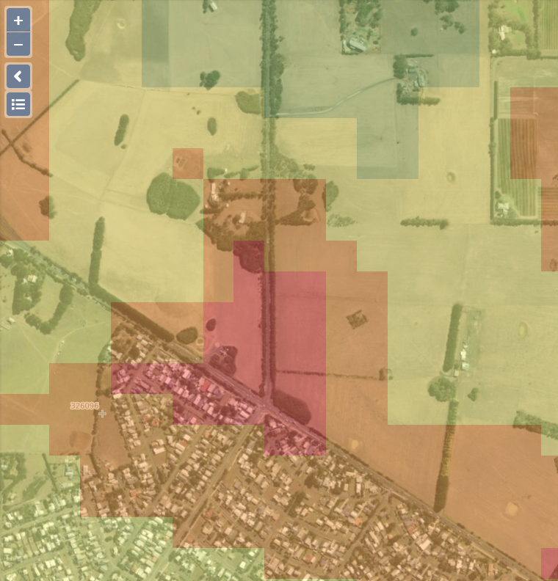
Groundwater resources
Online tools can show
Location of bores in the neighbourhood and depth to groundwater
Approximate depth of groundwater
Approximate water quality
Visualising Victoria’s Groundwater
www.vga.org.au
Notes:
Test water quality of supply;
For this example;
There are only a few bores on Phillip island between 30-60m depth.
Water quality indicated to be quite salty between 3,500 – 7000 mg/L (?)

Slide 24
Surface water
Catchment runoff into dams
Pumping from a creek or waterway
Notes:
Runoff and water quality are the two factors influencing a reliable surface water supply.
Dams can provide a reliable supply if away from the farm;
Direct stock access to a dam can reduce water quality;

Slide 25
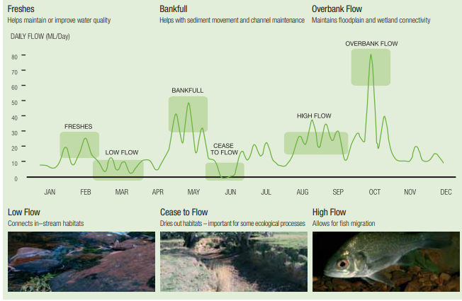
Stream flow
Source: DELWP, 2005 Central SWS available at https://www.water.vic.gov.au/__data/assets/pdf_file/0025/63259/Chapter2.pdf
Notes:
Winter fill licenses
Some licences are limited to higher flow periods when they can take water. Winter-fill diversion licences specify the times when water can be pumped, usually into a dam for later use. This is called the ‘winter fill period’, and is usually the high flow period between July and October. Some variations occur so check with Melbourne Water what applies to your catchment.

Slide 26
What factors influence catchment runoff?
Notes:
Drainage tends to accelerate runoff
Things that slow runoff help to allow nutrient to drop out and also reduce the erosive capacity of the water on streams/rivers.

Slide 27
Some ‘average’ runoff coefficients
Land Use | Annual Rainfall (mm) | Runoff coefficient
Agricultural | 1200 | 0.15
Industrial | 1200 | 0.95
Residential | 1200 | 0.78
Parkland | 1200 | 0.05
Adapted from Olmos and Birch 2008,
https://www.researchgate.net/figure/Annual-rainfall-mm-Runoff-coefficient-and-Event-Mean-Concentration-mg-L-for_tbl1_252614744

Slide 28
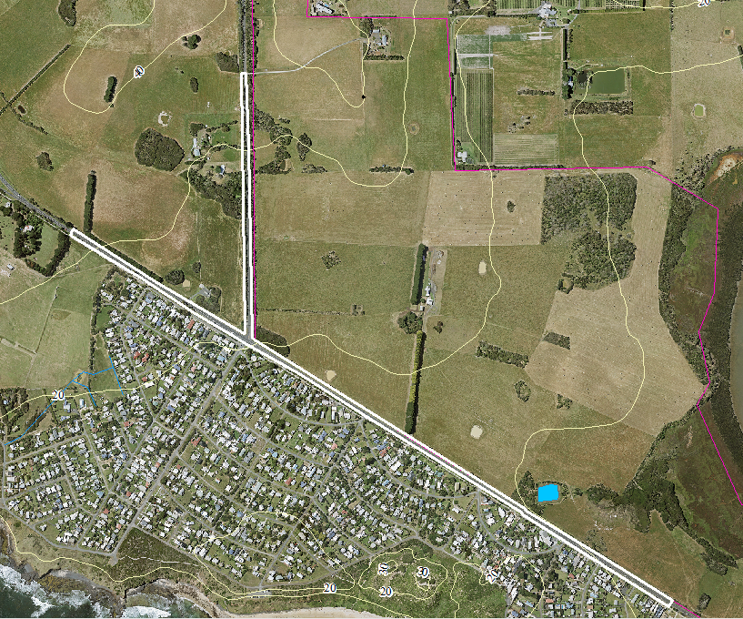
Water supply for stock from catchment runoff into a dam
The dam can hold around 4.8 megalitres with a 4.8ha road catchment.
The road will generate around 30 megalitres/year assuming a runoff coefficient of 80% and rainfall of 776mm/year.
In a dry year (2002) 572mm fell, this would generate 22 ML.
In comparison:
A perennial pasture with a medium texture soil with a catchment of 4.8 hectares could generate 2.2 ML/year.
Notes:
Anaecodotally – 10mm of rain will lift the dam by 1m.
No animal health issues
(40m x 60m x 3m)

Slide 29
Using impervious surfaces to improve reliability of supply...
A roof area can capture approximately 95% of rainfall.
Especially useful if only running a few stock (lifestyle properties).
For example a shed roof
345m² x 776mm/year x 0.95 = 254,334 litres/year

Slide 30
What are the legal requirements associated with water on your farm?
Water is licensed differently for stock and domestic use compared to a ‘commercial use’ or for ‘irrigation’.
Dams
Dams may also require a license to construct depending on the dam’s location (if it’s in a waterway) and size.
Dam wall greater than x metres high

Slide 31
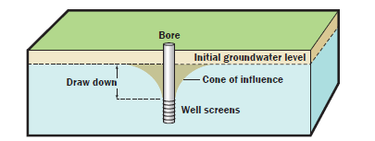
Why register your bore?
A bore construction license is needed prior to construction (for any bore regardless of use)
Source: Southern Rural Water, Phort Phillip GW Atlas, 2010
http://www.srw.com.au/wp-content/uploads/2016/03/Port-Phillip-GW-Atlas-Complete-Web.pdf
Notes:
When groundwater is being pumped from a bore a cone of influence is formed that extends outwards from the bore. This
can cause interference between bores. This means that when a neighbouring bore is being pumped there may not be
enough groundwater in your bore to achieve the usual yield.
Pumping may also intercept the flow of groundwater to nearby springs and streams, however this impact may not be
noticed for weeks, months or even years.
What happens when too much groundwater

Slide 32
Legal requirements continued…
Direct access to a creek
May need licensing for stock water depending on if you own both sides of the waterway.
Works on a waterway may also require a works on waterway permit obtained through West Gippsland Catchment Management Authority or Melbourne Water.
Rainfall collected off a shed roof
Doesn’t require licensing regardless of use (irrigation or for stock and domestic purposes).
Southern Rural Water should be consulted for licensing information.
Also consult with your local council if you are conducting earthworks.

Slide 33
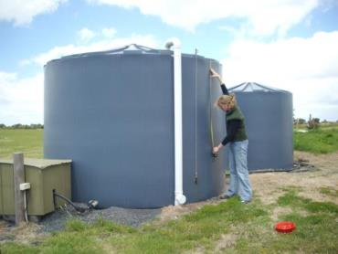
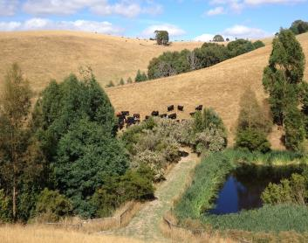
For times when there may be limited rainfall and runoff on farm storage becomes important
Refer to tank and dam look up tables.
Online farm water calculator:
http://agriculture.vic.gov.au search farm water calculator
Notes:
Benefit of a tank is that there is limited evaporation,
Benefit of a dam is …

Slide 34
A yearly water audit
Storage
Supply
Total storage = 4,831,700 Litres
Stock = 3,671,400 L/year
Requirements
Total supply = 30,186,200 L/year
Total requirement = 6,083,400 L/year
Dam volume ~ 4,800,000 litres
Stormwater runoff into dam ~ 30 ML/year
Evaporation and seepage losses from dam = 2,412,000L/year
Rainfall on dam surface ~ 1.862 ML/year
Header tank volume ~ 31,700
Notes:
** Based on 1000mm rainfall and ‘average water use figures’

Slide 35
A resilient water supply
Water Uses
Water Storage
Water Supply
Shade and shelter for stock
Minimal leaks and evaporative losses
Quality maintained through fencing to exclude stock
Multiple supplies as a back up
Back up pumps
Water tanks - if used as header tank to troughs with 3 days of storage
Dams - a year of on-farm storage

Slide 36
Other Risk Strategies
Incorporation of multiple supplies to manage risk if one supply fails.
Use of gravity such as a header tank ideally with 3 days back up to manage risk associated with power (no sun for solar system).
Consider options for when power outage or away from the farm. Such as dam access.
Ensure storages such as dams and tanks are large enough to overcome periods without runoff.
Minimise losses and/or cut back use.
Have a plan in place for fires.
Notes:
Irrigation infrastructure – pumps/ irrigation methods, stock troughs etc….
Access to power, back up if power is out
CFA outlet –for fire fighting (65mm male).
Water application
Application methods include drip irrigation, overhead fixed and moveable sprinklers, travelling irrigators like centre pivots and flood irrigation. Drip irrigation is the most water efficient application method but all systems have their pros and cons. Some production situations, crops or soil types may not be suited to specific irrigation methods. It is most important no matter what the method used, that an even distribution pattern of water is applied to ensure even and controlled crop growth. The method used will depend on the crop to be grown, how much water is available and the capital that can be invested. An irrigation designer is the best person to help determine what options you have.
Scheduling water application to crop needs is critical to managing irrigation. Over or under irrigation of crops can lead to quality problems, poor yields and crop loss. Monitoring the soil moisture levels is the best way to determine how much water a crop needs.
There are a number of methods that can be used to schedule irrigation, from the simple tensiometers (these require frequent monitoring and maintenance), to more expensive logging equipment such as environscan, aquaflex and neutron probes. Again check with your irrigation specialist for alternative methods. Another option is to use evapotranspiration figures. This is an estimate of evaporation and water use by crops and will indicate the amount of water used over a period of time. Evapotranspiration figures are available from some local weather stations and may be published in local newspapers or available electronically. See the Information Notes for some information on irrigation scheduling.
Monitoring of the irrigation system is important so that leaks and blockages can be picked up. The uniformity of the water application should also be checked every few seasons to detect worn nozzles. Irrigation management courses will teach you all the basics of irrigation application and system maintenance. There are run periodically by various training providers.

Slide 37
Learnings from the system
Things that have worked well
There is a two stage valve (reverse acting pressure switch) on the header tank, so pump isn’t switching on and off continuously to reduce wear and tear. This has worked really well. When the tank drops a foot it then refills.
Troughs that protect the float valve.
Having smaller troughs specifically for sheep work well.
Troughs result in less stock dying if getting stuck in dams.
Areas for future improvements
Would like to relocate the spillway on dam to reduce the risk of dam wall failure.
If didn’t have mains water, Bill would install a second header tank as a back up.
Plastic round troughs are being replaced for concrete troughs and/or modified to help trapped birds get out.
Notes:
If were to do it again
Would have made dam bigger, and would install a sump off to the side of dam, and have pump down lower.
Future would like to use telemetry to monitor the tank water levels.
Like that can always add another solar panel to the system to increase the flow rate for the pump.

Slide 38
Examples for reducing water use
Taps and protecting floats
Capturing rainfall
Shade for stock
Reducing evaporative losses
Being able to detect leaks
Notes:
Fix leaky troughs
Evaporative losses;
Reduce surface area available to wind – one deeper dam, rather than many small shallow dams.
Plants/ shade can help – but not on dam embankments.
Covers/films.
Monitor water supplies/ for leaks/ flags on tanks, flashing lights when pump running (for pressurised systems – so if pumping all the time), a pressure gauge as part of the system…
Checking for green patches in summer.
Become More Efficient
provide shade for stock
reduce losses from dams – evaporation, seepage
Implement water recycling for household or dairy
Capture and Store More Water
Alternative Sources
Improving reticulation – gain access to inaccessible water supplies – remote pumping.
groundwater, desalination
Improve quality of existing source by restricting stock access
Emergency standpipes
Neighbours
Alter or Change Enterprise

Slide 39
Water quality
Water quality can impact on
People, animal and plant health, infrastructure and chemical efficiency.
Testing water quality can be useful when;
New water source or you notice a change in supply.
Reducing sediment and nutrient runoff helps maintain water quality;
Stock exclusion from water sources and rivers
Fertiliser management to avoid applying to wet soils or before rainfall events.
Notes:
Blockages in pumps and pipes due to high iron levels, azolla or sediment
Salinity or pathogens in water supply can affect - animal and plant productivity
pH can affect plant growth, irrigation equipment, chemical efficiency and drinking water.

Slide 40
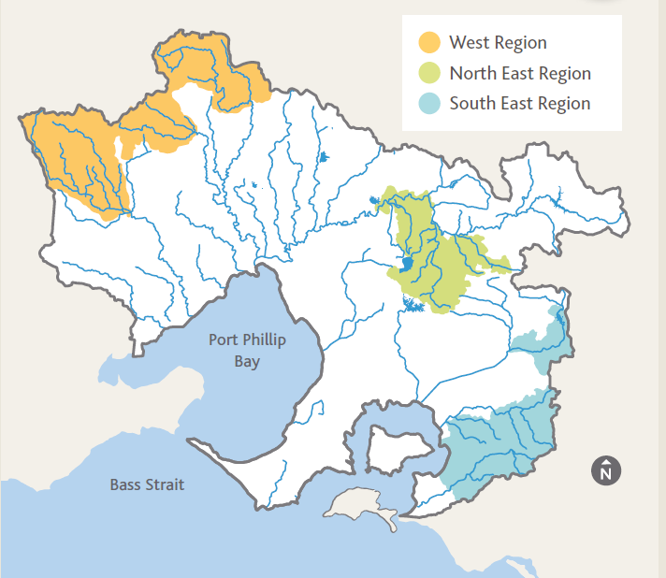
Melbourne Water – Rural Land Program
Incentives available through Melbourne Water to reduce nutrient runoff and improve water quality.
E.g. upgrading effluent systems, fencing gullies, wetlands, fencing to land class, upgrading drainage associated with tracks.

Slide 41
Questions?
Farm Water Calculator
http://www.agriculture.vic.gov.au then search ‘farm water calculator’
Southern Rural Water
http://www.srw.com.au/
Melbourne Water Rural Land Program
http://www.melbournewater.com.au
search ‘Rural Land Program’

Slide 42
Ensure a reliable supply through maintaining and protecting water quality
Stock exclusion from waterways and dams can helps to maintain water quality by:
Reducing bank erosion, direct deposition of manure and urine;
Trapping sediments in vegetation before reaching the water.
It also prevents animals from getting bogged and potentially dying.
Stock prefer to drink from troughs.
Avoiding applying fertiliser to wet soils or before heavy rainfall will help to prevent nutrient loss.

Slide 43
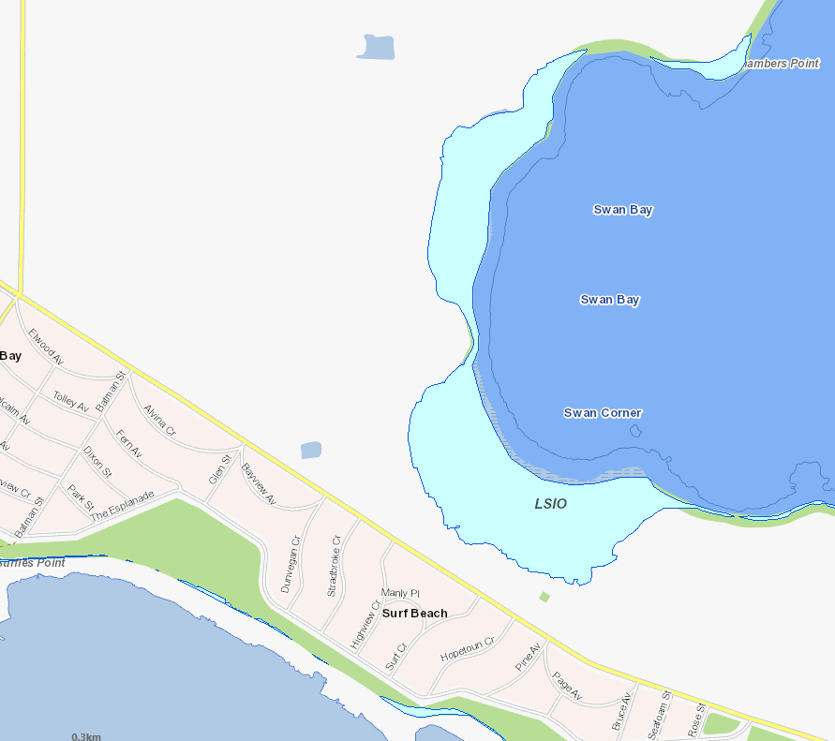
Understanding and planning for floods
VicPlan
Land subject to inundation overlay
1:100 year flood level
Web:
Planning.vic.gov.au

Slide 44
Stock drinking quality and salinity
Salinity Tolerance Levels for Stock Drinking Water
 | * Production decline begins @ |  | ** Maximum allowable
 | EC (ųS/cm) | mg/l (or ppm) | EC (ųS/cm) | mg/l (or ppm)
Lactating Ewes, Weaners | 6000 | 3800 | 10000 | 6400
Sheep (dry feed) | 9300 | 6000 | 21800 | 14000
Beef Cattle | 6250 | 4000 | 15600 | 10000
Dairy Cattle | 4700 | 3000 | 9300 | 6000
Horses | 6250 | 4000 | 10900 | 7000
Pigs | 3100 | 2000 | 6250 | 4000
Poultry | 3100 | 2000 | 6250 | 4000
* Production decline begins: Desirable maximum salt concentration for healthy growth ** Maximum: maximum salt concentration that may be safe for limited periods Source Victorian Department of Primary Industries
Notes:
Production decline begins maximum salt concentration desirable for healthy growth
Maximum: maximum salt concentration that may be safe for limited periods.
Reminder about resources available…

Slide 45
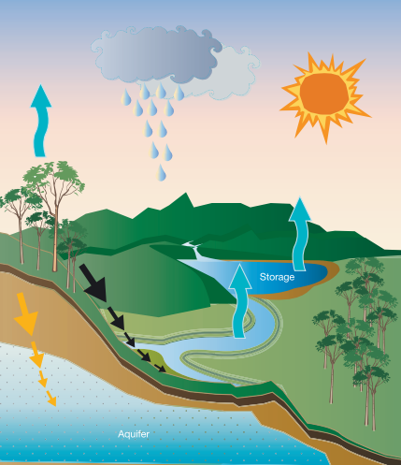
https://www.water.vic.gov.au/__data/assets/pdf_file/0018/63270/NRSWS-Full-Document.pdf
Notes:
From Northern SWS
Figure 2.5 shows how climate change could impact on all aspects of the water cycle. Reduced rainfall and hotter temperatures are expected to result in drier soils, less run-off into rivers and storages and more evaporation from rivers, channels and storages. Changes in rainfall and streamflow across Victoria over the past 12 years have generally been of the order of those expected under medium to high climate change projections by 2055. Across the state, there has already been a reduction in annual rainfall of about 13 per cent. Reduced rainfall has resulted in a 44 per cent decline in inflows to rivers and storages in the River Murray between July 1997 and June 2007. Inflows in 2006/07 were 1,110 GL; the lowest on record at only 15 per cent of the pre-1997 average (see Figure 2.6). This was followed by another dry year, with inflows in 2007/08 only 2,128 GL. With inflows in 2008/09 also very low, these three years are tracking as the lowest, third lowest and seventh lowest inflows in the historic record across the Murray-Darling Basin5 . Victoria has experienced similar periods of reduced water availability in the past; notably in the early 1900s (Federation drought) and the mid-1930/40s (World War II drought). These past periods were not as severe, in terms of streamflow and inflow reductions, as this recent period which has had higher temperatures and potential evapotranspiration6 . This recent period has also seen a complete absence of high rainfall years (that is, the loss of inter-annual variability) and there has been a disproportionately large decline in autumn and early winter rainfall. This has resulted in low winter-spring run-off and a decline in streamflows and inflows to surface water and groundwater storages.

Slide 46
Water quality
Water quality testing can be useful when:
You notice a change in the water supply
Investigating a new water supply especially groundwater
Groundwater can be of poorer quality in parts of Gippsland especially salinity, hardness and iron levels.
Water quality testing can be undertaken for:
pH, Total Dissolved Salts (salinity), hardness, iron, some particular ions (Cl, Mg), turbidity), nutrients (N & P)
E.coli, blue green algae, iron bacteria can also be tested for but require specific sampling procedures.

