Slide 1
Victorian Climate Projections 2019
Findings and tips for interpreting
Clare Brownridge
Climate Change Policy, DELWP
clare.brownridge@delwp.vic.gov.au
Vanessa Round
Climate Science Centre, CSIRO
Notes:
Thanks for joining us for the second webinar in this two-part series this week. The topic today is Victorian Climate Projections 2019 – looking at the findings and some tips to understand and interpret them
I’d like to start by acknowledging the Traditional Owners of the land on which we’re meeting – the presenters are on Wurundjeri and Dja Dja Wurrung country today. I’d like to pay my respects to the elders past, present and emerging from these areas, as well as those from the places you’re listening from across the state.

Slide 2
Some things to note before we start:
We are recording, and will make the recording available after the event
Please use the Q&A function to ask questions (and give those you're also interested in a 'thumbs up')
Slides will be made available

Slide 3
Overview
What are the pros and cons of local-scale climate data?
How to understand and work with the different sources of uncertainty in projections
What do the Victorian Climate Projections 2019 projections say for Victoria?
Top tips to interpret the projections correctly
Introduction to the datasets available
Notes:
Today we’re going to start with a brief introduction into how the local-scale projections were produced, and how they capture the different sources of uncertainty.
Then we’ll look at the findings from the Victorian Climate Projections 2019, and tips on how to interpret them, before finishing with an introduction to the datasets available.

Slide 4
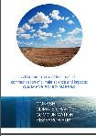




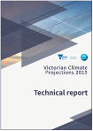
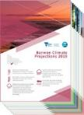
Decision tree
Communication
Climate Science Communication Guide
More information or data required?
VCP19 technical report
And
VCP19 regional reports
Change factor data sets
Statewide information
Climate Science Report
Detailed study
Data for incorporating into existing models
Application ready data sets
Identify climate change impacts
VCP19 technical report summary information
Regional or sector specific planning:
Narrative scenarios
Risk / vulnerability assessments
Pathways Planning
Regional of sector specific modeling
Are there sector specific guidelines or products available
Consider all available data.
For example: The Water sector has: Guidelines for Assessing the Impact of Climate Change on Water Supplies in Victoria, Victorian Water and Climate Initiative products and ARR
Summary information from the VCP19 regional reports
climate.science@delwp.vic.gov.au
Notes:
To put this in context for people who were at the first webinar – that largely focused on the resources on the left hand side: Climate Science Communication, Climate Science Report and the Regional Reports.
Today we’ll be focusing on a bit more on the information that’s contained in the Technical Report and the datasets covered on the right hand side here.

Slide 5
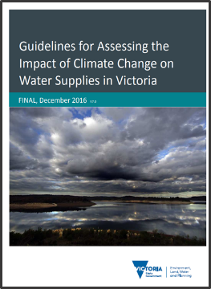
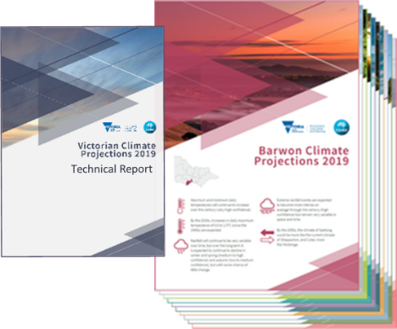
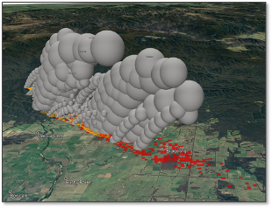
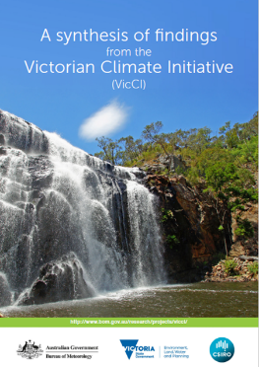
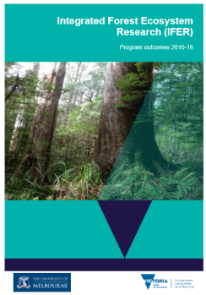

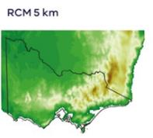

Victorian Government climate science research
The Victorian Government is providing climate research and future projections to help understand our climate risk and inform decisions that support a resilient future for Victoria.
Bushfire risk
Notes:
And while we’ll be focusing on Victorian Climate Projections 2019 today, it’s worth noting that there are other research programs across the Victorian Government looking at the impacts of climate change – such as the Victorian Water and Climate Initiative that’s produced a lot of information for the water sector and is used a lot by water corporations, and research done in the Fire area of DELWP to understand bushfire risk and the impacts of climate change on that.

Slide 6
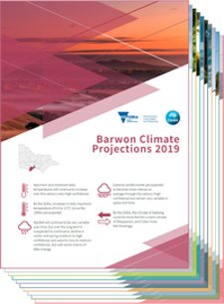
Victorian Climate Projections 2019
High-resolution modelling and analysis
    Climate projections for Victoria at a 5 km grid
    Temperature, rainfall, evapotranspiration, relative humidity etc.
    Two emissions scenarios, out to 2090s
Technical report
Regional reports (x10)
Fact sheets
Guidance
Datasets for download
Visualisation tool (under development)
Worked with CSIRO’s Climate Science Centre
Notes:
But before we get too far – what does Victorian Climate Projections 2019 – VCP19 for short – actually cover?
The project work was done by CSIRO’s Climate Science Centre over the last few years, and includes high-resolution modelling and analysis of those outputs.
It’s produced a range of products as listed on the slide.

Slide 7
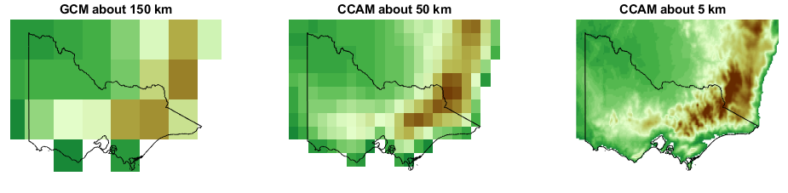
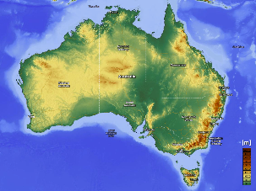
(Dynamically) downscaling climate projections
Example: topography at different scales
CCAM: Conformal Cubic Atmospheric Model, regional climate model used in in VCP19
GCM: Global Climate Model
Dynamical downscaling:
Running specialised regional climate models at high resolution with GCM inputs – like getting more megapixels on your photo
One of the ways to get localised data
Gives potential for more regional insights and ‘added value’
Downside: much larger quantities of data, added complexity & expensive
Areas of particular ‘added value’
Mountains, coasts, parts of the north
Notes:
To give some really brief background on projections and the downscaling: VCP19 considers the results from global models as well as new dynamically downscaled projections produced by CSIRO – what is dynamical downscaling actually?
Dynamical downscaling runs a regional climate model (in this case, one developed by CSIRO) focused over a smaller area at high resolution (5km in this case).
Dynamical downscaling can “add value” to global projections and give new insights – it is better able to capture features that vary on a small scale like topography – so mountain ranges and coasts are better represented (as shown in the map on the slide) – as well as weather systems such as storms that occur at small scales. I’ll mention a few instances later where VCP19 has shown some added value. It’s important to evaluate the results to work out what the added value is, making sure that the new results are plausible and fit with our understanding of the science.
Although downscaling results in a lot more data and added complexity, CSIRO have worked to process the data and make file sizes more accessible.

Slide 8
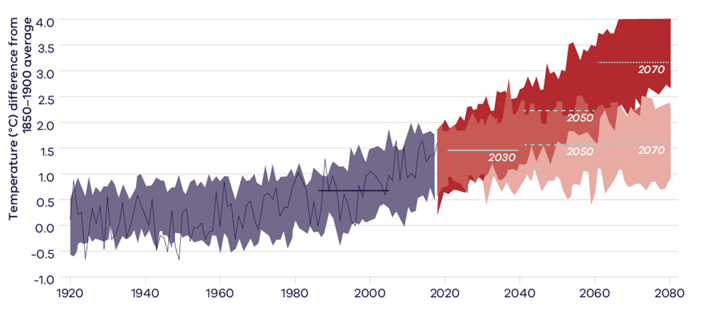
Sources of uncertainty
  Natural variability – year-to-year variability and longer timeframes, always ongoing, different for different variables
  Emissions scenario – what humans do
  Range of model response – estimated from different climate models
Historical models
Observed
1986-2005 Baseline
High emission scenario
Overlap between high and low
Low emission scenario
Notes:
One thing that often comes up when people are working with projections is dealing with uncertainty. Climate models give us our best understanding of what the future might be like, but can’t tell us for sure what the climate will be like in the future and when certain changes might occur.
There are three main sources of uncertainty that can be understood with a bit of knowledge about how the projections are created. I’m going to explain the different sources and how they are considered in VCP19. This diagram will be familiar to those of you who were at the first webinar and demonstrates the sources of uncertainty.
The first is natural variability in the climate – the year to year changes out to millennium to millennium changes that will continue and are inherent in the climate system. An example is El Nino, which was mentioned in the last webinar, and varies every few years. You can see in the graph, the observed temperature shown by the jagged line goes up and down from year to year.
Emissions scenario can be a big source of uncertainty – we don’t know what greenhouse gas emissions the global population will emit in the future. This is shown here with the darker red and lighter red paths that temperature may take in the future.
The third source is model to model differences. There are 40 different global climate models that represent different processes and interactions slightly differently. As well as natural variability, this is why you’ve got the thick band of results in the graph, and why you often see lower and upper values given in projections to represent the range given by the different models.
Image from Victoria’s Climate Science Report 2019, pg 28. Showing average annual temperature of Victoria in observations and models relative to the pre-industrial era.

Slide 9
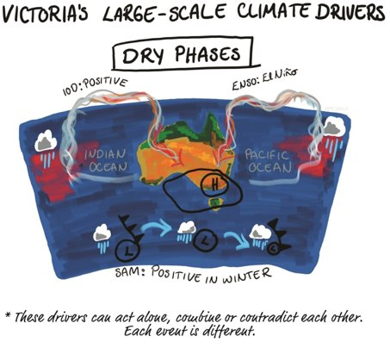
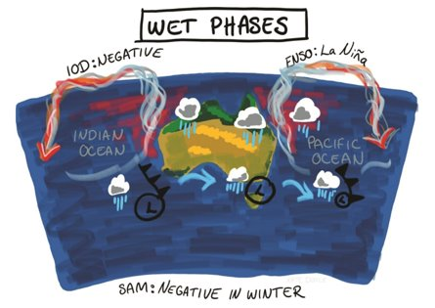
Natural variability
Notes:
More details about the types of uncertainty, and how VCP19 considers them.
First source: natural variability
Some of the forms of natural variability you might remember from the first webinar - Victoria is governed by a complex set of climate drivers, such as El Nino and the Indian Ocean Dipole. These drivers might change with climate change, but will continue to influence the climate in the future, on top of the broader trends due to climate change.
At a longer scale you’ve got things like Milankovitch Cycles that influence climate at the scale of multiple millennia due to how the Earth moves around the sun – again these changes will continue and be on top of the trends due to climate change.
Image from Victoria’s Climate Science Report 2019, page 17.

Slide 10
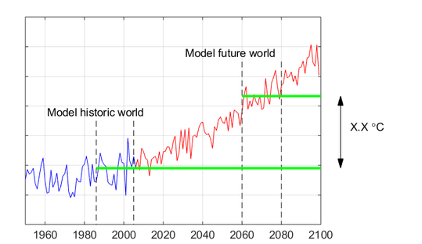
Climate baseline and dealing with natural variability
Dealing with natural variability:
- VCP19 often uses 20-year averages
Eg. ‘2070s’ = average for 2060-2079
1986-2005 baseline
Notes:
One way we often use to overcome the influence of (at least some of the) natural variability is by looking at climate averages over a 20 year period. This smooths out some of the variability that occurs at shorter timescales.
This means that when we talk about projections for ‘the 2070s’ as shown here, it’s actually a 20 year period centred on 2070.
This is compared to a 20-year baseline period, which is 1986-2005 in VCP19. This is consistent with international modelling considered by the IPCC, and while it may not seem that ‘current’ is restricted by the time lag between the end of ‘historic’ observations and subsequent modelling, analysis, drafting of IPCC reports and incorporation into downscaling.
Why is that baseline used?
Consistency with IPCC
Time lag between the end of ‘historic’ observations and subsequent modelling, analysis and drafting of IPCC reports.
Image from https://www.climatechangeinaustralia.gov.au/en/climate-projections/future-climate/victorian-climate-projections-2019/vcp19-accessing-datasets/

Slide 11
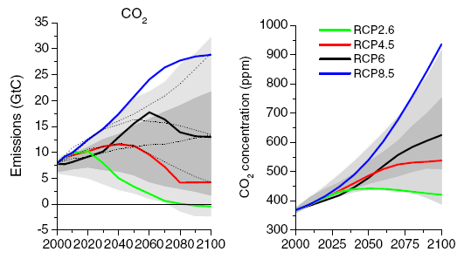
Emissions scenarios
Uncertainty about global emissions in the future
Representative Concentration Pathways (RCPs) represent possible future pathways, and allow for comparison between experiments
Notes:
Second source: emissions uncertainty
We can’t predict what emissions the global population will emit in the future – thus scientists across the globe use a consistent set of scenarios. The graph here shows global CO₂ emissions, but there are similar plots for other greenhouse gases.
The response of the climate is modelled based on the accumulated concentration of greenhouse gases in the atmosphere (shown on the right). Some of these gases last a long time in the atmosphere, which is why we don’t see their concentration drop as soon as emissions stop.
You can see here there are four main emissions scenarios that are used by scientists across the world, with different pathways of emissions.
Graph on the left shows global emissions of CO₂. Graph on the right shows total accumulated concentration of CO₂ in the atmosphere.

Slide 12
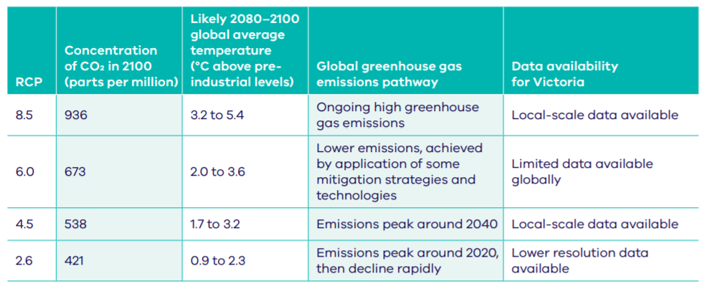
Emissions scenarios
Dealing with emissions uncertainty:
- VCP19 uses two emissions scenarios: high and medium
(“High”)
(“Medium”)
Notes:
To capture the range of possible pathways, VCP19 has high-resolution modelling for two of these emissions scenarios – high (also called Representative Concentration Pathway 8.5, or RCP8.5) and medium (or RCP4.5).
The high emissions scenario would see ongoing high greenhouse gas emissions. This was previously the pathway we were closest to, although in recent years emissions have started to fall below it.
Medium emissions sees emissions peak at around 2040 and then start to decline.
To put the emissions scenarios in context of the Paris Agreement, if we follow the lowest emissions scenario of RCP2.6, we have a 60% chance of meeting the Paris 2oC target. If we follow the medium emission scenario, the chance drops to only 20%.
Table from Victoria’s Climate Science Report 2019, page 23

Slide 13
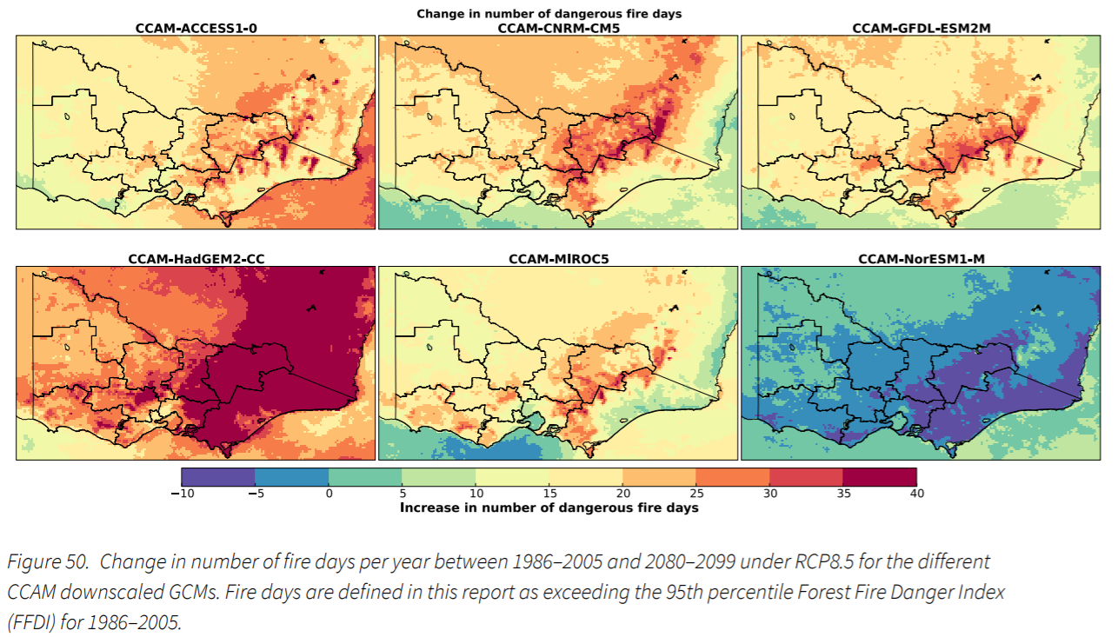
Model response
Dealing with the range of model response:
- VCP19 downscaled 6 different Global Climate Models, ranges given in projections
Notes:
Third source: model response
Looking finally at the range of model response. While we test to see how well the models represent the past climate, we can’t say which model is ‘best’ (without a crystal ball to see into the future), so we consider the range demonstrated by different models.
In VCP19, while we used a single Regional Climate Model, it was run multiple times with inputs from 6 different Global Climate Models.
Those 6 models were chosen as the represent the range of change shown in the Global Climate Models, and because they represent the Victorian climate well.
Image VCP19 Technical Report, page 66

Slide 14
Recap
Dynamical downscaling can give extra insights into future climate not available from global climate models
Three main sources of uncertainty in climate projections:
    natural variability
    emissions uncertainty
    model response
These are considered in the modelling and the way the projections are presented in VCP19

Slide 15
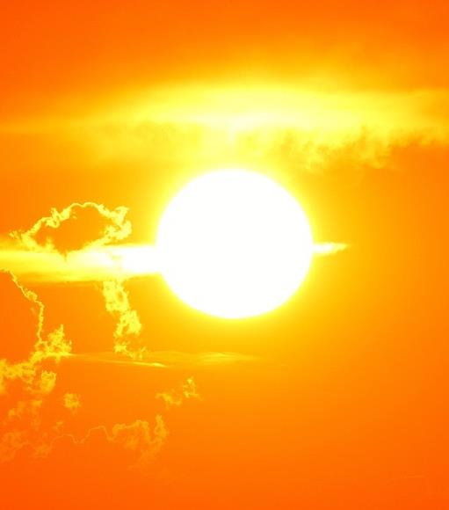
Projections for Victoria’s climate
Notes:
So what have the VCP19 projections told us about the future climate in Victoria? – some of this will be a recap from the first webinar, but we’ll also go into more detail about the additional insights we’ve got from the high-resolution modelling in VCP19

Slide 16
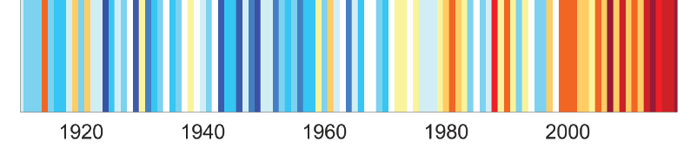
Annual average temperature
Observed:
Just over 1ºC increase in temperature since 1910
  Projected (2050s):
  High emissions scenario: 1.4 to 2.4ºC hotter
  Medium emissions scenario: 0.9 to 1.8ºC hotter
(Compared to 1986-2005 average)
‘Climate stripes’ for Victoria, where each stripe represents the temperature anomaly of one year, reds indicate temperatures above the 1961–1990 average and blues, below average
Notes:
As we saw on Wednesday, we know that temperatures have already increased (since consistent records began in 1910).
And this trend is projected to continue into the future.
Even in the few dot points about projected temperature you can see how the uncertainty is represented:
“The 2050s” – the 20 year period centred on 2050
We have two emissions scenarios – high and medium
Within each emissions scenario there’s a range presented from the different models used.
Image from VCP19 Technical Report, page 8

Slide 17
Annual average temperature (in more detail)
Emissions scenarios:
To the 2030s/2040s, the scenario doesn’t make a lot of difference
Beyond that, the projections diverge
Historical models
Observed
Baseline
High emission scenario
Overlap between high and low
Low emission scenario
New findings from VCP19:
Downscaled results show potentially hotter high ends of the range
Notes:
More detailed information on temperature:
Key points to note:
- In the short term, emissions scenarios don’t differ much – reinforcing the point that was made in the first webinar. Further into the future, they do make a significant difference to results
- One of the new findings from the VCP19 downscaling is that the high end of the range of temperature increase could be even higher than global models show

Slide 18
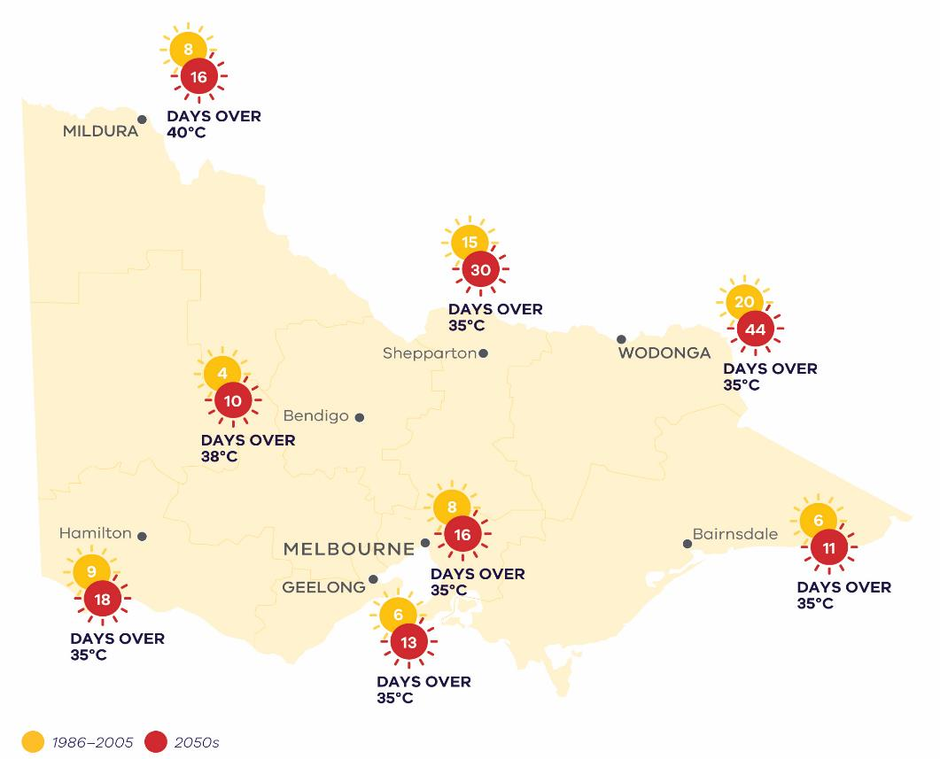
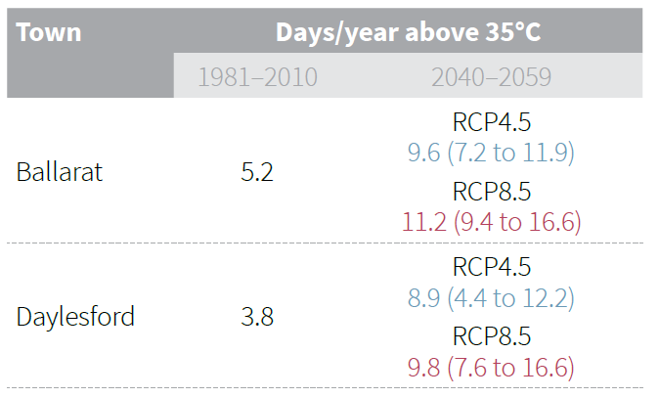
Hot days
Increase in average temperatures leads to increase in hot days
Hot days expected to approximately double by 2050
Notes:
An increase in average temperatures also leads to an increase in the number of ‘hot days’ – considered here as the average number of days per year over a certain threshold – 35 degrees for Melbourne, out to 40 degrees in Mildura.
These hot days are expected to approximately double by 2050, going from an average of 8 days per year over 35 in Melbourne up to 16 (these are average figures, so can vary quite a bit from year to year), and from 8 to 16 days per year over 40 degrees in Mildura in the north west (under a high emissions scenario)
The table on the right is from one of the VCP19 Regional Reports, and gives an example of the ‘hot days’ information they contain. You can find information for the 2050s for both emissions scenarios, and compare it to historical averages. For advanced data users, there are also full datasets of threshold calculations so you can pull out information for a particular threshold that’s of interest to you (see slide 35).
Image (left): Victoria’s Climate Science Report 2019, page 33. Table (right): Central Highlands Climate Projections 2019, page 4 (similar in brochures for all regions)

Slide 19
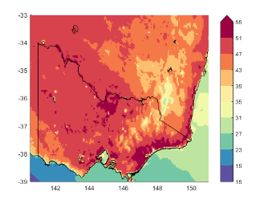
Hot days (in more detail)
New findings from VCP19:
Downscaled results representative of global models
Potential higher upper end to the range (due to a model with a dry projection)
Extreme heat (1-in-20-year hottest days) may increase a lot more than the average temperature
Example day in the 2050s – over 50 ⁰C in some areas!
Notes:
Added value from VCP19
As with average temperatures, heat extremes are also projected by VCP19 to get hotter than previously thought.
Particularly those really hot days, that occur on average once every 20 years, could increase by a larger amount than the average temperature, seeing the extremes become even more extreme.
You can see in the map on the right an example of a hot day in the 2050s (under a high emissions scenario) – not the hottest day the models project, but a representative hot day. And here there are temperatures nudging and even exceeding 50 degrees in parts of the state.
Image: VCP19 Technical Report, page 46 – best used for illustrative purposes of future hot day, rather than looking at exact temperature in specific locations.

Slide 20

Rainfall
Observed:
Decline in cool season rainfall over the last 30 years (compared to last century)
  Projected (2050s):
  Annual and cool season rainfall projected to continue declining (likely)
  Rainfall is more difficult to project than temperature – need to account for estimates from different models
Notes:
Looking now at rainfall:
We’ve seen a decline in cool season rainfall over the past 30 years.
Again, this is a trend that’s projected to continue into the future.
Rainfall is more difficult to project than temperature:
It varies more in space and time
Governed by complex processes that can counteract and reinforce each other (including climate drivers on slide 9).

Slide 21
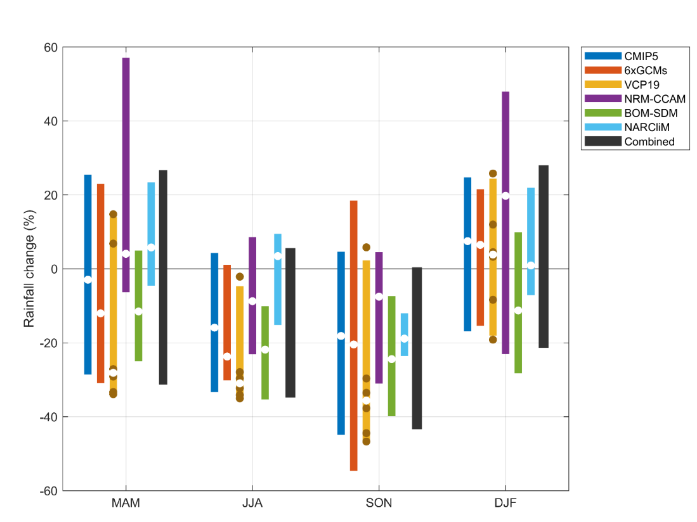
Rainfall (in more detail)
Melbourne Metro – 2090 high emissions
There’s not a ‘best’ answer
Different model ensembles with different ranges of results
Ranges overlap a lot
Range of possibilities for all seasons for all regions
Need to take a risk management approach – not a ‘predict then act’ approach!!
Autumn
Winter
Spring
Summer
Notes:
To emphasise the point that rainfall projections show a greater range of results, here are some results from different modelling projects.
The four groups of bars show results from each season, while each different coloured bar represents results from a different modelling effort – VCP19 is the yellow bar.
You can see that the results from the different projects all vary slightly, but their ranges generally overlap.
This reinforces the idea that it’s important to take a risk management approach, rather than planning for a single expected future, and making decisions that still lead to good outcomes in the different possible futures.
Image: VCP19 Technical Report, page 56.

Slide 22
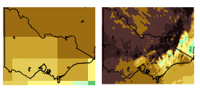

Rainfall in mountain regions
New findings from VCP19:
Better resolution of the topography of mountain areas
Better resolution of weather systems influenced by the topography
VCP19 projects greater decreases in rainfall on the western slopes of mountains (compared to global models)
Winter (%)
Notes:
In rainfall, some of the added value from VCP19 relates to mountain areas.
Because topography is represented at 5km, the relief of the mountain areas is much better represented.
This allows the weather systems that are influenced by the topography to be better represented too.
The finding from VCP19 indicates that there might be greater decreases in rainfall on the westerly slopes of mountains compared to what was projected in the global models. This result is consistent with studies in other parts of the world.
Insights for snow in the future: new analysis on snow wasn’t done for VCP19, but the results are consistent with previous work that indicates a decline in snow depth and extent.
Image: VCP19 Technical Report, page 55

Slide 23
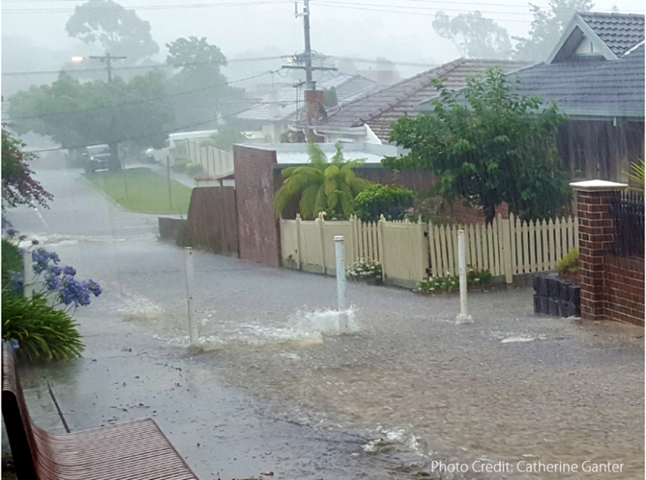
Change in extreme rainfall
Observed:
Increases in rainfall extremes
  Warmer atmosphere can hold more water vapour
  Projected:
  Continued increases in extreme rainfall, regardless of declines in averages
Can lead to flash flooding/urban catchments flooding
Notes:
We’ve already seen an increase in extreme rainfall events with a 1 degree change.
A hotter atmosphere can hold more water, giving the potential for big downpours (more of the rain that falls, falling in intense bursts).
This is projected to continue into the future, even as average rainfall across the year declines.
Can lead to flash flooding and flooding in urban flooding catchments where there are a lot of hard impermeable surfaces.

Slide 24
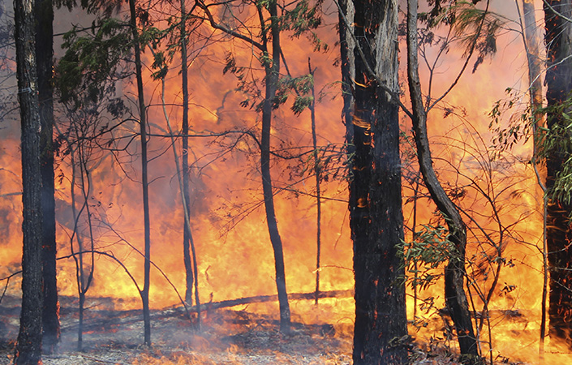
Changes in fire danger
Observed:
  Fire weather has become more dangerous since mid-1900s
  Longer fire seasons
  Fires seasons starting earlier
Projected (to 2050s):
Trends expected to continue
  Bendigo: 62% increase in number of dangerous fire days
  Wodonga: 44% increase in number of dangerous fire days
  Melbourne: 42% increase in number of dangerous fire days
Notes:
Fire danger is something that’s also increased in recent times, with the most recent seasons showing how widespread impacts can be.
Fire seasons have become longer and are starting earlier.
And these trends are expected to continue in the future.
For example, Bendigo might see up to a 62% increase in number of dangerous fire days (to the 2050s, under high emissions scenario)
The projections here are just looking at fire weather (based on the FFDI, Forest Fire Danger Index) – it doesn’t consider things like fuel, ignition that are relevant to a bushfire starting and spreading. But can indicate the frequency of days where the weather conditions are conducive to a fire spreading.

Slide 25
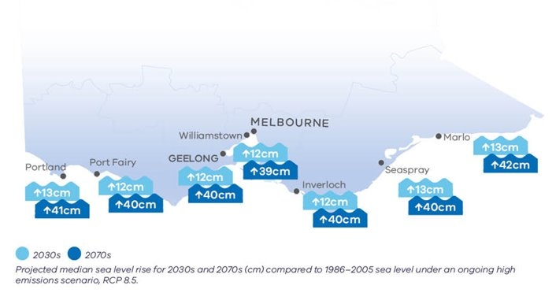
Sea level rise
Leads to increase in extreme sea levels, coastal erosion and inundation
Latest global projections are higher than previous ones
Detailed work for Port Phillip Bay underway: https://www.marineandcoasts.vic.gov.au/coastal-programs/port-phillip-bay-coastal-hazard-assessment
Notes:
Moving to the coastal environment, sea level rise leads to an increase in extreme sea levels, coastal erosion and inundation, impacting the buildings and infrastructure by the coast, as well as the natural environment.
Coastal and marine modelling is done separately to the downscaling completed for VCP19, so these figures are based on global models.
You can see for the 2030s sea level is projected to rise by 12 to 13 centimetres compared to 1986-2005 average, and about 40 cm by the 2070s.
New studies and findings are always emerging in this field, and recent global projections indicate that there’s potential for sea level rise to be quite a bit higher than previously thought.
Image: Victoria’s Climate Science Report 2019, page 35

Slide 26
Top tips to help decide what information to use!
Start with the simplest climate information available
If the simple information hasn’t met your needs, then look at more complex information or data
Choose timeframes that are relevant to the decision lifetimes
Avoid planning for a single future: start by considering multiple emissions scenarios, range of results
    If then decide to not consider the full range of change, be explicit about what potential futures you’re missing
  Document assumptions and data sources
  Seek advice from climate.science@delwp.vic.gov.au if needed
Notes:
Based on the brief intro to how the projections are produced, what do you need to think about when using them?
This is relevant whether you’re doing the analysis yourself, or commissioning someone else to do the work.
Number one takeaway is to start with the simplest information. There is a lot of information out there, and it can get very complex very quickly. If you start with resources like Victoria’s Climate Science Report or the VCP19 Regional Reports, that might be enough information.
Then, if that doesn’t meet your needs, move to more complex information.
Choose timeframes that are relevant to the lifetime of the decision you’re making. If you’re building a building that will still be around and exposed to the climate in 50 or 100 years time, you’ll want to be looking at projections further into the future. If you’re working on a program that’s running for the next 10 years, you can look at projections for a shorter time frame. This can simplify things as the emissions scenario doesn’t make a large difference at shorter timeframes.
As was mentioned in the last webinar, avoid planning for a single future – start by looking at multiple emissions scenarios and the range of results.
If you then make a decision to not consider the full range of change – perhaps you’re interested in investigating the worst case scenario – be explicit about the potential futures you’re not considering.
Which leads to the next point about documenting assumptions and data sources.
And if you only remember one thing from the webinar today – it’s the email address climate.science@delwp.vic.gov.au – get in touch and we’ll give assistance where we can, and also we’re lucky to have an arrangement with CSIRO to have some of their time on tap to assist as well.

Slide 27
Plan for multiple possible futures
Having a range of plausible futures is unavoidable, and there are planning and decision-making approaches that accommodate it.
Climate projections provide a solid evidence base to assess plausible ranges of future change
Honestly assess the range of possibilities
Recognise ‘unknown unknowns’
Make decisions that are robust across the range of plausible futures
Do not lock in one path of action
Notes:
This slide is taken straight from the first webinar – and talks about some of the ways to deal with the range of possible futures and factoring uncertainty into decisions.
It’s important to make decisions that are robust across the range of plausible futures, and do not lock in one path of action.
Tools and approaches such as scenario planning, pathways planning and vulnerability and risk assessments provide ways of doing this.

Slide 28
Data available
Notes:
There are a number of different types of datasets available from VCP19 – going to talk briefly through them now.
But it’s worth considering and getting an understanding of the basics, even if you’re not the person who’s going to be doing detailed analysis with the data, if you’re commissioning someone to do work for you, it’s good to have some insight into what they’re doing, and giving yourself confidence that their methods are appropriate.

Slide 29
Variables available
Mean temperature
Maximum temperature
Minimum temperature
Rainfall
Relative humidity
Pan evaporation
Potential evapotranspiration (soon)
Solar radiation
Wind speed
Regional averages:
  1-in-20 year hottest day
  1-in-20 year coldest day
  1-in-20 year wettest day
2030s
2050s
2070s
2090s
Notes:
Variables and timeframes available through VCP19

Slide 30
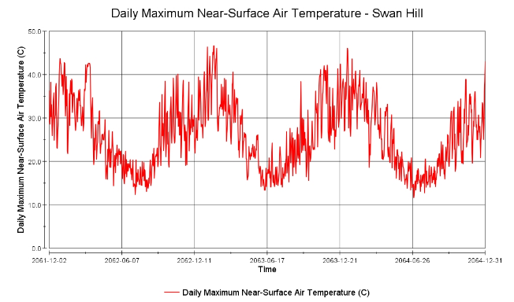
Types of projections datasets
Difference between future period (2030s, 2050s, 2070s, 2090s) and 1986-2005 period
  eg. +1.9ºC, -21% rainfall change
Can then apply this to weather observations
  eg. Melbourne historical average max temperature = 20.4ºC, +1.9ºC = 22.3ºC in future (2050s)
Change factor
VCP19 datasets
Application-ready
Change factor data added to past weather observations
Looks like a weather
dataset
Can be fed directly into other models
Notes:
The first choice to make is between change factor and application-ready data…
Change factor: a value for the difference (in degrees for temperature, or % change for the other variables) between the baseline period and the future period you’re interested in.
If you want to get more of a feel for what that means for your area, you can add the change factor to historical observations, like the example for Melbourne on the slide.
Application-ready: this is where the change factor data have been taken and added to past weather observations. This sounds attractive and like some of the hard work has been done for you, but it’s actually a more complicated dataset to use.
How to choose – change factor are a good starting point, good for general understanding or a first pass assessment. Application ready can be used in a detailed assessment, and are more complex datasets to work with.

Slide 31
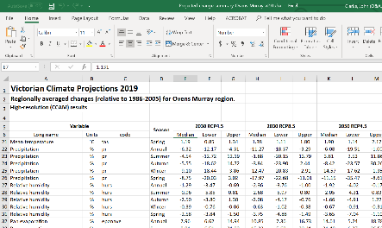
Change factor data
5km grid
NetCDF files
e.g. for 2040-2059
Gridded
20-year average
Change factor
Area average
20-year average
Averages for 10 regions of Victoria (Regional Partnership areas)
Back pages of Regional Reports
Excel spreadsheets
VCP19 datasets
Application-ready
Application-ready
Notes:
Change factor is available gridded for the whole state in NetCDF files for the 2030s, 2050s, 2070s and 2090s.
NetCDF files are able to show three dimensions of data across space and time. They can be imported into GIS programs, but we’re also working on ways such as the online visualisation tool to make the data more accessible. We’re also able to help extract the data you’re interested in if needed.
The most accessible data product is the area-average change factor data. This is all in Excel spreadsheets, and contains data averaged over the geographical area from each of the 10 Regional Partnership regions. Some of this data is contained in the tables in the back pages of the Regional Reports, while the full suite is in the Excel spreadsheets.

Slide 32
Application-ready data
Gridded
20-year average
Change factor
Area average
20-year average
VCP19 datasets
VCP19 datasets
Gridded
5km grid
NetCDF files
Application-ready
City/town
For 25 towns across the state
2-3 per region
NetCDF files
Notes:
Moving now to the application-ready data:
It’s also available gridded across the state, as well as for 25 cities or towns. This means you can focus just on the location of interest rather than working with the full state dataset, and provides some consistency for people who are looking at the same place.

Slide 33
Application-ready data
Gridded
20-year average
Change factor
Area average
20-year average
VCP19 datasets
20-year average
VCP19 datasets
e.g. 2040-2059
NetCDF (coming soon)
Gridded
Time series
To go straight into a model (netCDF files)
Application-ready
20-year average
e.g. 2040-2059
NetCDF (coming soon)
City/town
Time series
To go straight into a model (netCDF files)
Notes:
Difference between 20-year average and time-series application-ready data:
Data in 20 year averages can be easier to relate to and work with.
Time series has a value for each time-step into the future (can be up to daily), so produces a large dataset. But can be used in detailed modelling (eg. crop modelling, or infrastructure modelling).

Slide 34
VCP19 datasets
Change factor
Gridded
Area average
Application-ready
Gridded
City/town
Average
Average
Time series
Time series
Average
VCP19 datasets
Average
https://www.climatechangeinaustralia.gov.au/en/climate-projections/future-climate/victorian-climate-projections-2019/vcp19-accessing-datasets/
Notes:
Many different types of datasets… This is just a brief introduction – if you’re looking to use them and are still confused, remember to get in touch with our team.
The link on this slide is direct to Climate Change in Australia page where the data are hosted – but you can also find them via the DELWP VCP19 webpage

Slide 35
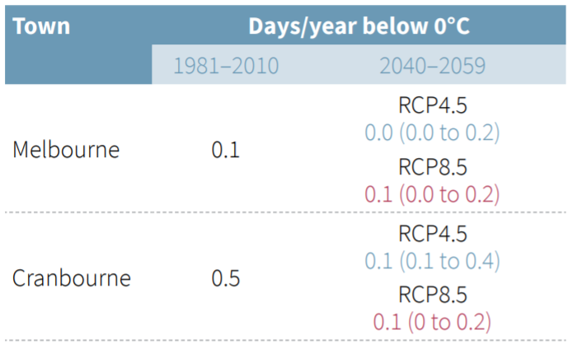
Thresholds datasets
Number of days (on average) when:
    Maximum daily temperature exceeds: 30, 31, 32 ... 44, 45°C
    Minimum daily temperature exceeds: 20, 21, 22 ... 29, 30°C
    Minimum daily temperature is less than: 0, 2, 4, ... 20, 22°C
Annual, seasonal and monthly totals
Gridded 5km
Developed from application-ready time-series data
NetCDF files
Notes:
The last type of dataset is one mentioned earlier – the thresholds datasets, which don’t fit neatly into the tree diagram.
This information on the average number of days per year with temperatures over or below a particular threshold. These can be useful if you have a piece of infrastructure that fails at a certain temperature, or a crop that needs chilling to flower, for example.
The data is similar to what’s available in the tables in the Regional Reports, but for a range of different thresholds and time periods.

Slide 36
Recap
Many publicly available datasets from VCP19
Change factor data is a simpler starting point
Change factor data can be applied to historical data from the Bureau of Meteorology to get local information
Application-ready data can feed directly into another model
We are working on making VCP19 datasets more accessible e.g. through different formats and platforms
Contact climate.science@delwp.vic.gov.au for assistance
Notes:
That brings us to the end of the brief tour of the datasets.
To recap, there are many datasets available – with change factor data being the simplest starting point. This can be added to historical data to get information that’s easier to relate to.
Application ready data can feed directly into a model.
We’re working on making the information more accessible, with the online visualisation tool for example. We’re also able to help get the information you need from the datasets, so do feel free to get in touch with any questions.

Slide 37
Questions any time, contact us at climate.science@delwp.vic.gov.au
www.climatechange.vic.gov.au/vcp19

